Slide 1
Maryland Behavioral Health Integration in Pediatric Primary Care (MD BHIPP) Resilience Break: Disruptive Behavior and DMDD November 2nd, 2021 Robert T. Paine, DO Assistant Professor of Psychiatry University of Maryland School of Medicine
1-855-MD-BHIPP (632-4477)
www.mdbhipp.org
Follow us on Facebook, LinkedIn, and Twitter! @MDBHIPP

Slide 2
Disclosures
Dr. Paine has no financial relationships with ineligible companies (either individually or as a group)

Slide 3
Learning Objectives
At the conclusion of this continuing medical education activity, the participant will be able to:
Understand the behavioral perspective of psychiatric illness and pathological behaviors.
Apply the theoretical perspectives discussed to develop a differential diagnosis for disruptive behavior disorders and DMDD.
Understand the evidence-based treatments for disruptive behavior disorders and DMDD.

Slide 4
Outline-Part 1
The Behavior Perspective
Driven/Motivated Behaviors
Socially Learned Behaviors
Disruptive Behavior Case Formulation
Overview
Assessment and Diagnosis
Treatment Planning

Slide 5
Outline-Part 2
Treatments
Therapy
Medication
Questions/Comments

Slide 6
The Behavior Perspective
The term behavior applies to any motor-sensory activity linked to a goal.
Learning plays a role in all behaviors.
Behaviors can be classified as driven or socially learned.
McHugh & Slavney, The Perspectives of Psychiatry, 1998

Slide 7
Driven Behaviors
Driven and satiated by physiological mechanisms.
Goals of driven behaviors are vital organismic needs.
Sex
Drinking/Eating
Sleeping
Maternity

Slide 8
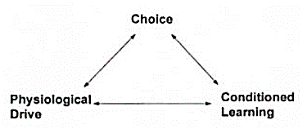
Triad of Driven Behaviors

Slide 9
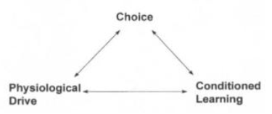
Treatment Targets
Choice: “Abstinence for today”
Physiological drive:
Methadone
Suboxone
Antiandrogen
Conditioned learning
Antabuse (punishment)
Contingency management

Slide 10
Goal-Directed Behaviors
Primarily shaped through social learning via interaction of antecedents, responses, and consequences.
Personal choice becomes enmeshed with social influences.

Slide 11
Triad of Goal-Directed Behaviors

Slide 12
Goal-Directed Behavioral Disorders
Disordered aspects of behavior may be defined by maladaptive goals, means, consequences, or provocations.
Disruptive behavior disorders
School refusal behavior

Slide 13
Behavioral Assessment
What is going on?
Why?

Slide 14
Functional Behavioral Analysis (What Is Going On?)
Caregiver report and observation in naturalistic settings (school and home) to determine:
Antecedent/trigger of problem behavior
Environmental response/consequence maintaining the behavior
Patterns of antecedent/consequence help to identify the problem behavior’s function
Bearss, K et al (2018)

Slide 15
Collaborative Problem-Solving (Why?)
Challenging behavior occurs when the demands being placed upon a child outstrip the skills he has to respond adaptively to those demands.
Doing well is preferable and kids do well if they can.
Conditions that precipitate challenging episodes are highly predictable.
The family, not the child, is the “identified patient.”
Greene, R & Ablon, J (2006)

Slide 16
Behavioral Therapy Components
Assessment
Psychoeducation
Prevention Strategies
Consequences
Generalization and Maintenance
Bearss, K et al (2018)

Slide 17
Books
Parents
Clinicians

Slide 18
Disruptive, Impulse-Control, and Conduct Disorders
Psychiatric conditions involving problems in emotional and behavioral regulation.
Disorders are differentiated by predominant impairment in emotional and behavioral dysregulation.
DSM-5 (2013)

Slide 19
Dysregulated Spectrum
Conduct Disorder
Behavioral dysregulation
Prevalence estimate: 4%
Oppositional Defiant Disorder
Behavioral and emotional dysregulation
Prevalence estimate: 3.3%
Intermittent Explosive Disorder
Emotional dysregulation
Prevalence estimate: 2.7%
DSM-5 (2013)

Slide 20
Case
Max is a 14 yr old male seen in the emergency department accompanied by his parents after becoming very aggressive with them.
He punched a wall and vandalized his room after his parents grounded him because of his previous defiant behavior.
He had been suspended from school that day for disrespecting his teacher after he was caught fighting another student.

Slide 21
His parents describe Max as a strong-willed, stubborn child. He has difficulty with rules and refuses to follow them. He is grouchy and irritable around adults, including the ED staff.
Max enjoys being with his friends and playing video games. He had been diagnosed with ADHD when he was in kindergarten, when his teacher noticed he had a poor attention span and could not sit still.

Slide 22
According to his parents, Max has “blown up” a few times before, smashing items in his room and shouting obscenities.
Parents noticed that he is more defiant in concurrence with discontinuing his ADHD stimulant medication.

Slide 23
Disruptive Mood Dysregulation Disorder
A childhood condition of chronic, extreme irritability, anger, and frequent, intense temper outbursts.
Categorized as a depressive disorder in DSM5 reflecting longitudinal finding that children with chronic irritability typically develop unipolar depressive disorders rather than bipolar disorders in adulthood.
Elmaadawi, A (2018); DSM-5 (2013)

Slide 24
DMDD Criteria = OI VEY
Outbursts - frequent, impairing, in more than one place (i.e. not just conflict with a parent or teacher)
Irritable mood when not having outbursts
Very chronic – has lasted at least a year
Explained by another [better understood] condition (e.g., mania (at least a day), MDD, PTSD, anxiety, autism?) NOT DMDD
Young – starts in childhood (after age 6, before age 10)
Carlson, G (2017)

Slide 25
Study Sample Size (irritable + explosive) | Inpatient DMDD 32 | LAMS DMDD 184 | SUSB DMDD 236 | New York University Tantrums 51 | No DMDD
Manic Symptoms: CMRS>=20 | 69.6 | 28 | 33.3 |  | 8.9
Bipolar I Manic | 3.1 | 9 | 9.7 | 0 | 6.4
ADHD | 81.2 | 79 | 81.9 | 74.5 | 76.0
Anxiety | 41.9 | 31.5 | 31.2 | 49 | 36.8
Depression | 41.9 | 20 | 17.4 | 29.4 | 18.4
ODD | 100 | 70 | 82.7 | 88.2 | 14.8
ADHD + ODD | 78.1 | 77 | 86.1 | n/a | 18.1
ASD | 28.1 | 3 | 31.8 | n/a | 15.7
Carlson, G (2017)

Slide 26
What is Max’s Diagnosis?
ODD
DMDD
Bipolar Disorder
ADHD
A and D

Slide 27
DDX of Explosive Outbursts
Carlson, G (2017)

Slide 28
Treatment Planning
Overall goal is to reduce the frequency, intensity, and duration of explosive episodes.
Behavioral therapy should always be considered a first-line intervention and should be implemented across all settings.
Medication treatment should target common comorbid disorders:
ADHD
Depression
Anxiety
Elmaadawi, A (2018)

Slide 29
Systematic approach to “mood dysregulation”
1) Comprehensive psychiatric assessment
While ADHD/ODD are common; anxiety, depression, and autism are other common primary disorders; it is why they are “rule outs” for DMDD
Keep careful records of frequency, intensity, number, and duration of outbursts
2) Maximize the treatment of the base condition
Most data: it is ADHD-C
If symptoms remain, add another medication
SSRI/SNRI
“Mixed receptor antagonists”
Mood Stabilizers
Pay attention to weight gain immediately (metformin has good data)
3) The condition appears quite chronic; short-term solutions are inadequate
Carlson, G (2017)

Slide 30
Pharmacotherapy Measurement of Target Symptoms
How the child feels
CESDC/PHQ-9 teens for depression/irritability
SCARED/GAD-7 (>12) for anxiety
What the child does
Modified Overt Aggression Scale
Parent and Teacher Vanderbilt
Carlson, G (2017)

Slide 31
Pharmacotherapy
No medications are FDA approved for DMDD.
ADHD Medications
Stimulants
Alpha-2 agonists
Atomoxetine
Antipsychotics
Mood Stabilizers
Divalproex
Lithium
Antidepressants

Slide 32
Stimulants
Emotional dysregulation commonly occurs in youth with ADHD.
Optimization of CNS stimulant therapy of ADHD is well tolerated and effective for externalizing symptoms, irritability, and parent-rated impairment.
CNS stimulants should be considered as first-line pharmacotherapy for DMDD, particularly for patients with comorbid ADHD.
Elmaadawi, A (2018); Baweja et al (2016)

Slide 33
Alpha-2 Agonists Guanfacine ER and Clonidine XR
ADHD Monotherapy
Effect size less robust than stimulants, but may be offered if patient/family objects to stimulant treatment.
Guanfacine ER: Target 0.1 mg/kg/day
Ages 6-12: Max 4 mg/day
Ages 13-17: Max 7 mg/day
Stimulant partial responders
25-30% of ADHD patients fail to respond to stimulant monotherapy.
Useful in afternoon for rebound impulsivity/hyperactivity/emotional dysregulation after stimulant wears off.
Wilens, T (2016)

Slide 34
Atomoxetine
Typically, a second-line agent for patients who cannot tolerate or fail to respond to stimulant therapy.
A RCT showed significant improvement in ADHD and ODD symptom domains compared to placebo after 9 weeks of treatment.
Initiate at 0.5 mg/kg/day, increase to 1.2 mg/kg/day after 3 days.
BID dosing may mitigate tolerability concerns at higher doses.
Greenhill, L (2015); Dittmann et al (2011)

Slide 35
Antipsychotics (Mixed Receptor Antagonists)
If the youth fails to make treatment gains with the agent best suited for his/her primary disorder, the physician should consider adding an atypical antipsychotic to the primary treatment.
Pappadopulos et al (2011)

Slide 36
TOSCA Trial
Evaluated the superiority of 6 weeks of PT plus stimulant plus risperidone (i.e., augmented treatment) over PT plus stimulant plus placebo (i.e., basic treatment) in children 6 to 12 years old with ADHD and severe aggression.
The acute 9-week trial consisted of 3 weeks of PT and stimulant treatment for everyone followed by 6 weeks of randomized double blinded augmented or basic treatment.
The second study drug (risperidone or placebo) was added only for children who did not respond sufficiently to PT and stimulant alone.
Result: medium advantage of augmented over basic treatment on the primary outcome measure of disruptive behavior

Slide 37
Divalproex
A RCT found that when treated with stimulant and divalproex adjunctive treatment, 30 youths with ADHD and chronic aggression refractory to stimulant monotherapy demonstrated higher rates of remission of aggressive behavior.
Zaraa, S et al (2017); Blader et al (2009)

Slide 38
Lithium
Earlier studies found that lithium significantly improves aggressive behavior in hospitalized pediatric patients with conduct disorder.
A later study comparing lithium vs placebo for treatment of severe mood dysregulation found no significant differences between groups.
Campbell et al (1995); Blader et al (2009); Dickstein et al (2009)

Slide 39
Antidepressants
Youth who present with severe irritability/aggression should be screened for depression and anxiety disorders.
If criteria for a depression/anxiety disorder are met, the clinician may consider a trial of SSRI medication indicated for that disorder.

Slide 40
Maryland Behavioral Health Integration in Pediatric Primary Care (BHIPP)

Slide 41
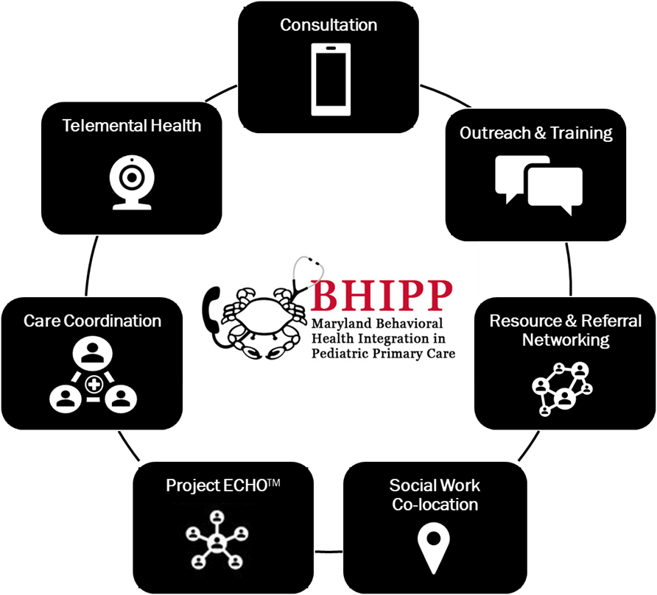
Who We Are – Maryland BHIPP
Offering support to pediatric primary care providers through free:
Telephone consultation (855-MD-BHIPP)
Resource & referral support
Training & education
Regionally specific social work co-location (Salisbury University and Morgan State University)
Project ECHO®
Direct Telespsychiatry & Telecounseling Services
Care coordination
Notes:
Maryland Behavioral Health Integration in Pediatric Primary Care or BHIPP is a Child Psychiatry Access Program that supports the capacity of primary care providers in Maryland to manage pediatric mental health concerns.
BHIPP offers free behavioral health telephone consultation, resource and referral networking, training and educational opportunities, Web-based longitudinal learning through Project ECHO, telemental health services, care coordination, and social work co-location in select primary care practices in collaboration with Salisbury University (SU) and Morgan State University (MSU).
BHIPP also recently received additional funding to expand warmline consultation services to select hospital Eds, and to provide Technical Assistance to select primary care practices with goal of practices becoming mental health hubs.

Slide 42
Thank you!
Maryland Behavioral Health Integration in Pediatric Primary Care (BHIPP)
1-855-MD-BHIPP (632-4477)
www.mdbhipp.org
Follow us on Facebook, LinkedIn, and Twitter! @MDBHIPP
For resources related to the COVID-19 pandemic,
please visit us at BHIPP Covid-19 Resources.
Notes:
You will a copy of these slides

