Slide 1
Maryland BHIPP Identification and Management of Eating Disorders in Pediatric Primary Care Thursday, February 18th, 2021 12:30 – 1:30 PM Shauna P. Reinblatt, MD, DFAACAP, DFAPA Clinical Assistant Professor, University of Maryland School of Medicine
855-MD-BHIPP (632-4477)
www.mdbhipp.org

Slide 2
Who We Are – Maryland BHIPP
Offering support to pediatric primary care providers through free:
Telephone consultation (855-MD-BHIPP)
Resource & referral support
Training & education
Regionally specific social work co-location (Salisbury University and Morgan State University)
Project ECHO®
Coming soon!
Direct Telespsychiatry & Telecounseling Services
Care coordination

Slide 3
Partners & Funding
BHIPP is supported by funding from the Maryland Department of Health, Behavioral Health Administration and operates as a collaboration between the University of Maryland School of Medicine, the Johns Hopkins University School of Medicine, Salisbury University and Morgan State University.
This program is supported by the Health Resources and Services Administration (HRSA) of the U.S. Department of Health and Human Services (HHS) as part of an award totaling $433,296 with approximately 20% financed by non-governmental sources. The contents of this presentation are those of the author(s) and do not necessarily represent the official views of, nor an endorsement, by HRSA, HHS or the U.S. Government. For more information, visit www.hrsa.gov.

Slide 4
BHIPP is Available to Provide Support to PCPs During the Pandemic
Ways to Connect:
Visit our COVID-19 Resource Page:
www.mdbhipp.org
Sign up for our newsletter:
https://mdbhipp.org/contact.html
Follow us on Facebook:
https://www.facebook.com/MDBHIPP/
Follow us on Twitter:
https://twitter.com/MDBHIPP

Slide 5
Meet The Presenter
Shauna P. Reinblatt, MD is a Clinical Assistant Professor at the University of Maryland School of Medicine (UMDSOM), Department of Psychiatry, Division of Child and Adolescent Psychiatry. She is Board Certified in General Adult, Child & Adolescent, and Consultation Liaison Psychiatry. Prior to her becoming a psychiatrist, Dr. Reinblatt worked as a family doctor in Canada. She subsequently completed a General Psychiatry Residency at Northwell/Hillside Hospital and a Child and Adolescent Psychiatry Fellowship at NYU School of Medicine. She then pursued a research fellowship in pediatric psychopharmacology at the Johns Hopkins University School of Medicine. Dr. Reinblatt has been a member of the full-time faculty at the Johns Hopkins University School of Medicine in the Department of Psychiatry for over a decade. During this time, she developed specialized clinical expertise working with children, adolescents, and adults with eating disorders in addition to her clinical child psychiatric work with youth.

Slide 6
Identification and Management of Eating Disorders
Identify warning signs for eating disorders
Learn screening questions and screening tools for eating disorders
Identify possible treatment plans to treat eating disorder patients and when to refer
Notes:
No conflicts of interest to report
May discuss off label use of medication that are not FDA approved for use in children.
This talk is informational ; the information conveyed does not constitute clinical supervision towards any specific patients.
Provide and overview of eating disorder categories with the goal of assessing warning signs (using clinical techniques and screeners), and implementing treatment approaches and referral strategies. For primary care
patients may present c/o problems secondary to their eating disorder – obesity, GI symptoms, syncope, seizure etc…Important to know about signs and symptoms and to screen patients if you suspect an underlying ED; and we will also review some screeners.
Given the nature of Eds patients may be very ambivalent about treatment and we will discuss some approaches to engage them into treatment so that they can be referred for mental health treatments and when to refer.

Slide 7
Fictional Case
Leah is a 14 year old girl; history of picky eating. No past diets. Has suddenly has cut out all sugar from her diet. Never eaten salads in the past and now is mainly eating salads.
She weighs herself multiple times daily. She says she feels good at this weight (her BMI is 17 ; fallen of her growth curve).
Goal is to lose weight as she does not want to be “fat” like her friend.
She lacks energy and no longer enjoys reading or her favorite tv show.
Refused to see an eating disorder therapist since she did not like seeing one last year so parents had not taken her back.
Notes:
She watches cooking videos.

Slide 8
PUBLIC HEALTH IMPORTANCE of Eating Disorders
Highest morbidity and mortality of pediatric mental health disorders (premature death).
Highest risk of suicide of mental health disorders in youth (up to 18x compared with matched controls).
Notes:
6x risk suicide

Slide 9
PREVALENCE ( Adolescence)
BED : Males 3.4%; Females 4.6% ----→1.6% overall
BN: Males 0.5%; females 1.3%------→0.9% overall
AN: Males 0.3%; Females 1% -------→0.3% overall
Swanson et al. Arch Gen Psych 2011 July
Notes:
Most common is BED followed by BN followed by AN
Overall, there is a 0.3% AN , 2# BN and 1.6% BED but together only comes to about 3 to 5 %
---Also 6x the risk in first degree relatives of AN patients
Peak incidence ED peripubertal
As can be seen 90 % females for AN and Bn in contrast to BED
ARFID is under-researched and not enough data yet to describe ; earlier incidence is more typical.

Slide 10
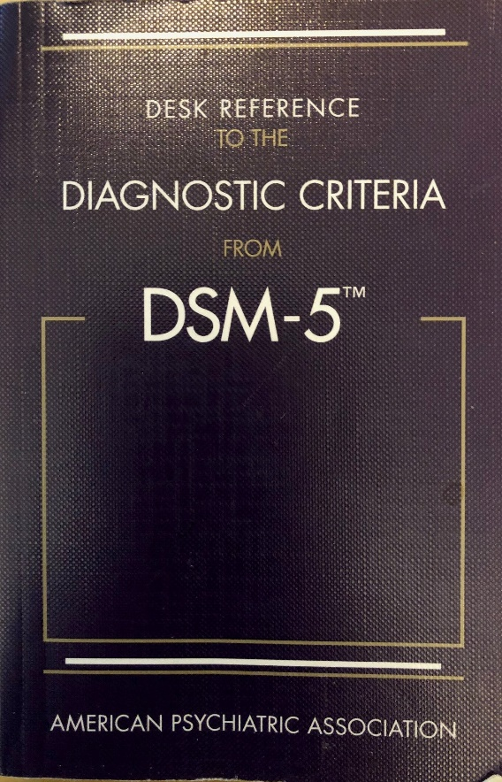
DSM-5 Eating Disorder Categories
Anorexia Nervosa (AN)
Bulimia Nervosa (BN)
Binge Eating Disorder (BED)
Other Specified Eating Disorders (OSFED)
Unspecified Eating Disorder
Avoidant/Restrictive Food Intake Disorder (ARFID)
Notes:
Cross over
OSFED include for example, Atypical AN, Purging disorder and Night eating syndrome.
Obesity is not an eating disorder in and of itself, although it may be present in some eating disorders
Binge Eating Disorder
Binge eating disorder was approved for inclusion in DSM-5 as its own category of eating disorder. In DSM-IV, binge-eating disorder described in Appendix B: Criteria Sets and Axes Provided for Further Study and was diagnosable using only the catch-all category of “eating disorder not otherwise specified.”
Binge eating disorder is defined as recurring episodes of eating significantly more food in a short period of time than most people would eat under similar circumstances, with episodes marked by feelings of lack of control. Someone with binge eating disorder may eat too quickly, even when he or she is not hungry. The person may have feelings of guilt, embarrassment, or disgust and may binge eat alone to hide the behavior. This disorder is associated with marked distress and occurs, on average, at least once a week over three months.
This change is intended to increase awareness of the substantial differences between binge eating disorder and the common phenomenon of overeating.
Anorexia Nervosa
Anorexia nervosa, is characterized by distorted body image and excessive dieting that leads to severe weight loss with a pathological fear of weight gain. The criteria have several minor but important changes:
• Criterion A focuses on behaviors, like restricting calorie intake, and no longer includes the word “refusal” in terms of weight maintenance since that implies intention on the part of the patient and can be difficult to assess. The DSM-IV Criterion D requiring amenorrhea, or the absence of at least three menstrual cycles, will be deleted. This criterion cannot be applied to males, pre-menarchal females, females taking oral contraceptives and post-menopausal females..
Bulimia Nervosa
Bulimia nervosa is characterized by frequent episodes of binge eating followed by inappropriate behaviors
such as self-induced vomiting to avoid weight gain. DSM-5 criteria reduce the frequency of binge
eating and compensatory behaviors that people with bulimia nervosa must exhibit, to once a week
from twice weekly as specified in DSM-IV.
The other primary change was with the first criteria, Criterion A, which now focuses on behaviors, like restricting calorie intake. More importantly, this criterion no longer includes the word “refusal” in terms of weight maintenance. The word was removed because it implied intention on the part of the patient, and can be difficult to assess.
As in DSM-IV, individuals with this disorder are required by Criterion A to be at a significantly low body weight for their developmental stage. The wording of the criterion has been changed for clarity, and guidance regarding how to judge
whether an individual is at or below a significantly low weight is now provided in the text.
Criterion B has also been expanded to include not only overtly expressed fear of weight gain, but also persistent behavior that interferes with weight gain.
Binge Eating Disorder
Binge eating disorder graduates from the DSM-IV category of “disorders needing further research” into its own diagnostic label. Which is just as well, given that it’s been used by clinicians in the field for years.
According to the APA, “Binge eating disorder is defined as recurring episodes of eating significantly more food in a short period of time than most people would eat under similar circumstances, with episodes marked by feelings of lack of control. Someone with binge eating disorder may eat too quickly, even when he or she is not hungry.
“The person [with binge eating disorder] may have feelings of guilt, embarrassment, or disgust and may binge eat alone to hide the behavior. This disorder is associated with marked distress and occurs, on average, at least once a week over three months.”
It’s important to differentiate binge eating disorder from simple over-eating. Over-eating happens only occasionally, and isn’t accompanied by the overwhelming feelings — often experienced non-stop — of guilt, shame, and embarrassment that someone with binge eating disorder experiences.
The DSM-5 criteria for binge eating are the same as what appeared in the DSM-IV, except that the minimum average frequency of binge eating has been changed from at least twice weekly for 6 months to at least once weekly over the last 3 months. This was changed, in part, to be consistent with the DSM-5 frequency criterion for bulimia nervosa.
The next three disorders are disorders that typically occur in childhood or affect teens.
Avoidant/Restrictive Food Intake Disorder
According to the APA, the DSM-IV feeding disorder of infancy or early childhood has been renamed avoidant/restrictive food intake disorder. The criteria for this disorder also have been significantly expanded.
Additionally, a large number of individuals, primarily but not exclusively children and adolescents, substantially restrict their food intake and experience significant associated physiological or psychosocial problems but do not meet criteria for any DSM-IV eating disorder. Avoidant/restrictive food intake disorder is a broad category intended to capture this range of presentations.
Elimination Disorders
No significant changes have been made to the elimination disorders. The disorders in this chapter were previously classified under disorders usually first diagnosed in infancy, childhood, or adolescence in DSM-IV. They now exist as an independent classification in DSM-5.
Pica and Rumination Disorder
The DSM-IV criteria for pica and for rumination disorder have been revised for clarity and to indicate that the diagnoses can be made for individuals of any age.

Slide 11
EVALUATION OF CORE SYMPTOMS
Weight
Shape

Slide 12
Anorexia Nervosa
Restriction of intake leading to low body weight
Intense fear of weight gain
Undue influence of shape or weight
Notes:
Significantly low weight in kids can mean not hitting expected gains.
Purging (small amounts) and restricting
Use growth curve (BMI for age % (some use less than 87% Bmi

Slide 13
Bulimia Nervosa (BN)
Binge: eating a large amount of food with loss of control
Recurrent binges
Compensatory behavior (purge, exercise laxative etc)
Undue influence of shape or weight
Notes:
Same binge frequency once a week for 3 month period of time

Slide 14
Binge Eating Disorder
Binge Behaviors
No compensatory behaviors
3 or more associated symptoms:
Eating faster
Eating until uncomfortable
Eating large amounts, in absence of hunger
Eating alone, embarrassed
Feeling disgusted, depressed or guilty afterwards

Slide 15
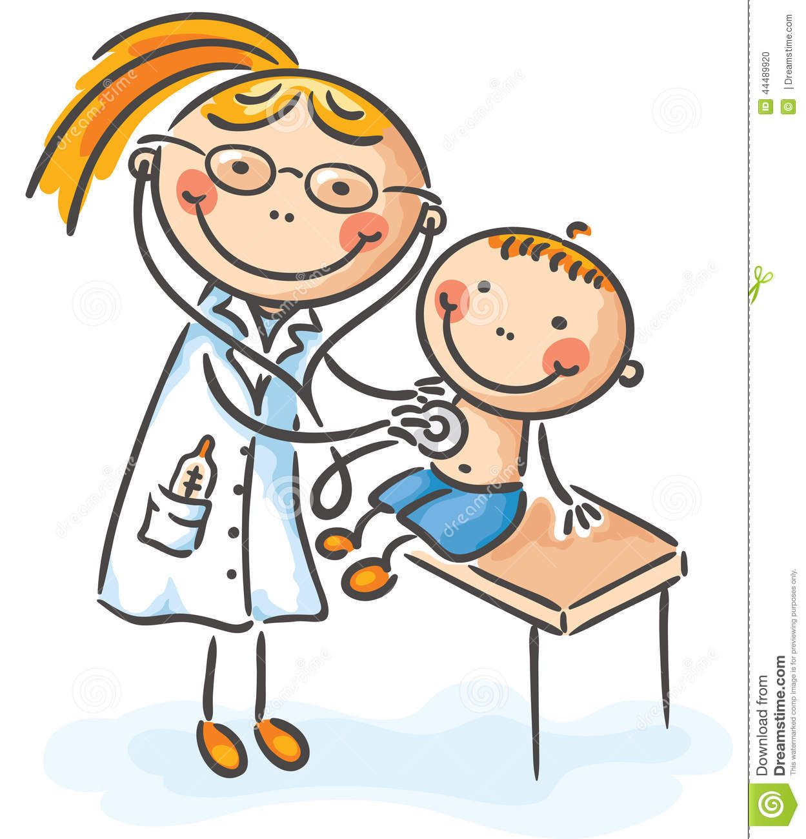
PEDIATRIC EATING DISORDERS & PRIMARY CARE PEDIATRICS
Pediatricians are often the first to encounter youth with symptoms of eating disorders.
American Academy of Pediatrics suggests screening for eating disorders
AAP Policy statement Jan 2003 Pediatrics
Notes:
Unique position of a longterm relationship with the patient.
The earlier an ED is identified, the earlier it can be treated…
AAP height, weight and eating disordered symptom screen (annual visit looking at growth curve or during fitness for sports eval)

Slide 16
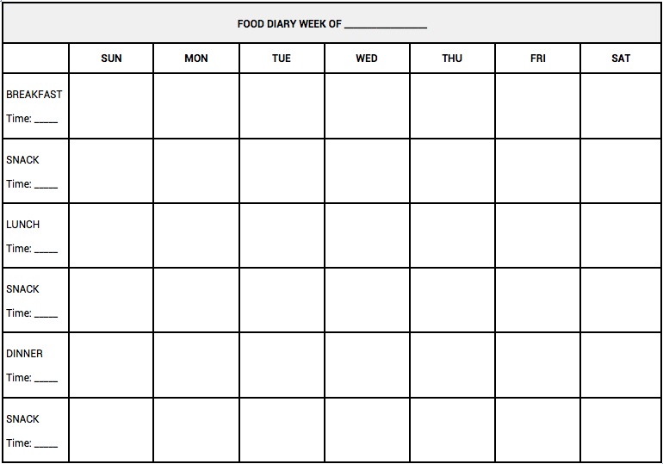
Assessment
KEY WORDS:
Healthy weight
Healthy choices
Physical Activity
FOOD LOGS :
Food
Eating behaviors
Notes:
Dieting word…avoid

Slide 17
MEDICAL COMPLICATIONS
Metabolic – hypokalemia, hypoglycemia, hypophosphatemia
Cardiovascular – bradycardia, hypotension, orthostasis
Musculoskeletal – osteoporosis –
GI – constipation, GERD
Endocrine – amenorrhea, sick euthyroid
Immunologic suppression
Neuro – seizures due to water loading,
MANY BODY SYSTEMS
MANY BODY SYSTEMS
Notes:
OP within 6 month of amenorrhea at risk.

Slide 18
Assessment
Safety -(medical and behavioral)
Weight and BMI
Hydration
Suicidal ideation….?
Labs – electrolytes
amylase?
BHCG
TSH
tox screen?
Other- EKG ? if electrolytic or cardiac concerns
Rosen DS; The American Academy of Pediatrics (AAP) Committee on Adolescence: Clinical Report—Identification and manage-ment of eating disorders in children and adolescents. Pediatrics. 2010;126:.

Slide 19
Quick behavioral screening questions:
What do you think should weigh?
Do you think you ever eat more than anyone you are eating with (but you just can’t stop eating…)?
Do you ever get rid of that food? Or take laxatives? Or exercise a lot?
What you think of your body’s shape?
Do you ever have trouble when you have to stop eating, like you lose control?
Notes:
Don’t need to endorse symptoms, can use behaviors and extrapolate
How often symptoms
(if you had a magic wand)
What you look like – body image

Slide 20
Differential ?
Medical causes of weight fluctuation
Medical causes of purging
Substances>?
Food insecurity
Overeating?
Comorbid psychiatric illness
OCD
Anxiety
Depression

Slide 21
RED FLAGS
New reduction in intake or cutting out foods
New intense exercise
New lab work findings
New physical exam findings
New comorbid psychiatric complaints
Preoccupation with weight and shape
Sneaking food
Eating alone or in secret
Notes:
Hypokalemia
Bradycardia or large parotids
(falling off growth curve)
Versus losing weight in adulthood.

Slide 22
Other warning signs…
Purging hints
Interferes with future or current goals
Behavioral changes?
Comorbid psychiatric symptom exacerbation
Notes:
( parotids, tooth decay …)
Using a bathroom right after meals
Personality changes?
Rarely calluses on hands

Slide 23
SCREENERS
SCOFF
Eating Disorder Screen for Primary Care (ESP)
Children’s Eating Attitude Test (ChEAT)
Children’s Binge Eating Disorder Scale (C-BEDS)

Slide 24
SCOFF QUESTIONNAIRE:
Do you make yourself Sick because you feel uncomfortably full? Do you worry you have lost Control over how much you eat? Have you recently lost > 1 Stone (14 lbs) in a 3-month period? Do you believe yourself to be Fat when others say you are too thin? Would you say that Food dominates your life? Scoring: 1 point for every affirmative answer; if >=2 possible Eating Disorder symptoms; warrants further evaluation Morgan JF, Reid F, Lacey JH. The SCOFF questionnaire: assessment of a new screening tool for eating disorders. BMJ 1999; 319:1467.

Slide 25
Eating Disorder Screen for Primary Care (ESP)
Are you satisfied with your eating patterns? Do you ever eat in secret? Does your weight affect the way you feel about yourself? Have any members of your family suffered with an eating disorder? Do you currently suffer with or have you ever suffered in the past with an eating disorder? Scoring: Affirmative screen =“no” answer for question 1 and “yes” answer for all other questions; If >=3 ->high likelihood of an Eating Disorder
Cotton MA, et al. Four Simple Questions Can Help Screen for Eating Disorders. J Gen Intern Med 2003.

Slide 26
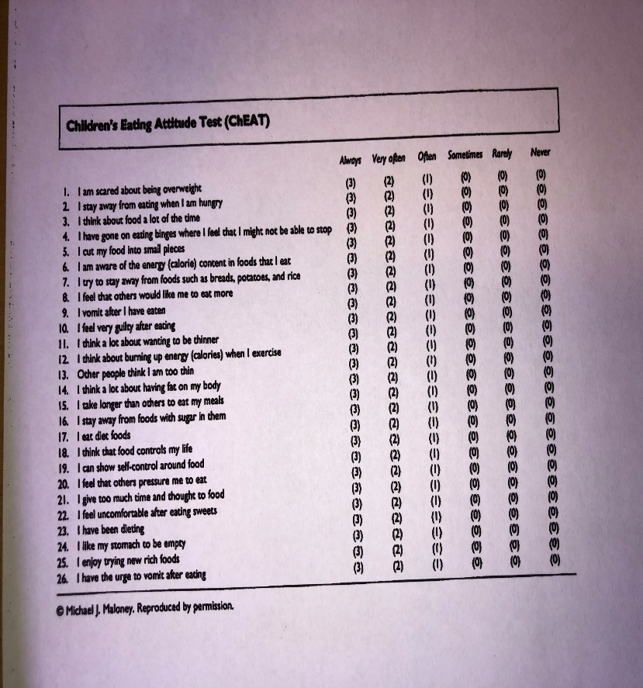
Child Eating Attitudes Test (ChEAt):
Self-administered assessment to screen for eating disorders in school aged kids and adolescents
26 items on a 6-point likert-type scale
Questions about body image, preoccupation with food, dieting etc.
Identifies issues that might be followed up further.
http://www.1000livesplus.wales.nhs.uk/sitesplus/documents/1011/ChEAT.pdf
Smolak L, Levine MP. Psychometric properties of the Children’s Eating Attitudes Test. Int J Eat Disord. 1994 Nov.
Garner DM, et al. The eating attitudes test: psychometric features and clinical correlates. Psychol Med. 1982 Nov.
Notes:
Validated
Adapted from adult version
ChEAT – self report instrument validated in children 8yrs to late adolescence, about 15-20 minutes to complete, specific focus on pediatric eating attitudes and disordered cognitions, based on adult EAT
n children
Give instructions to kids
Bit lengthly to follow change over time?

Slide 27
CBEDS (Shapiro et al 2006 IJED)
Children’s Binge Eating Disorder Scale
Advantages:
Good as a quick screen for clinical work
Can use in young children
Disadvantages:
Does not contain frequency nor severity data
Limited psychometrics
 | Items | Yes | No
1. | Do you ever want to eat when you are not even hungry? | 1 | 0
2. | Do you ever feel that when you start eating you just cannot stop? | 1 | 0
3. | Do you ever eat because you feel bad, sad, bored, or any other mood? | 1 | 0
4. | Do you ever want food as a reward for doing something? | 1 | 0
5. | Do you ever sneak or hide food? | 1 | 0
6. | How long have you been doing this for? (transformed to weeks) | _____ weeks
7. | Do you ever do anything to get rid of what you ate (for example by throwing up or pills to make you go to the bathroom)? | 1 | 0
Scoring:
# 1 and 2 positive
And one positive of any of # 3, 4,or 5
And at least 3 weeks on # 6
And negative response on # 7

Slide 28
TREATMENT and REFERRALS
Per the AAP Policy Statement in 2003*, pediatricians have a role to play in treating the patient and monitoring refeeding– but also communicating with the team --- the nutritionist and therapist (and possibly psychiatrist).
Explore family’s concerns about ED treatment with specialists…
Nutritionist
Therapist experienced in EDs
Psychiatrist..
*AAP Policy Statement – Identifying and Treating Eating Disorders; Pediatrics January 2003
Notes:
TREATMENT IN PRIMARY CARE
Goal for 90% IBS
but don’t allow them to look/obsess
Nutritionist re: different dx/refeed vs other

Slide 29
Family Role Induction
Involve all parents
Dispel blame
Firm but supportive limits
Avoid splitting
Keep a close eye on safety risks
Need for a team approach (with PCP, parents and mental health therapist, psychiatrist and dietician etc).
Notes:
Family Role Induction

Slide 30
What LEVEL OF CARE?
Outpatient
Intensive Outpatient
Day Hospital
Residential
Inpatient Psychiatric
Inpatient Medical
Notes:
FOOD= MEDICINE

Slide 31
INDICATIONS FOR HIGHER LEVEL OF CARE / HOSPITALIZATION
Failure of outpatient treatment
Weight loss (extreme or rapid)
Acute food refusal
Arrested growth and development
Acute medical safety concern -→ electrolytes, low sugar, Vital signs (HR<40, Orthostasis, hypotension, long Qtc or EKG abnormalities)
Acute psychiatric safety concern→ suicidal thinking, depression, obsessions)
Society for Adolescent Medicine Paper 2003
APA Practice Guidelines Eating Disorders and AACAP 2015 Practice Parameters

Slide 32
OUTPATIENT TREATMENT GOALS:
Address ambivalence
Helping the family who is in charge
Regular meals, snacks
Stop ED behaviors like binge/purging (depending on the specific disorder)
Weight restoration if underweight (safe refeeding)
Medical follow up (including weight)
Meds for psychiatric comorbidities?
(once refed if low weight especially)
Notes:
Safe refeeding (monitor LFTs, hydration, glucose)

Slide 33
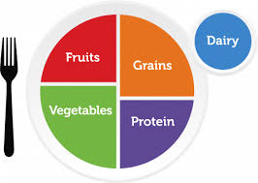
Nutritional Referrals?
Refeeding as an outpatient
Malnutrition
Eating disorder symptoms (even if weight is not the focus)
Medical comorbidities

Slide 34
Therapy for Youth with Eating Disorders…?
TYPE | TARGETS | EVIDENCE SUMMARY | RECS
FAMILY-BASED TREATMENT (FBT) | Supports parental management of behaviors | RCTs for AN RCTs for BN | USEFUL FOR MOST AN &BN CASES
COGNITIVE BEHAVIORAL THERAPY (CBT) | Manage distorted cognitions, fear of weight gain | 1 RCT and 1 case study for BN No data for AN or BED in youth yet | May be useful for BN
INTERPERSONAL Psychotherapy (IPT) | Changing interpersonal relationships trigger behaviors | Data suggesting IPT helps limit excess weight gain in youth (binge eating) | May be useful for BED in adolescents
F
AACAP Practice Parameter Eating Disorder May 2015 JAACAP
Notes:
In adults CBT has most evidence for BED other than FBT, though in children there is not yet much

Slide 35
Family-Based Treatment
A behavioral “real world” treatment
Parental involvement
Educate regarding ambivalence and relapse
Limit setting with patient
Charge parents with structuring mealtimes and diversifying food repertoire
Consider a treatment contract as needed
W

Slide 36
FBT (continued)
1. Externalization: The illness is responsible not the child.
2. Focus: Not on causation; focus on symptoms.
3. Caregiver: Responsible for supervising.
4. Monitor: Warning signs for the eating disorder.
Notes:
Track progress and as starts gaining weight can gradually start to regain control
No blame and no guilt

Slide 37
FBT for AN & BN.
←FBT Manuals (Lock and LeGrange)
3 phases of FBT;
PHASE 1: Parents are tasked with renourishing child. Nutritionist consults to parents.
Weekly sessions with all family members who must be aligned.
PHASE 2: The child begins to eventually regain some independence. Biweekly sessions. Gradual return to activity.
PHASE 3: Focus is recovery . Sessions are Child easts independently and try to help with adolescent issues.
Notes:
All meals and snacks
Patient does not necessarily know what they need

Slide 38
Some tips for feeding in Phase 1
Parents are responsible for providing food, plating and serving it.
3 regular meals (some fat at all meals)
Avoid diet foods (i.e. fat free, sugar free)
Eat with family, not alone
Monitor if bathroom breaks after eating
Stop all exercise while on weight restoration
Notes:
Work through a list of risk foods

Slide 39
FBT (continued)
Complete remission rate: only 38% --but no better treatment.
FBT is first line for AN. 75% have some improvement in eating and weight pathology.
FBT accelerates weight restoration and reduces inpatient admission ratees.
Notes:
Q month or 21
75% reduction eating path; However, need to gain at least 2.4 kg by week 4 otherwise your rate drops.

Slide 40
COGNITIVE BEHAVIORAL THERAPY
Excessive importance of self-image (shape or weight)
Purging
Anxiety / stress
or low mood
Inhibit purging behavior
Habituation
Extinction Learning
THIS IS STRESSFUL/CHALLENGING!
Fairburn 1993
Notes:
Extinction learning = Inhibitory Learning / Habituation.
Work on alternate coping mechanism

Slide 41
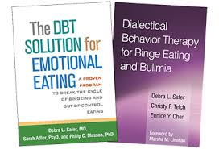
Dialectical Behavioral Therapy in Teenagers
Uses mindfulness principles (plus CBT)
Disconnection between thought and actions
Growing evidence that DBT (short term) helps reduce eating and shape concerns and eating restriction in teenagers 13-17 years of age . (5 clinical studies; 2 with only BED some with mix of AN/BN and other eating disorders).
Books by Safer et al re: Emotional eating
and BED in adults -------
Omiwole M, et al. Review of Mindfulness-Related Interventions to Modify Eating Behaviors in Adolescents. Nutrients. 2019 Dec
Notes:
Largest n=47
DBT vs weight management with LOC and BED

Slide 42
Interpersonal Therapy to prevent excess weight gain
Pilot study tested the feasibility of adapted version of group IPT for the prevention of excess weight gain (IPT-WG) vs. health education (HE) for adolescent girls (aged 12-17 years).
Aims to improve interpersonal function and reduce negative affect therefore reduce LOC eating.
Primary outcome:
Attendance and adherence good
Secondary outcome:
At 1 year follow up there was less than expected BMI growth
Tanofsky-kraff Int J ED 2010 43, 701

Slide 43
In children and adolescents with LOC eating or BED:
Goal is to normalize eating behaviors as it is with other eating disorders.
May first need to focus on bingeing to interrupt the binge cycle.
Depending on BMI percentile, AAP recommendations for rate of weight loss and multidisciplinary programs.
Depending on BMI percentile, may focus on prevention of excess weight gain rather than fast weight loss

Slide 44
General Strategies for Pediatric Binge-Eating Behaviors
Diary of binges; identify binge patterns.
Don’t skip meals
Identify eating cues
Do fun things to reward not bingeing or feeling guilty
Learn alternate coping skills for emotional eating triggers

Slide 45
What about psychotropic medications?
SSRI: Fluoxetine studied in adults up to 60 mg daily dose for BN. IN youth, only one uncontrolled trial (small) ; tolerated. May be useful for adolescents with comorbidity and second line for BN
NO BUPROPION re seizure risk in ED patients.
MIRTAZAPINE?
Notes:
: m- Limited data so far 15-25 mg daily dose in Case control study

Slide 46
Pharmacotherapy
OLANZAPINE: Most studied for AN in children and adolescents
Target comorbidity and ED cognitions
RCT with Small effect in study (N=23); 15 got the treatment.
Recommended very low dose (0.625-1.25 mg daily) and specialty consultation[ up to max 5 mg daily
ABILIFY – some case series
( 0.5-1 mg TDD with trained professional
Max 2 mg Daily dose
Canadian guidelines Couturier Feb 2020; AACAP ED Practice Parameters 2015
Notes:
Kafantaris – different levels of care

Slide 47
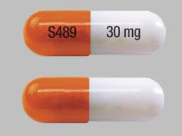
Meds?
Lisdexamfetamine : Adult studies in BED and adult indication for lisdexamfetamine but no data specifically for kids yet.
Treat comorbid psychiatric illness-- keeping in mind the weight of the patient re: malnutrition status and risk of QTc prologation.

Slide 48
PCPs play an important role to screen for pediatric eating disorders and to refer.
Eating disorders typically feature some combination of eating and shape concerns (clinical screening or via screener questionnaires).
Establishing medical safety and renourishing the patient is the first step, and then deciding the level of care.
FBT has the best evidence to support its’ use in AN and BN and is often used in outpatients.
Normalizing eating behaviors is the first step in BED; with growing evidence for DBT and IPT.
Limited evidence for medication use in children.
Notes:
Bed not dieting but normalizing eating.
Role screens

Slide 49
Thank you!
Questions?

