Slide 1
What To Do During a Psychiatric Crisis: Understanding Maryland’s Emergency Evaluation Processes
Sarah Edwards, DO
Associate Professor of Psychiatry and Pediatrics, UMSOM
Director and Medical Director,
Division of Child & Adolescent Psychiatry
Stephanie Knight, MD
Assistant Professor of Psychiatry, UMSOM
Director and Medical Director, Midtown Division
Chief of Psychiatry, UMMC Midtown

Slide 2
Disclosures
None

Slide 3
Who We Are – Maryland BHIPP
Offering support to pediatric primary care providers through free:
Telephone consultation (855-MD-BHIPP)
Resource & referral support
Training & education
Regionally specific social work co-location (Salisbury University and Morgan State University)
Project ECHO®
Direct telemental health services:
Care coordination
Psychiatry
Psychology
Counseling
Notes:
Maryland Behavioral Health Integration in Pediatric Primary Care or BHIPP is a Child Psychiatry Access Program that supports the capacity of primary care providers in Maryland to manage pediatric mental health concerns.
BHIPP offers free behavioral health telephone consultation, resource and referral networking, training and educational opportunities, Web-based longitudinal learning through Project ECHO, telemental health services, care coordination, and social work co-location in select primary care practices in collaboration with Salisbury University (SU) and Morgan State University (MSU).
BHIPP also recently received additional funding to expand warmline consultation services to select hospital Eds, and to provide Technical Assistance to select primary care practices with goal of practices becoming mental health hubs.

Slide 4
Partners & Funding
BHIPP is supported by funding from the Maryland Department of Health, Behavioral Health Administration and operates as a collaboration between the University of Maryland School of Medicine, the Johns Hopkins University School of Medicine, Salisbury University and Morgan State University.

Slide 5
Goals & Objectives
After completion of the lecture, learners will be able to:
Describe circumstances which necessitate completing a Maryland emergency petition
Outline the process of emergency petitioning someone
Learn the difference between an emergency petition and the psychiatric certification process
Describe what happens when a person is involuntarily committed to a psychiatric unit

Slide 6
Emergency Evaluations: What Do You Do?
I am worried about my…patient/friend/family member. They told me they… want to die/they are worried someone is poisoning their food and stopped eating.
How do I get them evaluated for psychiatric help if they can’t/will not go voluntarily?
Notes:
Reason to believe that the individual has a mental disorder and presents a danger to the life or safety of the individual or of others

Slide 7
Emergency Petition (EP)
Statutes guiding emergency evaluations and involuntary psychiatric commitment are different in every state!
In Maryland:
An EP enables an individual to be brought to the ED for evaluation if they have a mental health disorder and demonstrate concerning behaviors (presenting a danger to life or safety of the individual or others).
Not the same thing as a “72-hr hold”
Doesn’t guarantee a psychiatric admission
Helps assist individuals whose mental illness makes them unable to recognize their need for treatment

Slide 8
The Blame Game & Stigma
Anosognosia
Lack of awareness into one’s own condition
#1 cause of delayed treatment in people with serious/severe mental illness (SMI)
Video³ courtesy of Treatment Advocacy Center, https://www.treatmentadvocacycenter.org/index.php
Notes:
Approximately 50% of people with schizophrenia and 40% of people with bipolar disorder experience anosognosia as a symptom of their psychiatric illness. They lack insight into their illness and its symptoms. People with anosognosia often refuse evaluations and treatment since they don’t consider themselves to be “sick.”

Slide 9
Emergency Petition Criteria
Mental illness - not intellectual disability and not substance use only
Danger - may be passive (not eating or drinking, neglect of medical conditions) or active (assault)

Slide 10
Emergency Evaluation Process
Reason to believe the individual has a mental disorder and presents a danger to the life or safety of the individual or of others. Concern for dangerousness: harm to self or others, not taking care of activities of daily living.
Concern for Dangerousness
1
Concern
Complete Emergency Petition
2
If your situation requires immediate intervention, call 911. If you call 911, police officers will come and evaluate whether the person meets the emergency petition criteria. Can also call 988 and a mobile crisis team will respond if able.
Call 911/988
Police/crisis
may EP
Complete EP Go to district court
ED Evaluation
3
Have an emergency evaluation
ED Evaluator will decide the appropriate treatment plan
(inpatient vs outpatient vs day hospital).
Evaluated in ED
Admit
Not admit
Notes:
Call 911: If your situation requires immediate intervention, call 911. If you call 911, police officers will come and evaluate whether the person meets the emergency petition criteria. In making this determination, they will take into account all pertinent information, including what you tell them about the person and what they observe directly. If they decide that an evaluation is needed, they will take the person to the nearest emergency room.
Peace Officer must observe or based on “other information obtained that is pertinent to the factors giving rise to the petition.
File a petition for emergency evaluation: Any interested person (friend, relative, neighbor, or health professional) may file a petition for emergency evaluation review by a judge. When a petition for emergency evaluation is granted, the person to be evaluated is taken by a police officer or sheriff to an emergency room and is then evaluated for possible hospital admission.
To file a petition for emergency evaluation, go to the nearest district court during court hours and ask for the ‘petition for emergency evaluation’ form.

Slide 11
Three Ways Someone Can Be Emergency Petitioned
1. Law Enforcement
Can serve as petitioner AND transport, or just transport of evaluee if #2 or #3 processes enacted.
Transports patient to the closest ED for eval
2. Qualifying Clinician
Must have personally examined the patient
3. Family Member/Loved One
Requests an EP directly from the court. Judge will review, hear petitioner testimony, and decide whether the potential evaluee meets the statutory criteria.
Least common means of EPs
If petitioner, must observe the evaluee (but not necessarily the behavior) to determine whether criteria are met
Includes physicians, psych NPs (not Family NPs or other specialty APPs), psychologists, LCSW-Cs, LCPCs, LMFTs
Once signed by the judge, the EP is given to law enforcement and is actionable/valid x 5 days only. Officers locate the evaluee and bring them to the nearest ED.

Slide 12
Emergency Petition Form
https://www.courts.state.md.us/sites/default/files/court-forms/courtforms/joint/ccdc013.pdf/ccdc013.pdf
Cc-DC-013 (Rev. 12/09/2020)
Page 1

Slide 13
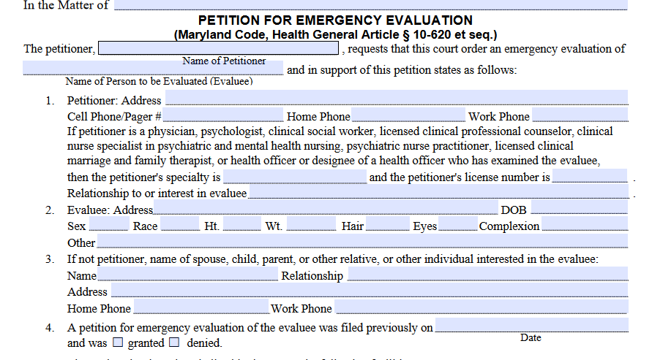
Filling out the EP
Petitioners:
Physician, psychologist, LCSW-C, LCPC, psych NP, LMFT, or health officer or designee of health officer who has examined the individual

Slide 14
Filling out the EP
Your job is to draw a complete and vivid portrait of a person with disturbance in mental functioning so serious that the individual should be evaluated at the hospital
Never be vague, very detailed!

Slide 15
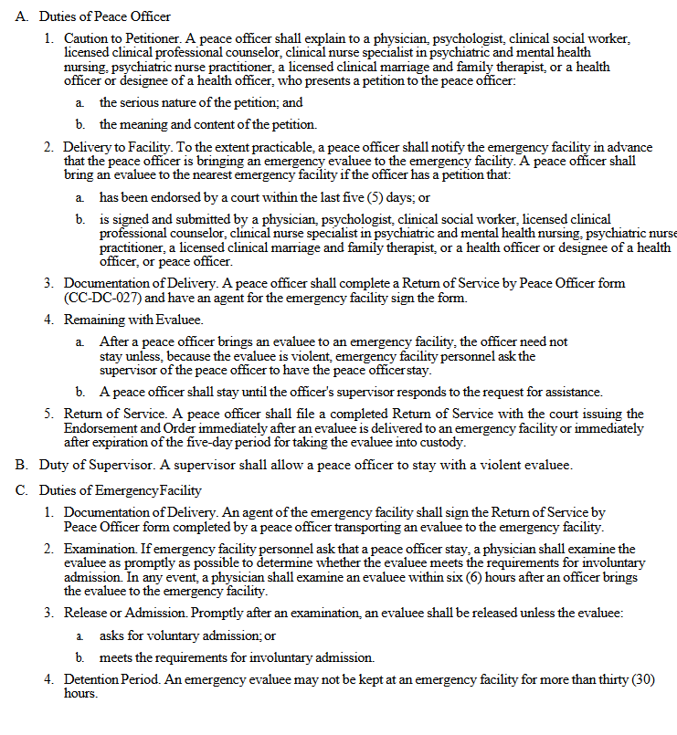
Emergency Petition Form
https://www.courts.state.md.us/sites/default/files/court-forms/courtforms/joint/ccdc013.pdf/ccdc013.pdf
Cc-DC-013 (Rev. 12/09/2020)
Page 2

Slide 16
You need another form! Certification By Peace Officer
https://www.courts.state.md.us/sites/default/files/court-forms/courtforms/joint/ccdc014.pdf/ccdc014.pdf
CC-DC-014 (Rev. 12/2020)
Give to a peace officer – you sign the bottom of the form

Slide 17
Roadmap for Clinicians Filing EPs
Complete
Certification by Peace Officer form
Patient will be brought to closest ED for evaluation
1
2
4
3
Complete EP form
Describe concerns in detail!
Call 911 for police to pick up the completed EP. They may request that you drop off at police station (jurisdiction of patient’s location).

Slide 18
Filling out the EP – Lessons Learned
Be prepared – have an office policy, forms, etc.
It takes time to complete the forms and have police pick up/you drop off the EP
You want evaluators in the ED to call you for information; your concern and information matters so be available, give your cell phone
Keep in mind the function of an EP - patients may be evaluated and discharged…they return to you
Don’t use blue ink

Slide 19
Mental Health Law & the EP Process
Emergency evaluation statutes are some of the oldest risk reduction methods in mental health care
EP documents must include a description of the person’s behavior and statements, plus other info that led the petitioner to believe that the evaluee (a) has a mental disorder, and (b) presents a danger to the life or safety of the individual or others.
Does not require imminent danger
Specifically solicits petitioner’s knowledge about evaluee having firearms bc of previous incidents
2022 legislative session --> SB2 passed to allow for electronic EP forms and electronic transmission of EP paperwork. Effective 10/1/22.
Notes:
Re: firearms question. Per Dr. Erik Roskes, “This question was added over 20 years ago after a tragic incident in which an individual who had been petitioned killed a police officer while the EP was being served.” Firearms may be seized by police during the service of an EP, but patients released from the ED may immediately request return of their weapons, unless other mechanisms are in place to prevent it. This is one of the loopholes that an ERPO might close if timely filed and executed.”

Slide 20
Why Does Timing Matter?
Why the Rush? Can’t You Just Wait Until They’re Agreeable?
Timely treatment is critical
Dangerous symptoms that risk the life or safety of the person or others constitute an emergency!
Treatment delays associated with neuronal damage, worsening sxs, poorer prognosis¹
For pts with psychotic disorders, increase in duration of untreated psychosis from 1 week to 4 weeks associated with > 20% more severe symptoms²
Prompt treatment of severe mental illness can minimize the social consequences of untreated SMI like homelessness, arrest, and incarceration.³
Emergency petition processes allow for the transport of an evaluee to the nearest ED, even without their consent.

Slide 21
Admission Process
Has a mental disorder;
The mental disorder is susceptible to care or treatment
The individual understands the nature of the request for treatment;
The individual is able to give continuous assent to retention by the facility; and
The individual is able to ask for release
Admit
Met criteria for Admission
1
2
Voluntary vs. Involuntary
Involuntary
Voluntary
Certify if:
Has a mental health condition and
Needs inpatients care or treatment and
Presents a danger to the life or safety of themselves or others and
Is unable or unwilling to be voluntarily admitted and
There is no available less restrictive form of intervention
Certify and Hearing
3
Certify when Conditions are met
Hearing with Administrative law judge

Slide 22
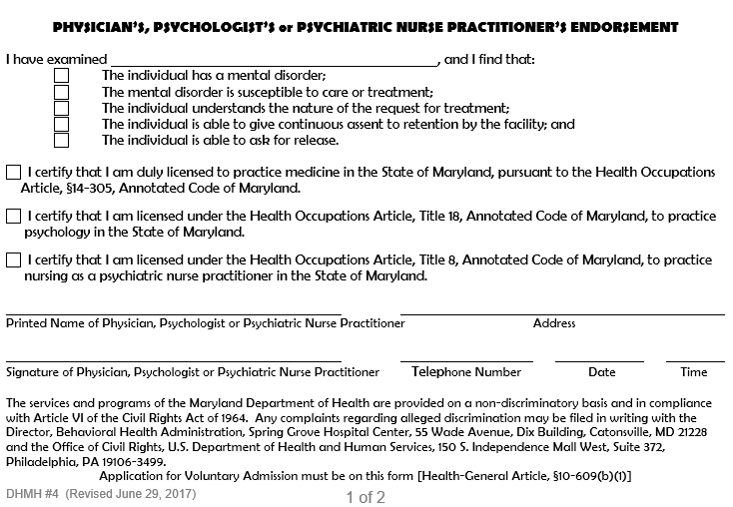
Voluntary Admission Form
As of 2018, pts with guardians of person CAN be admitted voluntarily, as long as the person retains the capacity to understand the tenets of a voluntary application. There are separate voluntary applications for psych admission for disabled adults.

Slide 23
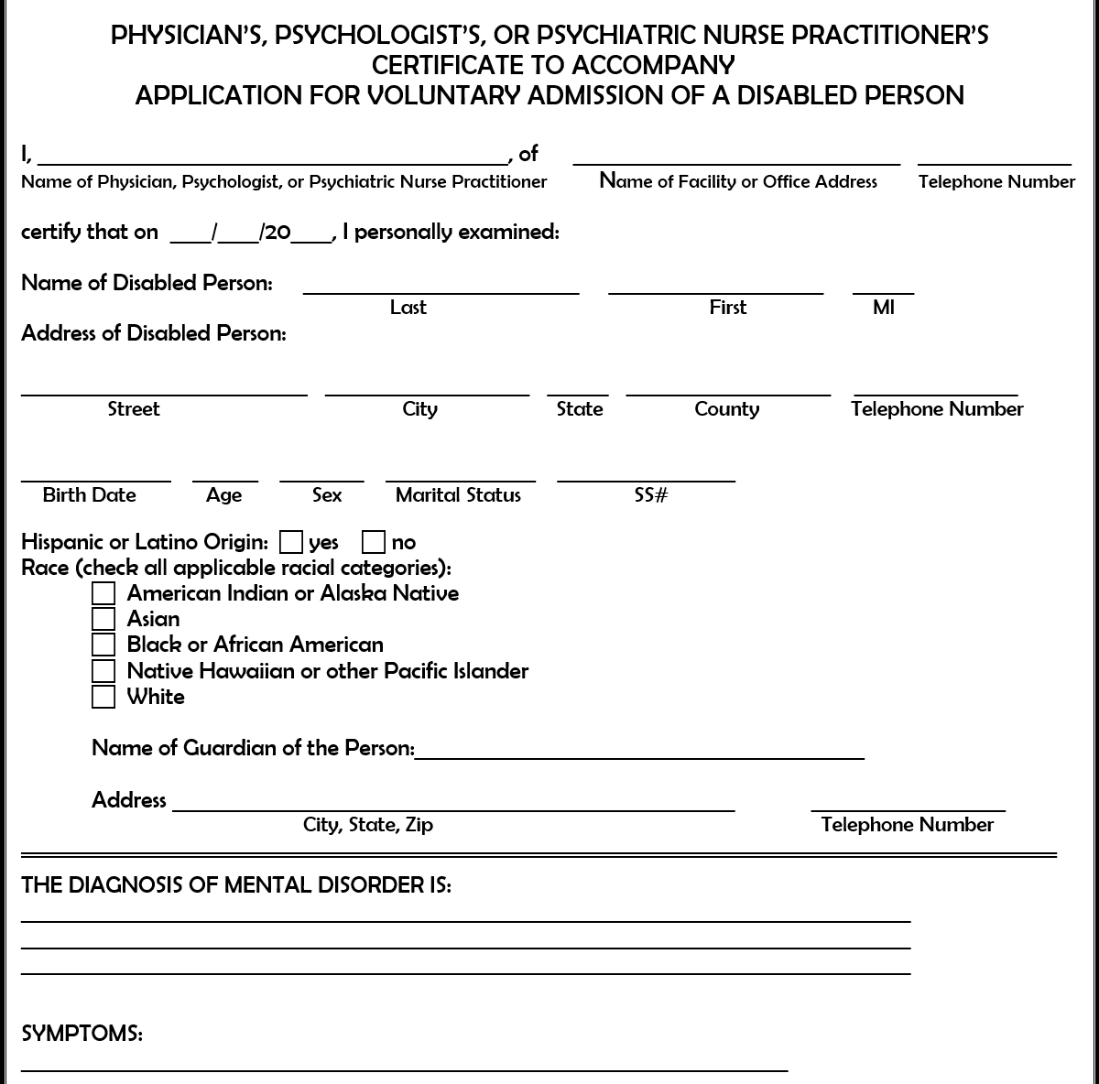
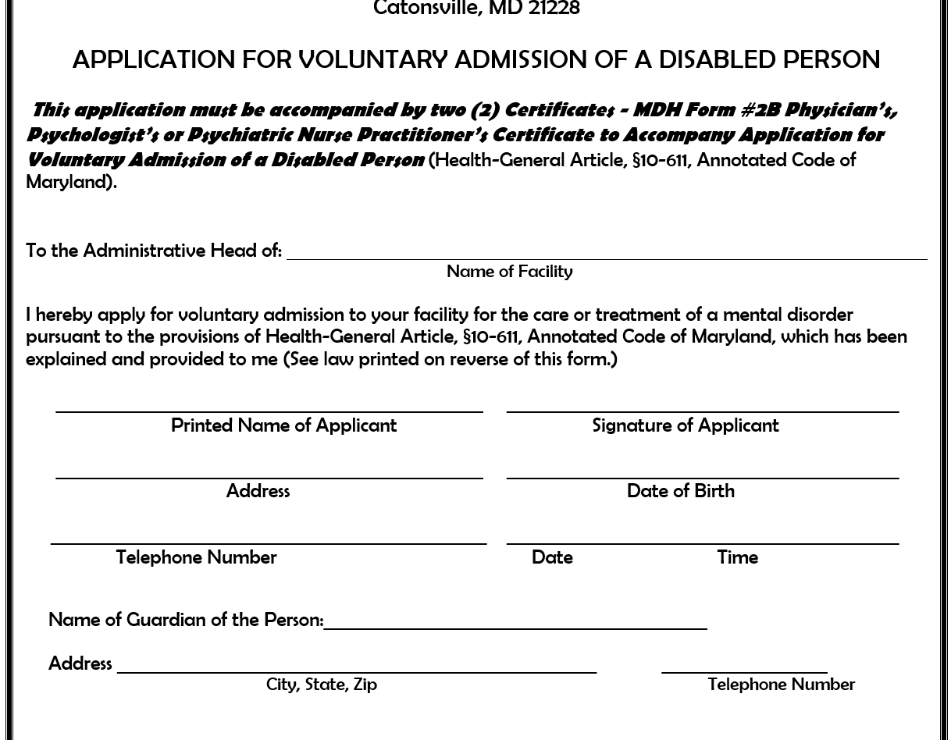
Voluntary Admission of a Disabled Adult

Slide 24
Involuntary Psychiatric Hospitalization & Civil Commitment
Maryland is very patient rights centered, one of only 3 states in the country without an enforceable outpatient civil commitment statute
Challenging balance between need for treatment and individual rights, especially when anosognosia is so prevalent
2012 analysis of state Medicaid data showed that < 1% of the population of Marylanders with SMI accounted for 25% of all ED visits that year
Not uncommon for folks with SMI to go to local EDs > 6 times each year
Would the patient make the same choice to avoid treatment if they had insight into their illness and its consequences??
Notes:
A physician MUST be one of the certifying providers. You can’t involuntarily admit someone without physician participation in the process.

Slide 25
Involuntary Psychiatric Hospitalization & Civil Commitment
Involuntary admission only the 1st step in commitment process
Involuntarily admitted pts must have a hearing with an administrative law judge (ALJ) within 10 days of their confinement on the inpatient unit to determine whether they meet state criteria for involuntary commitment
Confinement as a “legal” and temporarily restriction of civil rights, so must be checked by judicial authority
ALJ hearing ensures that processes have been followed accurately, confirms pt rights weren’t further limited or violated during the process of involuntary admission
Hearings currently virtual only (due process??)
Possible hearing outcomes: postponement, retained, released on merit, released on technicality

Slide 26
Civil Commitment Process
Not everyone who’s admitted involuntarily will have a civil commitment hearing
Inpatient team determines legal course based on situational, administrative, and clinical factors. The team can choose to:
Postpone the IVA hearing - Need more time to get to know the patient and determine recommended care
Offer a voluntary application for admission (which cancels the IVA hearing) – If pt providing continuous assent to care, taking meds, going to groups, not being aggressive, etc.
Proceed with the civil commitment hearing if the pt meets IVA criteria (often pts aren’t taking meds or engaging in care either)

Slide 27
Civil Commitment Process
Hearings occur on designated days at each civil and forensic facility/unit in the state
Hearing structure:
Hospital represented by a lay person trained in the hearings (usually not an attorney).
Pt can hire a private attorney, represent themselves, or make use of free representation by the Office of Public Defender (Mental Health division).
ALJ hears testimony and arguments on the technical and clinical aspects of pt’s admission.
Burden of proof is on the hospital, which has to prove by “clear and convincing evidence” that the patient has met the criteria for admission.

Slide 28
Civil Commitment Process
Civil commitment criteria:
Do they have a mental illness?
Do they require inpatient level of care?
Are they a danger to themselves and/or others?
Are they unwilling or unable to be a voluntary patient?
Has the patient failed a less restrictive level of care?
Family members and outpatient providers may be asked to provide testimony during the IVA hearing. Anyone testifying (including loved ones, physicians, the patient, etc.) will undergo direct examination by the hospital representative and be cross-examined by the PD.
Testimonies are given under oath. Physicians may be qualified as expert witnesses in their field prior to testifying. Hearsay is admissible bc of the administrative nature of the hearing.

Slide 29
Does Civil Commitment Reduce Risk of Future Violence?
ALJs must consider the firearms provision in Health-General §10-632(i):
Allows the ALJ in a second finding based only on dangerousness to others to “order the individual….to (1) surrender to law enforcement authorities any firearms in the individual’s possession; and (2) refrain from possessing a firearm unless…granted relief from firearms disqualification….”
The statute, as written, does not permit the ALJ to order surrender of firearms based solely on dangerousness to self (may be that’s where an ERPO could come in handy!). Such individuals are reported to the Maryland Department of Health (MDH), which manages a database concerning them. MDH in turn reports to both the State Police (who enforce the Public Safety Article) and to the FBI (who enforce federal restrictions, which differ slightly from state restrictions).
Individuals subject to any of the above restrictions can petition for relief, formally requesting that their rights to possess firearms be returned. This is managed by the MDH Office of Court Ordered Evaluation and Placement (formerly, the Office of Forensic Services).
Notes:
Notably, option “a,” civil commitment, both (1) addresses the illness and its consequent risk and (2) protects the patient’s confidentiality.
Re: firearms question. Per Dr. Erik Roskes, “This question was added over 20 years ago after a tragic incident in which an individual who had been petitioned killed a police officer while the EP was being served.” Firearms may be seized by police during the service of an EP, but patients released from the ED may immediately request return of their weapons, unless other mechanisms are in place to prevent it. This is one of the loopholes that an ERPO might close if timely filed and executed.

Slide 30
EP vs. ERPO
Duty to protect: §5-609 of the Courts and Judicial Proceedings article of the Annotated Code
Healthcare providers cannot be held liable for the action of a patient unless “the patient indicated… by speech, conduct, or writing [his/her] intention to inflict imminent physical injury upon a specified victim or group of victims.”
If risk is imminent, provider has three (3) options to take protective action:
Seek civil commitment (EP the patient)
“Formulate a diagnostic impression and establish and undertake a documented treatment plan calculated to eliminate the possibility that the patient will carry out the threat;” or
“Inform the appropriate law enforcement agency and, if feasible, the specified victim or victims of:
“The nature of the threat;
“The identity of the patient making the threat; and
“The identity of the specified victim or victims.”
§5-609 protects healthcare providers from liability regarding violating the patient’s confidentiality if act in good faith, regardless of the course of action we choose to take
Notes:
Notably, option “a,” civil commitment, both (1) addresses the illness and its consequent risk and (2) protects the patient’s confidentiality.
Re: firearms question. Per Dr. Erik Roskes, “This question was added over 20 years ago after a tragic incident in which an individual who had been petitioned killed a police officer while the EP was being served.” Firearms may be seized by police during the service of an EP, but patients released from the ED may immediately request return of their weapons, unless other mechanisms are in place to prevent it. This is one of the loopholes that an ERPO might close if timely filed and executed.

Slide 31
Extreme Risk Protective Order (ERPO)
Extreme Risk Protective Order (ERPO) – Maryland’s Red Flag law (est. 2017)
13th state to pass a law allowing temporary restriction of access to firearms if someone poses a risk to others
Can be filed by spouse, any relative by blood/marriage/adoption, a co-parent, a current or former intimate or dating partner, current or former guardian, a law enforcement officer, or a medical professional who’s examined the individual (MD was 1st state to include clinicians in the list of people who can file an ERPO)
ERPO can include an EP as part of the process, but this not required
ERPO alone does not require the petitioner to cite the cause of the risk.
ERPO must include information regarding the person’s “behavior that leads me to believe he/she presents an immediate and present danger of causing personal injury to himself/herself, to me, or to others by possessing a firearm.” There are several optional forms that may be appended to the petition (available online).
Forms must be filed at the District Court with the clerk (during business hours) or a District Court Commissioner (after hours). The petitioner is required to appear at a hearing. Under the statute, the commissioner or judge reviewing the petition must consider whether an EP is appropriate and, if so, to take appropriate action.
Oct 2018 (first month of ERPO): 114 ERPO petitions filed, only 1 filed by a clinician⁵
Gun in the home = triples the risk of suicide, doubles the risk of homicide⁶
Maryland’s red flag law currently ranked by Everytown as the #7 strongest gun law in the country
Notes:
Notably, option “a,” civil commitment, both (1) addresses the illness and its consequent risk and (2) protects the patient’s confidentiality.
Re: firearms question. Per Dr. Erik Roskes, “This question was added over 20 years ago after a tragic incident in which an individual who had been petitioned killed a police officer while the EP was being served.” Firearms may be seized by police during the service of an EP, but patients released from the ED may immediately request return of their weapons, unless other mechanisms are in place to prevent it. This is one of the loopholes that an ERPO might close if timely filed and executed.

Slide 32
Should You File an ERPO if Your Patient is Unstable and Has a Firearm?
ERPO statutes provide liability protection for providers who file an ERPO in good faith, regardless of outcome
ERPO does not provide similar protection for providers who opt not to file an ERPO for whatever reason
Per Dr. Erik Roskes, forensic psychiatrist – “Providers [who] elect not to file an ERPO should document their reasoning in detail, noting that they have elected another course of action to mitigate the risk of harm (such as seeking civil commitment or an EP). One attorney I spoke with surmised that following the path laid out in the “Duty to Protect” section above should afford the provider the protection of the good-faith provision therein. Maryland Appellate law provides similar protection to providers who elect not to involuntarily commit a patient after making a decision that commitment criteria have not been met, expressly to eliminate any incentive that providers might curtail patients’ liberty interests merely to avoid liability.[1]
Opportunities for process improvement:
ERPO petitions must be filed by the petitioner in district court
Burden on the petitioner, who can expect to testify at up to three (3) subsequent court hearings
Notes:
Notably, option “a,” civil commitment, both (1) addresses the illness and its consequent risk and (2) protects the patient’s confidentiality.
Re: firearms question. Per Dr. Erik Roskes, “This question was added over 20 years ago after a tragic incident in which an individual who had been petitioned killed a police officer while the EP was being served.” Firearms may be seized by police during the service of an EP, but patients released from the ED may immediately request return of their weapons, unless other mechanisms are in place to prevent it. This is one of the loopholes that an ERPO might close if timely filed and executed.

Slide 33
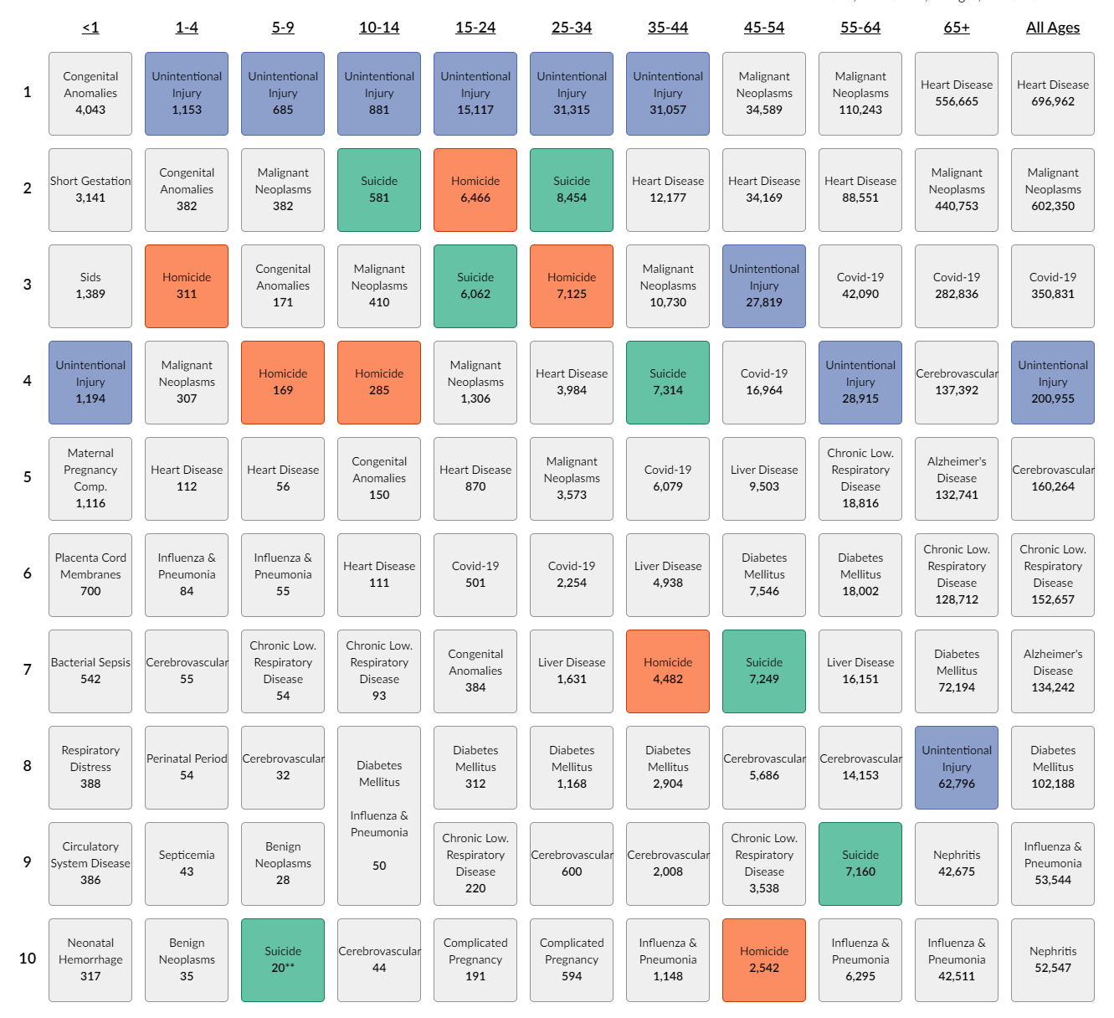
ERPOs and Violence Prevention
10 leading causes of death in the U.S. in 2020 (CDC)
https://wisqars.cdc.gov/data/lcd/home
Suicide was a top 10 cause of death in 7 of 10 age categories (36,840 people)
Firearms were the most frequently used method of suicide in people aged 15-64 yrs old. 17,820 (48%) of people who suicided used a firearm.
Firearms were the #2 method of injury in the 10-14 yr old group (224 kids), behind suffocation.
Notes:
(both sexes, all races)

Slide 34
ERPOs and Violence Prevention
10 leading causes of death in the U.S. in 2020 (CDC)
https://wisqars.cdc.gov/data/lcd/home
Homicide was the cause of death for 21,380 people in the U.S. in 2020. It was a top 10 cause of death for people aged 1-54 yrs old.
Firearms were the most frequently used method of homicide in people aged 5-54 yrs old.
17,831 (83%) of homicides were committed with a firearm.
Firearms were the #2 method of injury in the 1-4 yr old group (75 kids), behind “unspecified.”
Notes:
(both sexes, all races)

Slide 35
ERPOs and Violence Prevention
Oldest red flag law in the U.S. = Connecticut (1999)
Risk-Based Gun Removal Law
Estimated by policy researchers to have saved 1 life for every 10.6 guns seized⁷
Indiana: Red flag law reduced firearm suicides by an estimated 7.5% over 10 years, without an increase in suicides by other means⁸
Lots of data about gun suicides and firearm removal laws on the Everytown site and its affiliates, https://everytownresearch.org/report/gun-suicide-city-gun-violence/

Slide 36
References

Slide 37
Questions?
Thanks!

