Slide 1
Maryland Behavioral Health Integration in Pediatric Primary Care (MD BHIPP) Addressing Child and Adolescent Depression in the Primary Care Setting BHIPP Resilience Break May 20th, 2021, 12:30 PM Mark A. Riddle, MD Professor of Psychiatry & Pediatrics Johns Hopkins University School of Medicine
1-855-MD-BHIPP (632-4477)
www.mdbhipp.org
Follow us on Facebook, LinkedIn, and Twitter! @MDBHIPP

Slide 2
Conflicts and Off-Label Prescribing
No Conflicts of Interest
Some Off-Label Prescribing May be Discussed

Slide 3
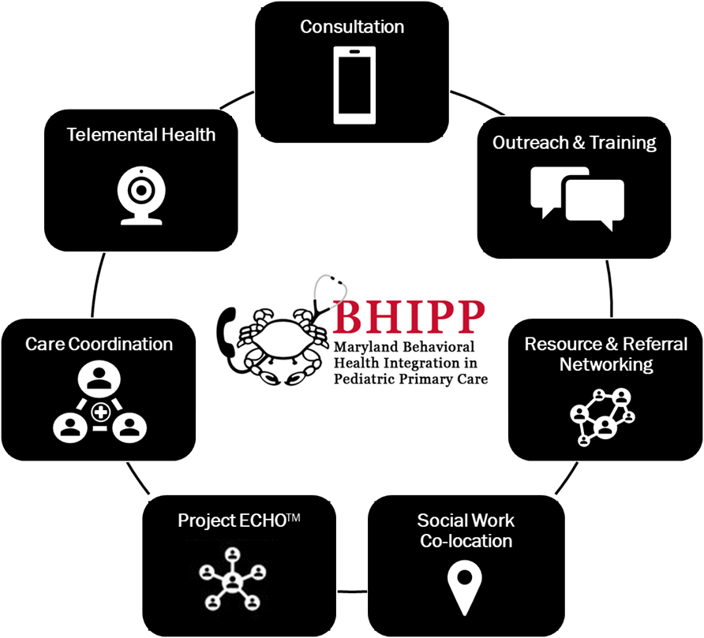
Who We Are – Maryland BHIPP
Offering support to pediatric primary care providers through free:
Telephone consultation (855-MD-BHIPP)
Resource & referral support
Training & education
Regionally specific social work co-location (Salisbury University and Morgan State University)
Project ECHO®
Direct Telepsychiatry & Telecounseling Services
Care coordination

Slide 4
Partners & Funding
BHIPP is supported by funding from the Maryland Department of Health, Behavioral Health Administration and operates as a collaboration between the University of Maryland School of Medicine, the Johns Hopkins University School of Medicine, Salisbury University and Morgan State University.
This program is supported by the Health Resources and Services Administration (HRSA) of the U.S. Department of Health and Human Services (HHS) as part of an award totaling $433,296 with approximately 20% financed by non-governmental sources. The contents of this presentation are those of the author(s) and do not necessarily represent the official views of, nor an endorsement, by HRSA, HHS or the U.S. Government. For more information, visit www.hrsa.gov.

Slide 5
Learning Objectives
Participants will learn, in the context of the COVID pandemic:
How to identify children and adolescents who need treatment for symptoms of depression
Basic principles of therapeutic treatment of depression in children and adolescents
How to implement and monitor medications to treat depression in children and adolescents

Slide 6
Impacts of the Pandemic
Exhausted parents
Teens reporting low motivation
Sleep schedules disrupted
Most children and adolescents miss school
Most parents miss school
Teens with anxiety about personal appearance don’t like being in front of screen—”they can all see me all the time”
Teens with social anxiety are less anxious during virtual school
ADHD symptoms worse at home than in structure of classroom

Slide 7
Why is Primary Care Important?
Too few CAPs and skilled Psych NPs and skilled therapists
No state or national plan to improve this shortage
Too many adolescents with episodes of major depression in past year
13.3% of 12-17 yo;
20% females, 6.8% males
71% of depressive episodes cause severe impairment that usually requires combined treatment
Too few receiving treatment
60% no treatment
20% therapy only
2% med only
18% both
2017 National Survey of Drug Use and Health

Slide 8
Office appointment: mother has concerns about 13 yr old daughter
“She’s not the same”
Low motivation
Falling grades
Arguing with parents and sibs
Spending lots of time in her room
Refusing to walk the dog
No recent trauma losses of stress except pandemic
Family history of recurrent depression in mother and MGM

Slide 9
What are the possibilities?
Major depressive disorder
Demoralization
Adjustment disorder
Adolescent developmental stuff

Slide 10
Demoralization
Understandable reaction to troubling circumstances
Diminished interest or pleasure is not present
Useful concept for most preteens with low mood/irritability
---------------------------------------------------------------------
Not a DSM-5 diagnosis, but is an ICD-10 diagnosis
Explanation for placebo response of 50% in depression studies?
Think COVID-19 pandemic (and low motivation)

Slide 11
CHILD/TEEN SUICIDE RATES — U N I T E D S T A T E S, A G E S 6–16, 1990–2005 —
Average Number of Suicides
Age
CDC 2008 (WISQARS) (reviewed 01/24/2008)
E26

Slide 12
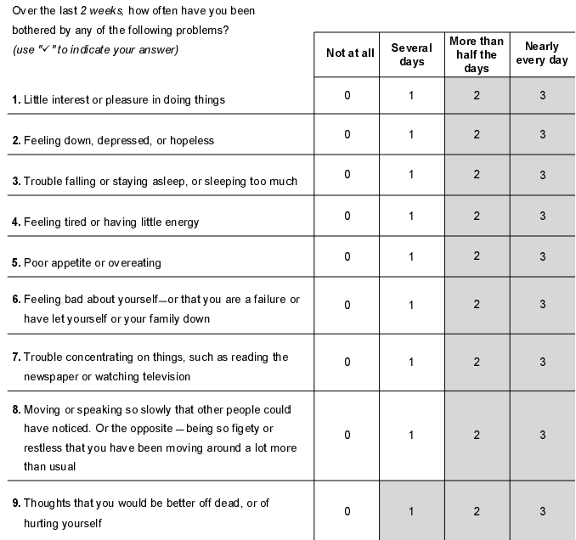
Assessment--PHQ-9 for Teens
Past year (persistent depressive disorder)
Function: work (school), home, relationships
Suicidal thoughts past month; Suicide attempt ever

Slide 13
Scoring the PHQ-9
Total Score Depression Severity
0 – 4 No or minimal
5 – 9 Mild
-------------------------------------------------
10 – 14 Moderate
15 – 19 Moderately severe
20 – 27 Severe

Slide 14
DSM-5 Symptoms of Depression
Mood
Depressed and/or irritable
Neurovegetative (Somatic)
Diminished interest or pleasure
Insomnia or hypersomnia
Fatigue or loss of energy
Weight loss or gain
Psychomotor agitation or retardation
Cognitive
Decreased concentration or indecisiveness
Worthlessness or guilt
Suicidal ideation

Slide 15
For 2’s and 3’s (positive symptoms) “Tell me more about….”
Mood: low…..sad….irritable
Physical symptoms: sleep….energy….appetite….….slow/fast
Diminished interest or pleasure
Cognition: concentration….self worth…..guilt…..never get better
Suicidal thoughts
Function……school, home, friends, activities
Course of symptoms over time…..recently…..in past
Who have your shared with?.....family…..friends……their response?
So far, has anything helped?.....therapy…..exercise…..sleep

Slide 16
Your diagnosis is major depressive disorder
Majority (5) of DSM-5 symptoms
1 symptom either depressed mood or loss of interest or pleasure
Present most of day, nearly every day, for
2 weeks duration
Major change from previous functioning
Causing clinically significant distress or impairment (school, home, activities)

Slide 17
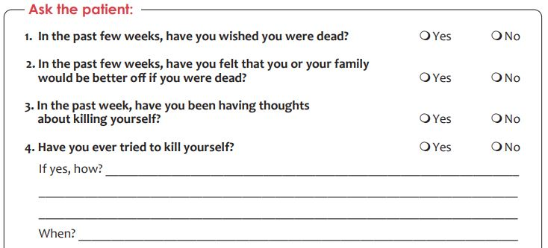
NIH Ask Suicide-Screening Questionnaire (ASQ)

Slide 18
Suicidal Thoughts and Behaviors
Level of Concern
Passive death wish?---If you fell asleep and never woke up, would that be okay?
Active thought of doing something to harm self?
Active thoughts of specific plan to kill self?
Intent?
Most consistent predictor: past history of suicide attempts or threats
Safety plan: Who will the patient tell if suicidal thoughts emerge? Guns, sharps, drugs?
Active monitoring: Staff phone calls….or electronic communication
Management Plan: Threshold for referral to hospital ED (no agreement on safety plan)
Behavior/Mental Health Consultation?

Slide 19
Development and the Course of Depression
Likelihood of onset increases markedly during puberty
Course quite variable
Episodic…..with complete or incomplete remission
Chronicity increases likelihood of personality, anxiety & substance use disorders & decreases treatment response
Somatic symptoms recover first; cognitive symptoms recover last (including suicidality)

Slide 20
Education About Depression
Episodic
Sometimes runs in families
No ones fault
Sometimes recurrent (may need chronic illness approach, like asthma)
Treatable
You are committed and confident that treatment will work

Slide 21
Depression Treatment—”Just do something”
Personal Commitments
Primary care clinician
Parent, guardian, coach, religious leader
Activation
Sleep
Exercise
Substances

Slide 22
Sleep
Studies of adults with MDD show that treatment of sleep is an important separate treatment for MDD
There is a simple psychotherapy (CBT) for insomnia in adults; it has been adapted for use in adolescents
Sleep hygiene counseling works but requires persistence!
Scheduled regular awakening
Daytime sleep restriction (no naps) and caffeine restriction
Bedtime stimulus control (lights, electronics, music, etc.)
Melatonin, a sedative at higher doses, is a popular sleep aid, but……

Slide 23
Melatonin
Pineal gland hormone regulates 24-hour sleep-wake cycle and other circadian rhythms
Peak levels during night
Daytime dose in young adults of 0.1-0.3 mg increased plasma melatonin to normal night range
Melatonin has sedative effect at higher doses
Adult data: sleep onset about 30 minutes earlier; this effect wears off in about 4 weeks
OTC melatonin preparations range from 1 to 10 mg
In a study of 31 melatonin preparations, melatonin varied from -83% to + 478% of labeled content
USP verified preps are accurate, but cost more and only available in 3 and 5 mgs dosages

Slide 24
Melatonin and Children
Used by lots of parents with or without recommendation of PCP
Best efficacy data for autism
“Data supporting use of melatonin in developmentally normal children are limited and its long-term safety is unknown.” (Medical Letter, June 29, 2020)
Long-term melatonin supplementation can suppress the hypothalamic-gonadal axis and may be associated with delayed onset of puberty, possibly by preventing the decline in nocturnal levels of melatonin that occur during the onset of puberty
Melatonin may be the most benign sedative for sleep onset, with above caveats, although not meds preferred, if possible

Slide 25
Exercise
Just do something—some better than none
Child’s choice
Rewards (not Snickers)

Slide 26
Substances
Marijuana—anxiety treatment that does help while high; but lowers motivation; prevents recovery
Alcohol—another anxiety treatment

Slide 27
Therapies for Depression
Cognitive Behavior Therapy (CBT)
Not as straightforward as with anxiety
Exposure and response prevention more difficult
Interpersonal Therapy (IPT)
Personal commitments
Behavioral Activation Therapy (BAT)
Exercise, participation

Slide 28
CBT Components
Psychological education about child/adolescent anxiety
Relaxation training
Cognitive strategies
Exposures or “behavioral experiments”
Homework Assignments

Slide 29
CBT Components – Hierarchy and Exposures
Generate list of anxiety-provoking situations
Get fear thermometer ratings
Create a hierarchy based on ratings
Set up exposures
Practice, Practice, Practice facing fears!
Types of Exposures for Separation Anxiety Disorder:
Exposure to worries about something bad happening to them or their caregiver while separated

Slide 30
Example Fear Hierarchy
Worry/Feared Situation | Child Rating | Parent Rating
Separating from parent for 10 minutes while child still at home | 2 | 2
Separating from parent for 1 hour while child still at home | 4 | 3
Separating from parent for 1 hour while child at school | 5 | 6
Separating from parent for whole school day | 8 | 7
Separating from parent for 10 minutes in a less familiar environment (e.g., grocery store) | 7 | 9
Staying in own bed for half of the night | 6 | 6
Staying in own bed for the whole night | 10 | 9

Slide 31
Umm…what about the meds?!

Slide 32
SSRI’S
Generic | Brand Name
Fluoxetine (MDD 8+; OCD 6+) | Prozac
Escitalopram (MDD 12+) | Lexapro
Sertraline (OCD 7+) | Zoloft
Fluvoxamine (sigma1) | Rarely used in USA
Citalopram | Less safe than Lexa
Paroxetine | Nonlinear kinetics

Slide 33
SSRI Differences
Escitalopram (Lexapro)
No isoenzyme interactions
Generic scored 10 & 20 mg tablets (only one prescription for dose range)
Least activating (better for sleep)
Sertraline (Zoloft)
Moderate inhibitor of CYP450 2D6, 2B6
Wider dosing range (max is 200 mg/day)
Fluoxetine (Prozac)
Very long half-life
Strong inhibitor of CYP450 2D6
Most activating

Slide 34
General Principles
START LOW, GO SLOW…….BUT not too slow…….
Effect size* with comparison to stimulants for ADHD = 1.0
0.7 for anxiety
0.2 for depression (b/o high placebo response rate)
Side effects generally minimal and reversible if SSRI discontinued
4-8 weeks to reach therapeutic dose and maximum benefit
Screening lab: TSH
*Locher C et al, JAMA Psychiatry, 74: 1011-1020; 2017

Slide 35
Doses (mg)
Agent | Start Adult—Teen--Child | Maximum Adult | Increments Adult-Teen-Child
Sertraline | 50 25-50 <25 | 200 | 50 25-50 <25
Fluoxetine | 20 10 5 | 20* | 20 10 5
Escitalopram | 10 5-10 5 | 20** | 10 5-10 5
* 60 mg/day for bulimia nervosa
** 10 mg/day for adults with GAD

Slide 36
SSRI Dose Equivalencies
Fluoxetine 20 mg
Escitalopram 10 mg
Sertraline 50 mg*
*Least valid or the 3 equivalencies; much larger range of values across studies.
NOTE: Adult data; increases to fluoxetine 40 mg equivalent can increase response, higher dose yields only more side effects
Furukawa TA et al. Optimal dose of selective serotonin…..Lancet Psychiatry: 6, 601-609, 2019.

Slide 37
Reversible Side Effects of SSRIs
None (most common)
GI discomfort, nausea
Behavioral activation……suicidality (1 per 100)
more common in younger children
agitation, restlessness, insomnia, impulsivity
behavioral disinhibition
Sexual
diminished libido
delayed orgasm or anorgasmia
erectile dysfunction
Pregnancy

Slide 38
Serotonin syndrome*
GI: nausea, vomiting, diarrhea
Mental Status: agitation, delirium, hallucinations, coma
Autonomic Instability: tachycardia, labile blood pressure, diaphoresis, hyperthermia, flushing, dizziness
Neuromuscular: tremor, hyperreflexia, rigidity, myoclonus, hyperreflexia, incoordination
*5HTP supplements and tryptans for migraines common causative agents

Slide 39
Discontinuation Syndrome
Flu-like symptoms
GI symptoms – nausea, vomiting, diarrhea
--------------------
Dizziness, vertigo
Tingling/numbness
--------------------
Sleep disruption
Anxiety, agitation
Irritability, low mood

Slide 40
Other “Antidepressants”
Duloxetine (Cymbalta) SNRI FDA indication for C&A GAD, milder sexual AEs
Bupropion (Wellbutrin) similar to amphetamine, no serotonin effect, seizures
Venlafaxine (Effexor) SNRI more side effects than duloxetine
Mirtazapine (Remeron) serotonergic; sedating and appetite inducing
Lamotrigine (Lamictal) rare fatal rash; used for bipolar depression

Slide 41
Thank you!
Maryland Behavioral Health Integration in Pediatric Primary Care (BHIPP)
1-855-MD-BHIPP (632-4477)
www.mdbhipp.org
Follow us on Facebook, LinkedIn, and Twitter! @MDBHIPP
For resources related to the COVID-19 pandemic,
please visit us at BHIPP Covid-19 Resources.

