Slide 1
Maryland Behavioral Health Integration in Pediatric Primary Care (MD BHIPP) Tuesday, June 21st, 2022 Types of Mental Health Evaluations and When to Recommend Them Antonia Girard, PsyD, BCBA, LBA
Maryland BHIPP Resilience Break Presentation
855-MD-BHIPP (632-4477)
www.mdbhipp.org
Follow us on Facebook, LinkedIn, and Twitter! @MDBHIPP

Slide 2
Who We Are – Maryland BHIPP
Offering support to pediatric primary care providers through free:
Telephone consultation (855-MD-BHIPP)
Resource & referral support
Training & education
Regionally specific social work co-location (Salisbury University and Morgan State University)
Project ECHO®
Direct Telespsychiatry & Telecounseling Services
Care coordination

Slide 3
Partners & Funding
BHIPP is supported by funding from the Maryland Department of Health, Behavioral Health Administration and operates as a collaboration between the University of Maryland School of Medicine, the Johns Hopkins University School of Medicine, Salisbury University and Morgan State University.
This program is supported by the Health Resources and Services Administration (HRSA) of the U.S. Department of Health and Human Services (HHS) as part of an award totaling $433,296 with approximately 20% financed by non-governmental sources. The contents of this presentation are those of the author(s) and do not necessarily represent the official views of, nor an endorsement, by HRSA, HHS or the U.S. Government. For more information, visit www.hrsa.gov.

Slide 4
BHIPP is Available to Provide Support to PCPs During the Pandemic
Ways to Connect:
Visit our COVID-19 Resource Page:
www.mdbhipp.org
Sign up for our newsletter:
https://mdbhipp.org/contact.html
Follow us on Facebook:
https://www.facebook.com/MDBHIPP/
Follow us on Twitter:
https://twitter.com/MDBHIPP

Slide 5
Meet The Presenter
Antonia Girard, PsyD, BCBA, LBA is an Assistant Professor and Licensed Psychologist within the Division of Child and Adolescent Psychiatry at the University of Maryland School of Medicine. She graduated from Nova Southeastern University in Ft. Lauderdale, FL in 2014 and completed her postdoctoral fellowship at Mt. Washington Pediatric Hospital in Baltimore, MD. During her time there following her fellowship she developed an Early Intervention Program and psychology’s role within multidisciplinary pediatric clinics.
She currently conducts psychological evaluations through the Center for Infant Study and the Maryland BHIPP TAP and supervises HealthySteps specialists (early childhood development experts) embedded in pediatric primary care and family medicine practices.

Slide 6
Disclosures
Dr. Girard has no potential conflicts of interest
Faculty at the University of Maryland School of Medicine

Slide 7
Learning Objectives
Determine when to refer patients for psychological evaluations
Differentiate between 3 types of evaluations and appropriate referrals for each
Discuss how testing results can inform treatment and school supports

Slide 8
Evaluation Referrals
Notes:
When and why to refer patients for testing

Slide 9
Surveillance and Screening
Screening is the first step in getting children the support or services needed
Continuum from developmental guidance and watchful waiting to referral for assessment and treatment

Slide 10
Screening and Assessment
If screener is positive, does not mean child will receive a diagnosis
If screens normally, but still have worries, refer for further evaluation
A full evaluation is needed for diagnosis
Observation
Detailed history
Test administration
Notes:
It is important to remember that diagnoses cannot be made on a screener alone. If a screener is positive, it does not necessarily mean a child will receive a diagnosis, and the opposite can be true as well.
If a screener is negative, but the family or you still have concerns, refer for further evaluation.
A full psychological evaluation can then be administered to confirm or rule-out a diagnosis.

Slide 11
Types of Evaluations
Psycho-Educational Evaluations
Psychological Evaluations
Developmental disabilities (ASD, Intellectual Disability)
Neuropsychological Evaluations
Assessment of skills and abilities related to brain function
Executive functioning
Memory
Language
IQ
Visual-Spatial
Language skills
Executive functioning
Behavioral and emotional concerns
Personality Disorders
Academic level and achievement
Learning and intellectual disabilities

Slide 12
Psycho-Educational Evaluations
Administered by school psychologists (either doctoral degree or master's + graduate certificate)
Typical measures include:
IQ test
Achievement test
Behavior rating scales completed by parents & teachers
Testing results in an EDUCATIONAL diagnosis
This is different than a MEDICAL diagnosis
Used to inform IEP coding and school accommodations
Qualifies for SSI benefits with intellectual disability, learning disabilities, and borderline intellectual functioning ONLY
Notes:
Psycho-educational evaluations typically include a child's social history, intellectual abilities, basic academic skills, and psychological screening
Sometimes not even an educational diagnosis is included, just used for the IEP classification
SSI-Supplemental Security Income

Slide 13
IEP Disability Coding Categories
Intellectual Disability
Hearing Impairment
Deafness
Speech or Language Impairment
Visual Impairment
Emotional Disability
Orthopedic Impairment
Other Health Impairment
Specific Learning Disability
Multiple Disabilities
Deaf-Blindness
Traumatic Brain Injury
Autism
Developmental Delay
Notes:
*Note about Developmental Delay-only goes through age 7
http://marylandpublicschools.org/programs/Documents/Special-Ed/NonpublicSpEd/NTAP/IndividualPlacementDirections.pdf

Slide 14
Psychological Evaluations
Administered by clinical psychologists
Typical Measures Include:
IQ tests
Social/emotional/behavioral measures
Personality assessments
Achievement tests
Language
Executive function
Testing Results in a MEDICAL diagnosis
Required to qualify for certain services (e.g., ABA therapy)
Required for SSI
Include recommendations for community-based supports & school accommodations
Can inform medication management
Notes:
Typically they include detailed developmental, medical, social, and psychological history, test battery to examine, intellectual, academic, attention, executive functioning, language, and visuospatial skills. Also included standardized parent, teacher, and self-report (if appropriate) measures.
SSI-Supplemental Security Income
Focuses on child's learning, behavior, and mental health at home, school, and community settings.

Slide 15
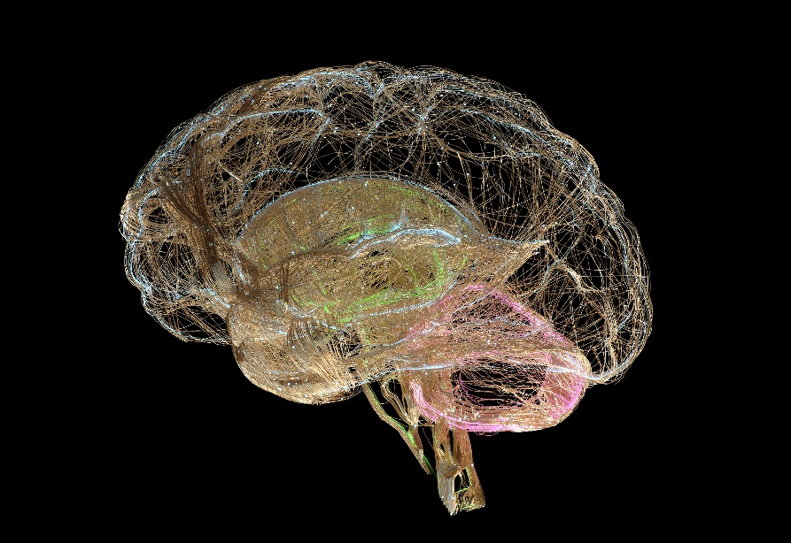
Neuropsychological Evaluations
Administered by neuropsychologists
Typical Measures Include:
IQ tests
Language
Executive function
Learning/memory
personality
Determine whether specific areas of the brain are responsible for current functioning
E.g., after brain injuries
Testing results in a MEDICAL diagnosis
Include recommendations for community-based supports & school accommodations
Can inform medication management
Notes:
Some components of neuropsych testing overlap with psychological testing, but these tests are more comprehensive and take longer to administer.
Typically they include detailed developmental, medical, social, and psychological history, extensive test battery to examine, intellectual, academic, attention, executive funcitoning, language, visuospatial, visuocontsructional, memory and fine motor skills. Also included standardized parent, teacher, and self-report (if appropriate) measures.

Slide 16
Referral Guidelines
Psycho-Educational | Psychological | Neuropsychological
Presenting concern is related to academics/learning disability | Cognitive/developmental concerns Autism spectrum disorder Mood disorders (anxiety, depression) Behavior disorders (e.g., ODD) Trauma Giftedness | Cognitive/developmental concerns are present In addition to a known medical, genetic, developmental condition or brain dysfunction is suspected cause of cognitive/behavioral difficulties Examples: TBI, genetic disorders, epilepsy, tumors, leukemia, stroke, CNS infection, hydrocephalus, congenital heart disease, history of prematurity
Notes:
Psycho-educational
*appropriate when challenges only occur in academic settings or particular subjects
Psychological
*help when the cause of problems are less clear and occur in multiple settings
Neuropsychological
*warranted when there is a known medical
*Insurance will typically only cover these evaluations if there is a history of some sort of medical/genetic disorder
*Neuropsychological testing is not appropriate for patients who are not stable (e.g., active psychosis) b/c cognitive and other functioning can't be adequately assessed

Slide 17
Navigating Maryland Infants and Toddlers Program and IEP’s

Slide 18
Maryland Infants and Toddlers Program (MITP)
Part C system of Individuals with Disabilities Education Act (IDEA)
Provides early intervention services to children with disabilities from birth to age 3 at no cost to families
Eligibility requirements
Delay of 25% or more in development or is developing in an “atypical” way in comparison to most same-aged peers
Diagnosed condition that is likely to affect development (e.g., genetic disorder, deafness, blindness)

Slide 19
How to initiate MITP Services
Submit a referral to the local MITP
Can be submitted by primary care provider, parent, childcare provider, etc.
Referrals can be submitted online via https://referral.mditp.org/Referral.html, phone or fax by referencing the MITP Physician’s Guide (https://health.maryland.gov/mmcp/epsdt/healthykids/AddendumSection5/Sec_5_Adden_Local_Infants_Toddlers_2009.pdf)
MITP has 45 days from the date of the referral to complete a functional child and family assessment and develop an Individualized Family Service Plan (IFSP).

Slide 20
MITP Contact List
Allegany County (PH) 301-689-0466 (Fax) 301-689-3834
Anne Arundel County (PH) 410-222-6911 (Fax) 410-222-6916
Baltimore City (PH) 410-396-1666 (Fax) 410-547-8292
Baltimore County (PH) 410-887-2169 (Fax) 410-339-3946
Calvert County (PH) 410-535-7380 (Fax) 410-535-7383
Caroline County (PH) 410-479-3246 (Fax) 410-479-0108
Carroll County (PH) 410-876-4437, x277 (Fax) 410-479-0108
Cecil County (PH) 410-996-5444 (Fax) 410-996-5454
Charles County (PH) 301-609-6808 (Fax) 301-609-6691
Dorchester County (PH) 410-221-2111, x1023 (Fax) 410-221-5215
Frederick County (PH) 301-600-1612 (Fax) 301-600-3280
Garrett County (PH) 301-334-1189 (Fax) 301-334-1893
Harford County (PH) 410-638-3823 (Fax) 410-638-3825
Howard County (PH) 410-313-7017 (Fax) 410-313-7103
Kent County (PH) 410-778-7919 (Fax) 410-778-6193
Montgomery County (PH) 240-777-3997 (Fax) 240-777-3132
Prince George’s County (PH) 301-265-8415 (Fax) 301-883-3907
Queen Anne’s County (PH) 410-758-0720, x4456 (Fax) 410-827-4548
Somerset County (PH) 410-651-1485 (Fax) 410-651-2931
St. Mary’s County (PH) 301-475-4393 (Fax) 301-475-4350
Talbot County (PH) 410-820-0319 (Fax) 410-822-9508
Washington County (PH) 301-766-8217 (Fax) 301-791-6716
Wicomico County (PH) 410-677-5250 (Fax) 410-677-5817
Worcester County (PH) 410-632-5033 (Fax) 410-632-3867

Slide 21
Individualized Family Service Plan (IFSP)
Developed following a child and family assessment
A document developed by a multidisciplinary team including a service coordinator, early intervention providers, and caregivers
As required by law, the IFSP document includes:
A child’s strengths and needs
The family’s priorities
Outcomes the family wishes to achieve, timelines for achieving results, and details on outcome measurements
The specific services the child will receive and where the services will be provided
Services must be initiated within 30 days following the development of the IFSP
IFSP’s are reviewed every 6 months

Slide 22
MITP Services
Possible Early intervention services provided by MITP:
Special Instruction
Speech and Language Services
Physical Therapy
Occupational Therapy
Hearing and Vision Screenings/Services
Social Work
Family Counseling
Nursing Care
Nutrition Counseling

Slide 23
Transition Planning
Begins at age 2
Have a choice at age 3 to:
Continue with services through the IFSP until beginning of school year after 4th birthday
Transition to an IEP if child is eligible for preschool special education

Slide 24
Individual Education Program (IEP)
The IEP is a document that contains the following:
Student’s current level of academic achievement and functional performance
The statewide assessments the student will participate in
Special considerations (e.g., behavioral intervention plan (BIP), positive behavioral supports, assistive technology)
Description of the delivery of special instruction, supplementary aids and services, program modifications and supports
Notes:
BIP: a proactive plan designed to address problem behaviors exhibited by a student in the educational setting through the use of positive behavioral interventions, strategies, and supports.
Functional Behavioral Assessment (FBA): The systematic process of gathering information to guide the development of an effective and efficient behavioral intervention plan for the problem behavior. An FBA includes the identification of the functions of the problem behavior for the student; a description of the problem behavior exhibited in the educational setting; and identification of environmental and other factors and settings that contribute to or predict the occurrence, nonoccurrence, and maintenance of the behavior over time.
Supplementary aids and services: electronic communication devices, preferential seating, use of a calculator, peer tutoring
Program modifications and supports: adapted assignments, specialized classroom seating, testing modifications, physical modifications of classroom, individual assistance

Slide 25
Child Find
Special education services provided to identify children from ages 3 to 21 suspected of having an educational disability and who may be eligible for special education and related services

Slide 26
IEP Process
Step 1: Referral
Completed by caregiver, teacher, primary care providers, social workers, childcare providers, etc.
Step 2: Assessment
Determine if student has a disability and requires special education
Step 3: Eligibility
Initial IEP team meeting must be held withing 60 days of caregiver consent for testing
Notes:
Reevaluation
Purpose of reevaluation is to decide:
If your child continues to be a child with a disability
Your child’s educational needs and present levels of academic achievement and related developmental needs
Whether additions or modifications to special education services are needed to help your child meet the measurable annual goals to participate in the general curriculum
Whether your child continues to need special education services
A reevaluation may or may not require new tests. Your child’s IEP team is to reevaluate your child:
At least once every 3 years
If you or your child’s teacher asks for new tests; and
Before the IEP can determine your child no longer needs special education
A school is not required to give new individualized tests to your child:
Unless you ask for new tests
Before your child graduates from high school with a regular high school diploma: or
If no longer eligible for special education services

Slide 27
IEP Procedures
Caregivers must receive a copy of the IEP draft, along with other relevant documents (e.g., assessment, report) at least 5 days prior to a scheduled IEP team meeting
IEP team includes student’s caregivers, general education teacher, special education, public agency representative, and the student (when appropriate)
Parents must receive proper written notice of IEP team meeting date, time, location, purpose, and list of all persons who will attend at least 10 days prior

Slide 29
Child Find Contact List
County | Phone Number | County | Phone Number
Allegany County | 301-759-2082 | Harford County | 410-638-4386
Anne Arundel County | 410-766-6662 | Howard County | 410-313-7046
Baltimore City | 443-984-1011 | Kent County | 410-778-7164
Baltimore County | 410-887-3017 | Montgomery County | 301-947-6050
Calvert County | 410-535-7388 | Prince George’s County | 301-808-2719
Caroline County | 410-479-3246 | Queen Anne’s County | 410-758-2403 ext.182
Carroll County | 410-751-3295 | Somerset County | 410-623-4321
Cecil County | 410-996-5444 | St. Mary’s County | 301-475-5511 ext. 213
Charles County | 301-753-1745 | Talbot County | 410-820-8263
Dorchester County | 410-221-1111 ext. 1023 | Washington County | 301-766-2964
Frederick County | 301-644-5292 | Wicomico County | 410-677-5250
Garrett County | 301-334-7655 | Worcester County | 410-632-5033

Slide 30
Thank you!
Questions?

Slide 31
Thank you!
Maryland Behavioral Health Integration in Pediatric Primary Care (BHIPP)
1-855-MD-BHIPP (632-4477)
www.mdbhipp.org
Follow us on Facebook, LinkedIn, and Twitter! @MDBHIPP
For resources related to the COVID-19 pandemic,
please visit us at BHIPP Covid-19 Resources.
Notes:
You will a copy of these slides

