Slide 1
Maryland Behavioral Health Integration in Pediatric Primary Care (MD BHIPP)
1-855-MD-BHIPP (632-4477)
www.mdbhipp.org
Follow us on Facebook, LinkedIn, and Twitter! @MDBHIPP

Slide 2
Who We Are – Maryland BHIPP
Offering support to pediatric primary care providers through free:
Telephone consultation (855-MD-BHIPP)
Resource & referral support
Training & education
Regionally specific social work co-location (Salisbury University and Morgan State University)
Project ECHO®
Direct Telespsychiatry & Telecounseling Services
Care coordination
Notes:
Maryland Behavioral Health Integration in Pediatric Primary Care or BHIPP is a Child Psychiatry Access Program that supports the capacity of primary care providers in Maryland to manage pediatric mental health concerns. We do this, currently, in a number of ways: 1. We offer a free behavioral health telephone consultation service, including resource and referral support, 2. education and training, 3. Through our partnership with Salisbury and Morgan State University, we offer co-location of social work interns at select primary care sites, 4. Web-based longitudinal learning through Project ECHO similar to today’s event, 5. Direct telepsychiatry and telecounseling services (coming soon) , 6. Care Coordination (coming soon)

Slide 3
Partners & Funding
BHIPP is supported by funding from the Maryland Department of Health, Behavioral Health Administration and operates as a collaboration between the University of Maryland School of Medicine, the Johns Hopkins University School of Medicine, Salisbury University and Morgan State University.
This program is supported by the Health Resources and Services Administration (HRSA) of the U.S. Department of Health and Human Services (HHS) as part of an award totaling $433,296 with approximately 20% financed by non-governmental sources. The contents of this presentation are those of the author(s) and do not necessarily represent the official views of, nor an endorsement, by HRSA, HHS or the U.S. Government. For more information, visit www.hrsa.gov.

Slide 4
BHIPP Resilience Break: Prescribing Atypical Antipsychotics in Pediatric Primary Care

Slide 5
Atypical (second generation) Antipsychotics Atypical (second generation) Antipsychotics

Slide 6
Atypical Antipsychotics
Aripiprazole (Abilify)
Asenapine (Saphris)
Brexpiprazole (Rexulti)
Cariprazine (Vraylar)
Clozapine (Clozaril, Fazaclo)
Iloperidone (Fanapt)
Lurasidone (Latuda)
Olanzapine (Zyprexa, Zydis)
Paliperidone (Invega)
Quetiapine (Seroquel)
Risperidone (Risperdal)
Ziprasidone (Geodon)

Slide 7
Mechanism of Action
D2
SDA = second generation antipsychotics; D2 = dopamine 2 receptors; 5HT2A = serotonin receptors

Slide 8
Atypical Antipsychotics
Higher rate of metabolic disturbances
Weight gain
Diabetes
Dyslipidemia
Reduced risk of causing extrapyramidal symptoms (EPS) or tardive dyskinesia
Do not raise prolactin levels (as a group)

Slide 9
Atypical Antipsychotics
-DONES
Ziprasidone
2 PIPS AND A RIP
Aripiprazole
Paliperidone
Brexpiprazole
Cariprazine
Iloperisone
Lurasidone
Risperidone
-PINES
Asenapine
Clozapine
Olanzapine
Quetiapine

Slide 10
Aripiprazole (Abilify)
Dose | Initial: 2 mg daily for 2 days, followed by 5 mg daily for 2 days with a further increase to target dose of 10 mg daily Maximum daily dose of 30 mg/day.
Available formulations | Tablet, ODT, liquid solution, LAI
Metabolism | CYP3A4 and CYP2D6
Clinical Pearls | Headaches Less sedation and anticholinergic effects Low metabolic effects More akathisia
* ODT = oral disintegrating tablet; LAI = long-acting injection

Slide 11
Brexpiprazole (Rexulti)
Dose | Initial: 0.5 mg once daily for 4 days (days 1 to 4); titrate to 1 mg once daily for 3 days (days 5 to 7), followed by 2 mg once daily on day 8 based on response and tolerability; target dose range: 2 to 4 mg once daily Maximum daily dose: 4 mg/day.
Available formulations | Tablet
Metabolism | CYP3A4 and CYP2D6
Clinical Pearls | Very long half-life (91 hrs) Low metabolic syndrome Headaches, N/V/D are common Titrate slowly for hypotension BBW for suicidal thoughts/attempts in pediatrics and young adults

Slide 12
Cariprazine (Vraylar)
Dose | Usual range: 1.5 mg to 6 mg once daily
Available formulations | Capsule
Metabolism | CYP3A4 and CYP2D6
Clinical Pearls | Low metabolic symptom risk and orthostasis/sedation Moderate EPS Possible cataract development

Slide 13
Asenapine (Saphris)
Dose | Initial: 2.5 mg twice daily; may titrate after 3 days to 5 mg twice daily, then after an additional 3 days to 10 mg twice daily based on tolerability; recommended daily dose range: 5 to 20 mg/day in 2 divided doses Maximum dose: 10 mg
Available formulations | SL, transdermal
Metabolism | CYP1A2
Clinical Pearls | Minimal effects on lipids and glucose QTc prolongation Do not eat/drink for 10 minutes after administration FDA 9/2011 Warning- 52 cases of “serious” allergic reactions

Slide 14
Quetiapine (Seroquel)
Dose | Immediate-release tablet: Oral: Initial: 25 mg twice daily on day 1; increase to 50 mg twice daily on day 2, 100 mg twice daily on day 3, then 150 mg twice daily on day 4, then continue at a target dose of 200 mg twice daily beginning on day 5. Usual dosage range: 200 to 400 mg twice daily; maximum daily dose: 800 mg/day. Extended-release tablet: Oral: Initial: 50 mg once daily on day 1; increase to 100 mg once daily on day 2, then increase in 100 mg/day increments each day until a target dose of 400 mg once daily is reached on day 5. Usual dosage range: 400 to 800 mg once daily; maximum daily dose: 800 mg/day.
Available formulations | Tablet
Metabolism | CYP3A4
Clinical Pearls | Weight gain Increased glucose and cholesterol Sedation Cataracts in animals with quetiapine Titration with IR formulation Relatively benign EPS profile (second behind clozapine)

Slide 15
Olanzapine (Zyprexa)
Dose | Oral: Initial: 2.5 to 5 mg once daily; increase dose in 2.5 or 5 mg increments at weekly intervals to target dose of 10 mg once daily Maximum dose: 20 mg/day.
Available formulations | Tablet, injection, ODT, LAI
Metabolism | CYP1A2 and CYP3A4
Clinical Pearls | Weight gain Increased glucose levels Increased cholesterol High anticholinergic effects

Slide 16
Clozapine (Clozaril)
Dose | Children ≥6 years: Oral: 6.25 or 12.5 mg once daily. Adolescents: Oral: 12.5 mg once or twice daily.
Available formulations | Tablet, ODT, suspension
Metabolism | CYP1A2, CYP3A4, CYP2C19
Clinical Pearls | Drug of choice in treatment-resistant schizophrenia Increased blood glucose and cholesterol Weight gain !!! High anticholinergic effects and orthostasis Hypersalivation and drooling Myocarditis and cardiomyopathy Benign EPS and TD profile Goal serum concentration: > 350 ng/mL (max concentration is unknown

Slide 17
Clozapine (Clozaril)
Seizure risk
< 300 mg/day 1% to 2%
300 – 600 mg/day 3% to 4%
> 600 mg/day ~5%
Agranulocytosis
Risk in clinical trials 1% to 2%
Register with TEVA clozapine registry before dispensing
Do not initiate in patients with
History of myeloproliferative disorder
Clozapine induced agranulocytosis or granulocytopenia
Initial WBC < 3500

Slide 18
Clozapine Monitoring: General Population
 | General Population
 | Treatment Recommendation | ANC Monitoring
Baseline | ANC ≥ 1500 | Weekly x 6 months Biweekly x 6 months Monthly afterwards
Mild neutropenia (1000-1499) | Continue treatment | 3x/week until ≥ 1500 Then resume
Moderate neutropenia (500-999) | Interrupt tx Resume ANC ≥ 1000 Consider hematology consult | Daily until ≥ 1000 3x/week until ≥ 1500 Weekly x 4 weeks Then resume
Severe neutropenia (<500) | Interrupt therapy Do not rechallenge until determining benefits > risks | Daily until ≥ 1000 3x/week until ≥ 1500 If rechallenged, restart monitoring frequency
Absolute neutrophil count (ANC) = Total WBC count X (total % of neutrophils)
ANC = Total WBC count X (segs plus bands)

Slide 19
Ziprasidone (Geodon)
Dose | Children 5 to 11 years: IM: 10 mg Children ≥12 years and Adolescents: IM: 10 to 20 mg
Available formulations | Capsule, injection
Metabolism | Aldehyde oxidase, CYP3A4
Clinical Pearls | Minimal weight gain and effect on metabolic profile Contraindicated in QTc prolongation Capsule must be taken with food to increase GI absorption More akathisia

Slide 20
Risperidone (Risperdal)
Dose | Oral: Initial: 0.5 mg once daily; dose may be adjusted if needed, in increments of 0.5 to 1 mg/day at intervals ≥24 hours, as tolerated, to a dose of 3 mg/day.
Available formulations | Tablet, ODT, liquid soln, LAI
Metabolism | CYP2D6
Clinical Pearls | Hyperprolactinemia Sexual dysfunction Dose dependent EPS (> 6 mg) Moderate weight gain and metabolic disturbances

Slide 21
Paliperidone (Invega)
Dose | Invega Usual dose: 3 – 9 mg/d (max 12 mg/d) Invega Sustenna Usual dose: 39 – 234 mg/d (max 234 mg/d)
Available formulations | ER, LAI
Metabolism | CYP2D6, CYP3A4, some dealkylation and hydroxylation
Clinical Pearls | Side effect profile similar to risperidone Hyperprolactinemia Dose dependent EPS (> 6 mg) Tablet eliminated in stool QTc prolongation

Slide 22
Iloperidone (Fanapt)
Dose | Usual dose: 2 – 24 mg/d (max 24 mg/d)
Available formulations | Tablet
Metabolism | CYP2D6, CYP3A4
Clinical Pearls | Orthostasis QTc prolongation Moderate metabolic effects

Slide 23
Lurasidone (Latuda)
Dose | Oral: Initial: 40 mg once daily; may increase dose further based on response and tolerability; age-dependent maximum recommended daily dose: for ages <18 years: 80 mg/day; for ages ≥18 years: 160 mg/day.
Available formulations | Tablet
Metabolism | 3A4
Clinical Pearls | Neutral effects on glucose, lipids, cardiac conduction Dose-dependent akathisia, somnolence, nausea, parkinson, and agitation Take with food (at least 350 calories) Black Box Warning for suicidal thoughts and behavior in pediatrics and young adults

Slide 24
Typical (traditional, conventional, or first generation) Antipsychotics

Slide 25
Typical Antipsychotics
Phenothiazines
Chlorpromazine (Thorazine)
Fluphenazine (Prolixin)
Thioridazine (Mellaril)
Mesoridazine (Serentil)
Perphenazine (Trilafon)
Trifluoperazine (Stelazine)
Dibenzepines
Loxapine (Loxitane)
Butyrophenones
Haloperidol (Haldol)
Diphenylbutylpiperadine
Pimozide (Orap)
Thioxanthene
Thiothizene (Navane)
Indolones
Molindone (Moban)

Slide 26
Mechanism of Action
α1 = alpha-1 receptor; H1histaminic receptor; and M1 = muscarinic receptor

Slide 27
Dose Equivalencies
Generic Name | Equivalent Doses (mg) | Usual Dose Range (mg/d) | Maximum Dose (mg/d)
Chlorpromazine | 100 | 100 - 800 | 2,000
Fluphenazine | 2 | 2 - 20 | 40
Haloperidol | 2 | 2 - 20 | 100
Loxapine | 10 | 10 - 80 | 250
Molindone | 10 | 10 - 100 | 225
Perphenazine | 10 | 10 - 64 | 64
Thioridazine | 100 | 100 - 800 | 800
Thiothixene | 4 | 4 - 40 | 60
Trifluoperazine | 5 | 5 - 40 | 80

Slide 28
Typical Antipsychotics
High-potency (haloperidol, fluphenazine)
High risk of EPS
Low risk of orthostatic hypotension, tachycardia, and anticholinergic effects (HAM)
Low-potency (chlorpromazine, thioridazine)
Low risk of EPS
High risk of sedation, orthostatic hypotension, tachycardia, and anticholinergic effects
Medium-potency (loxapine, perphenazine, molindone)
Medium EPS and anti-HAM

Slide 29
Side Effects
Higher risk of extrapyramidal symptoms (EPS)
Dystonia
Parkinsonism
Akathisia
Tardive dyskinesia (potentially permanent)
Neuroleptic Malignant Syndrome
Anti-HAM side effects
Hyperprolactinemia
QT prolongation

Slide 30
Treatment Algorithm
Treatment Algorithm

Slide 31
APA Practice Guidelines (2020)
Stage 1
Trial of single FGA or SGA
Partial or Nonresponse
Stage 2
Trial of single FGA or SGA
Partial or Nonresponse
Stage 3
CLOZAPINE
Partial or Nonresponse
Stage 4
Augmentation or Combination Strategies

Slide 32
Treatment Considerations
When choosing an antipsychotic medication, consider:
Patient preferences
Past responses to treatment
Medication’s typical side effect profile
Presence of physical health conditions that may be affected by medication side effects
Other medication related factors such as available formulations, potential for drug-drug interactions, receptor binding profiles, and pharmacokinetic considerations

Slide 33
Antipsychotic Medication Prescribing Tips for Children and Adolescents
Shauna P. Reinblatt, MD, DFAPA, DFAACAP
Clinical Assistant Professor,
Department of Psychiatry,
Division of Child and Adolescent Psychiatry,
University of Maryland School of Medicin,

Slide 34
Fictional Case
10 year old male with ADHD and Autism Spectrum Disorder (high functioning /level 1) who has no PMH. On 75th percentile BMI. Has been increasingly aggressive at school and at home (for the past year with a gradual increase in frequency and intensity). Has difficulty functioning at school despite an Individualized Educational Plan (IEP). Also noted to demonstrate irritability and obsessional ,rigid thinking. Has difficulty with transitions. No imminent SI or HI currently. No clear AVH but at times talks to his friends who are not present and seems to think his video games are real and he is inside them. Takes guanfacine ER 4 mg at night and Vyvanse 40 mg daily for ADHD. Has had multiple prior medication trials but no antipsychotic medication. No reported side effects from current ADHD medication; adherent and appears to help with ADHD symptoms including impulsive behavior. Gets behavioral therapy services in school.

Slide 35
Antipsychotic Prescribing Principle #1
A working diagnosis provides the most effective medication treatment plan

Slide 36
Diagnosis --with Target Symptoms
Do not prescribe an antipsychotic medication if there is no working diagnosis/clear indication
What symptoms are being targeted?
Prior psychotropic treatment trials?
What other medications currently?

Slide 37
Antipsychotic medications are NOT typically indicated for:
Insomnia
Developmental delays or learning disabilities
Language/communication problems
Adjustment disorders
ADHD alone without comorbidity (particularly if no prior medication trials)
Anxiety disorders
Medical somatic conditions (e.g. asthma, migraine headaches)
Very young children (especially if no other prior medication trials)

Slide 38
Considering at Risk/ Safety Concerns Related to the Working Diagnosis
At risk to self or others?
At risk for placement?
At risk for suspension from school?
Utilize crisis services/higher level of care to increase safety monitoring and accelerate completion of evaluation as needed

Slide 39
Principle #2:
Prescribing should follow evidence- based practice and standard of care

Slide 40
Pediatric Evidence-Base for Antipsychotic Use?
Pediatric Studies: the younger the age, less studies available
Adult Studies: May differ in terms of physiology or co-occurring illnesses
Food and Drug Administration (FDA) Approval specific for medication, age, and indication
Expert Consensus Practice Guidelines: AAP, AACAP, APA, Primary Care Guidelines
Expert Consultation: Often for subspecialty areas or less common conditions

Slide 41
Pediatric Approved Antipsychotics
Irritability due to autism
Risperdal (risperidone) 5-17*
Abilify (aripiprazole) 6-17
Schizophrenia Bipolar I
Risperdal (risperidone) 13–17 * 10-17 *
Abilify (aripiprazole) 13-17 10-17
Zyprexa (olanzapine) 13-17 13-17
Seroquel (quetiapine) 13-17 10-17
Invega (paliperidone) 12-17
Saphris (asenapine) 10-17
Latuda(lurasidone) 13-17 10-17 (depressed)
*age in years

Slide 42
Avoid Outlier Prescribing
Utilize medication options that have the most pediatric data for first-line treatment
Treatment refractory illness: Seek consultation/second opinion for high dose treatment (above FDA guidelines) and complex regimens
Re-assess the diagnosis and adherence if child is not responding to standard treatment

Slide 43
Typical Examples of AP Pediatric Start Doses
Antipsychotic (AP) | Typical initial doses:
Abilify (Aripiprazole) | 2 - 2.5 mg daily
Quetiapine (Seroquel) | 25 or 50 mg daily
Olanzapine (Zyprexa) | 2.5 mg daily
Risperidone (Risperdal) | 0.5 mg daily (if over 20 kg) 0.25 mg daily (if under 20 kg)
Ziprasidone (Geodon) | 20 mg daily
Asenapine (Saphris) | 2.5 mg daily
Paliperidone (Invega) | 3 mg daily
Lurasidone (Latuda) | 20 mg daily

Slide 44
Psychosocial therapy
Recommend psychosocial therapy with AP use.
Psychosocial therapy in conjunction with AP is particularly important with the younger patients

Slide 45
Antipsychotic Prescribing Principle #3
Discussion about and monitoring for Side Effects

Slide 46
Weight gain
Youth are more vulnerable to this side effect than adults
Active counseling on health lifestyle and behavioral changes
Often excess of 7% baseline weight within first 3 months of treatment
Need to assess for “silent” side effects (e.g. increased cholesterol)
Olanzapine>quetiapine>risperidone> abilify/Latuda

Slide 47
AACAP Practice Parameter Atypical Antipsychotic Medication
Recommendation 3:
Obtain a personal and family history of diabetes and Hyperlipidemia, seizures and cardiac abnormalities as well as a family hx of previous response or adverse effects with AP

Slide 48
Dyslipidemia
Less consistently reported in RCT’s
Analysis of pediatric short term trials (3-12 weeks) – ½ received aripiprazole or risperidone
Olanzapine/quetiapine – 20 mg/dL increase in triglycerides

Slide 49
Metabolic Syndrome
Olanzapine has direct hepatic effect
Generally same propensity for Metabolic Syndrome as for weight gain:
Olanzapine> quetiapine> risperidone> abilify/Latuda/ ziprasidone
Monitor weight/BMI
Lab monitoring

Slide 50
Systematic review
Galling et al., 2016
T2DM incidence among antipsychotic tx youth (3 month after med initiated), clinical comparison, and healthy controls
Risk among antipsychotic tx – 3 X and clinical comparison 1.8 times compared to health control

Slide 51
Specific Side Effects of Antipsychotic Medications
Early or late onset extrapyramidal side effects
Dystonia
Cogwheel and Parkinsonism
Akathisia
Tardive dyskinesia

Slide 52
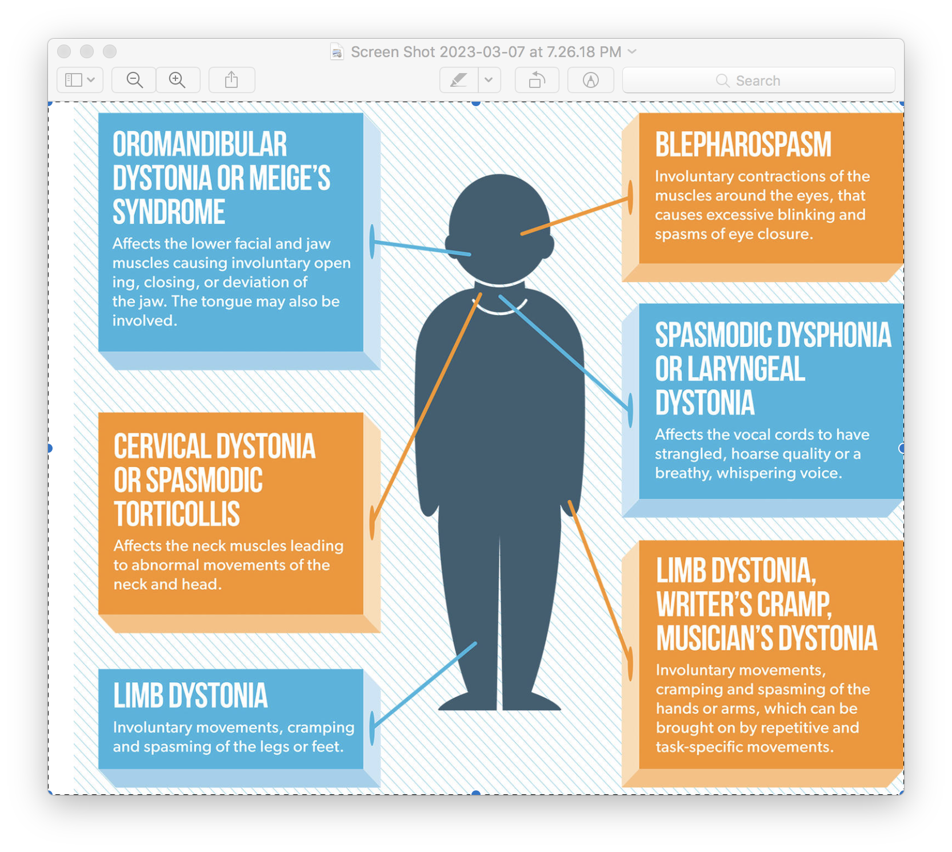
Dystonia
Acute
Particularly higher start doses or with dose increases
Danger of respiratory/laryngeal dystonia
Treat with diphenhydramine or benztropine
https://www.michaeljfox.org/news/dystonia

Slide 53
Extrapyramidal/ Parkinsonism
Cogwheel
Mild tremor

Slide 54
Akathisia
Feeling of internal restlessness or jitteriness
In youth often found with new hyperactivity or fidgetiness.
Suspect when report these symptoms or if symptoms get worse as you increase the antipsychotic medication.

Slide 55
Tardive Dyskinesia
https://sjrhem.ca/tardive-dyskinesia-in-an-emergency-setting/

Slide 56
Abnormal Involuntary Movement Scale

Slide 57
AIMS sample
https://aapp.org/ed/movement-disorders

Slide 58
Neuroleptic Malignant Syndrome
Rigidity
change in mental status
CK elevation
vital sign / autonomic instability

Slide 59
QTC Prolongation
High risk :
Ziprasidone
Lower risk:
Aripiprazole & Latuda
*Use of other meds
https://www.mayoclinic.org/diseases-conditions/long-qt-syndrome/multimedia/prolonged-q-t-interval/img-20007972

Slide 60
Torsades de pointes
https://first10em.com/torsades-de-pointes/

Slide 61
Antipsychotic Prescribing #4
Follow up

Slide 62
New Psychiatric Medication on Board? What to Watch for:
Which side effects should remit over time?
Which side effects need to be reported to parent/prescriber?
Which, if any, would warn of potential medical emergency?
Sedation
Impaired concentration
GI disturbance
Headache
Restlessness
Muscle spasm/tics
Activation
Jitteriness
Dry mouth
Blurred vision
Constipation or diarrhea

Slide 63
Every Medical Visit
Adherence
Side effects
Benefits
Psychosocial issues– Team work

Slide 64
Follow up?
Monthly BMI first three months than quarterly
Repeat blood pressure
Fasting labs (glucose, lipids, LFT) at 6 months and again at 1 year
Annual monitoring of waist circumference
More frequent monitoring as clinically indicated

Slide 65
Polypharmacy Issues
Step-wise adjustments whenever possible
Attention to contraindications (ex. Clarithromycin and Ziprasidone)
Optimize before adding (dose and duration)
Re-assess ineffective medication
Consider if partial response vs treatment refractory

Slide 66
Non-Responses to AP
Reassess the diagnosis and treatment plan.
Seek psychopharm consultation (e.g. from BHIPP or a medical director etc…)
When switching to another antipsychotic it is typically advantageous to go slowly if clinically possible
A cross-over titration/tapering is typical for antipsychotic switches.

Slide 67
Medication Administration Tips
Certain medications should be given with food: Geodon (ziprasidone), Latuda (lurasidone), etc.
Others should be taken without food or drink: Saphris (asenapine); dissolve under tongue
When switching AP may taper and titrate to switch
Close attention should be paid to formulation: longer-acting vs immediate release, rapidly dissolving formulations, etc.
Some tablet or capsule shells may be seen in feces: (Invega etc.)

Slide 68
Overview
Indications for various SGAs for schizophrenia and Bipolar1 (except Latuda’s approval is for BPAD depressed)
Safety monitoring: weight/height, fasting labs (glucose, cholesterol/lipids, liver function) at baseline and follow up; ECG for some medications
Risk of new onset diabetes, metabolic syndrome and weight gain; less commonly tardive dyskinesia (irreversible)
Non-adherence is common (consider restart dosing)
Medication titration often necessary
Watch for early onset side effects: sedation, constipation, dry mouth, movement disorders
Medication trial usually 4-6 weeks to see greatest response

Slide 69
Summary
Many steps to prescribing
Collaborative biopsychosocial evaluation and diagnosis
Follow evidence-based standards of care
Establish baseline symptoms and monitor side effects and adherence

Slide 70
Thank you!
Maryland Behavioral Health Integration in Pediatric Primary Care (BHIPP)
1-855-MD-BHIPP (632-4477)
www.mdbhipp.org
Follow us on Facebook, LinkedIn, and Twitter! @MDBHIPP
Notes:
You will receive a copy of these slides

