Slide 1
Acute Care of Eating Disorders in Pediatric Primary Care
Shauna Reinblatt, MD, DFAPA, DFAACAP

Slide 2
Disclosures
No potential conflicts of interest
Faculty at the University of Maryland School of Medicine
This presentation aims to help present general teaching options for typically presenting Eating Disorders in youths but does not represent clinical guidance nor is it meant to substitute your clinical decision making or judgment.

Slide 3
Learning Objectives
By the end of this session, you will be able to identify:
Three indications for a higher level of care for eating disorders
Three psychiatric reasons for high mortality within eating disorders
Three medical causes contributing to high mortality within eating disorders

Slide 4

Public Health Importance of Eating Disorders
Highest morbidity and mortality of pediatric mental health disorders (premature death).
Highest risk of suicide of mental health disorders in youth (up to 18x compared with matched controls).
Notes:
6x risk suicide

Slide 5

Prevalence (Adolescence)
Binge Eating Disorder (BED): Males 0.8%; Females 2.3% ----→1.6% overall
Bulimia Nervosa (BN): Males 0.5%; females 1.3%------→0.9% overall
Anorexia Nervosa (AN): Males 0.3%; Females 0.3% -----→0.3% overall
Swanson SA et al. Arch Gen Psych 2011 July 68(7)

Slide 6
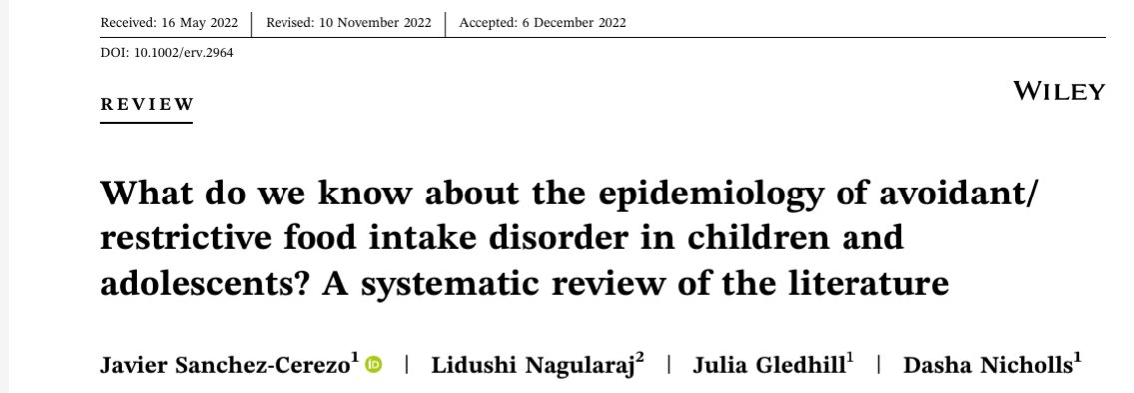
Prevalence Rates Avoidant/Restrictive Food Intake Disorder (ARFID)
-----> 0.3% to 16% in non-clinical samples (Eur Eat Disorders Rev 2023; 31-226)
Largest community based prospective study of ARFID 24 months (Canadian): 2.02/100,000 prevalence (Katzman JAMA Peds 2021)
Between 0.5%-5% children and adults in the general population (USA) https://www.nationaleatingdisorders.org/avoidant-restrictive-food-intake-disorder-arfid/

Slide 7

Pediatric Eating Disorders & Primary Care Pediatrics
American Academy of Pediatrics (AAP)
suggests screening for eating disorders
Pediatricians are often the first to encounter youth with symptoms of eating disorders (EDs). Early ED recognition of may help the prognosis.
Pediatricians have a role to play in treating the patient and monitoring refeeding– but also referring to and communicating with the parents and the team --- the nutritionist and therapist (and ED psychiatrist).
By understanding the presentation and screening for EDS it will enhance the ability to identify acute and common signs and symptoms
(Rome et al.,2003)

Slide 8
ARFID & Pediatric Primary Care
Pediatricians are often the first to encounter youth with symptoms of ARFID
American Academy of Pediatrics suggests screening for eating disorders; When do yearly follow up of growth curve, might raise flags?
Up to half of the children with ARFID have medical and psychiatric comorbidities and may be seen in pediatric specialists’ offices as well (Grubb JAMA Peds, 2021)
Decreased energy and growth occurs at an important time developmentally when the child needs it in preadolescence/adolescence (not just picky eating)
AAP Policy Statement Jan 2003 Pediatrics

Slide 9
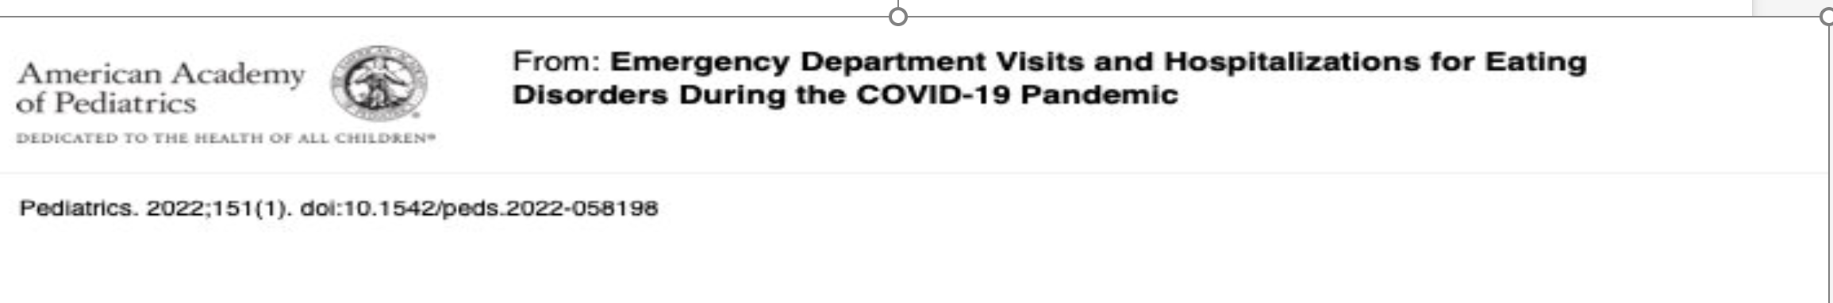
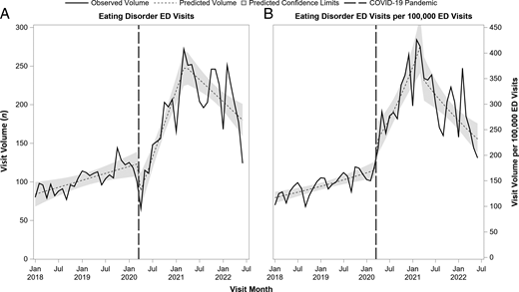
Emergency Department Visits and Hospitalization for Eating Disorders During COVID-19
"Emergency Department visits and Hospitalizations for Eating Disorders (EDs) during the COVID Pandemic" Pediatrics 2022; 151(1).
N=8010; monthly ED visit volume (n) to Pediatric Hospitals over 54 mos. in USA with reference line (March 2020) indicating COVID-19

Slide 10
Screening/Assessment Basics
1. Weight: highest #, lowest #, ideal #/wish (for current developmental stage)/growth curve
  SCALE: in view vs out of sight?
  Frequency of weighing?
2. Shape: What are thoughts about your body shape or how they look in mirror
Weight
Shape

Slide 11
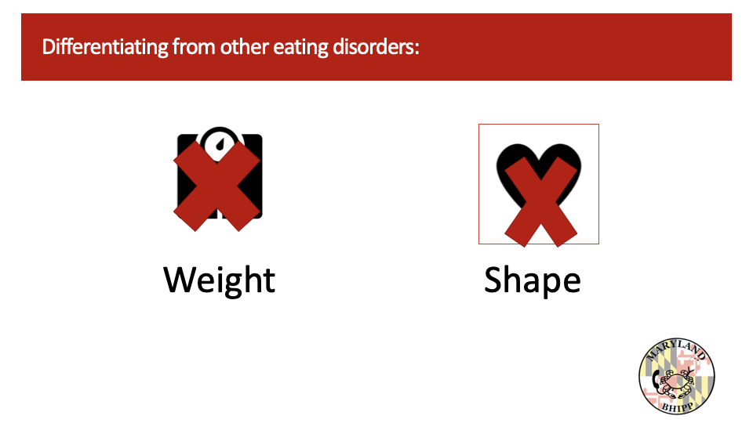
Pediatric Eating Disorders - Body Image
 | BODY IMAGE DISTURBANCE | NO BODY IMAGE DISTURBANCE
 | Anorexa Nervosa (AN) | Avoidant/Restrictive Food Intake Disorder (ARFID)
 | Bulimia Nervosa (BN)
 | Binge Eating Disorder (BED)
Weight
Shape

Slide 12
 | Anorexia Nervosa | Bulimia Nervosa | Binge Eating Disorder
Weight | Underweight | Normal Range or Overweight/ Obese | Normal Range or Overweight/ Obese
Shape | Overvaluation | Overvaluation | Overvaluation mainly
Eating behaviors | Restricting vs Purging | Restricting vs Purging | Bingeing
Associated Symptoms (Compensatory Behaviors) | Fasting vs Purging (Compensatory Behavior) | Binge & Purge (Compensatory Behavior) | Binge (NO Compensatory Behavior)

Slide 13
Screening /Assessment Basics (Continued)
3. Associated behaviors/ details:
Restrict to lose weight? Vs Purge:
  “Get rid “ of the food you eat? (e.g., purge, Laxatives , excessive exercise)
  Feelings of losing control overeating (frequency too)

Slide 14
What about ARFID?
Pattern of eating limited in variety and/or amount, which is often associated with medical and psychiatric sequalae.
Not just occasional picky eating.
Not due to lack of available food
Not motivated by fear of weight gain nor shape concerns.
If co-occurring with a medical or psychiatric problem must be severe enough to require attention in and of itself.
Lack of Interest
Fear of Aversive Consequences
Food Selectivity & Sensory Sensitivity

Slide 15
Some Basic Screening Questions for ARFID:
What reason does youth give for not eating (r/o shape and weight concerns)
What does youth think of weight loss?
Food avoidance / Neophobia (fear of new foods)
Nausea or early satiety/abdominal pain
Fear of choking, gagging or vomiting when eat or fear of having an allergic reaction

Slide 16
Eating Disorders and Psychiatric Comorbidity
Psychiatric comorbidities most often encountered with EDs are:
ADHD
Anxiety
Depression
OCD
Commonly comorbid with ARFID:
ADHD, Autism Spectrum and/or Anxiety disorders
Screen for ADHD and other comorbidities like anxiety
Screen for past or current Neuropsychiatric Disorders such as history of autism or developmental history of social and other deficits?

Slide 17
How Else Can Eating Disorders Manifest Acutely?
Pediatric /PCPs can see multiple somatic symptom presentations
In multiple body systems..:
GI (abdominal pain, motility issues, vomiting, diarrhea, GERD, Constipation …)
Cardiac (chest pain, dyspnea, sycope, palpitations …)
Psychiatric (suicidal ideation, Obsessive compulsive symptoms, anxiety ….)
With differential diagnoses.

Slide 18

Medical Complications
Metabolic – hypokalemia, hypoglycemia, hypophosphatemia
Cardiovascular – bradycardia, hypotension, orthostasis
Musculoskeletal – osteoporosis
GI – constipation, GERD
Endocrine – amenorrhea, sick euthyroid
Immunologic suppression
Neuro – seizures (e.g., water loading)
MANY BODY SYSTEMS

Slide 19
Atypical Cases that can Present Urgently
Youth with Diabetes type 1
Males
GI complaints (bloating and GI motility)
Menstrual disturbances
Unexplained Liver dysfunction, electrolyte imbalances and hypoglycemic
Bradycardia

Slide 20
Red Flags Eating Disorders (Psychiatric and Medical)
New reduction in intake or cutting out foods
New intense exercise
Newly using the bathroom much more? Purging
New preoccupation with weight and shape
New psychiatric symptoms (obsessions, etc.)
New lab work findings (new hypokalemia?)
New physical exam findings (bradycardia, parotid enlargement, falling off growth curve, Callus on hands)

Slide 21
Warning Signs of ARFID
Fear of chocking or vomiting
Sudden refusal to gain weight
Sudden refusal to eat foods that were previously eaten
Losing appetite for unclear reasons
Not gaining weight anymore or growing

Slide 22
Screeners
Sick, Control, One, Fat, Food (SCOFF)
Eating Disorder Screen for Primary Care (ESP)
Nine Item Avoidant/Restrictive Food Intake Disorder Screen (NIAS)

Slide 23
SCOFF Questionnaire
Do you make yourself Sick because you feel uncomfortably full? Do you worry you have lost Control over how much you eat? Have you recently lost > 1 Stone (14 lbs) in a 3-month period? Do you believe yourself to be Fat when others say you are too thin? Would you say that Food dominates your life? Scoring: 1 point for every affirmative answer; if >=2 possible Eating Disorder symptoms; warrants further evaluation Morgan JF, Reid F, Lacey JH. The SCOFF questionnaire: assessment of a new screening tool for eating disorders. BMJ 1999; 319:1467

Slide 24
Eating Disorder Screen for Primary Care (ESP)
Are you satisfied with your eating patterns? Do you ever eat in secret? Does your weight affect the way you feel about yourself? Have any members of your family suffered with an eating disorder? Do you currently suffer with or have you ever suffered in the past with an eating disorder? Scoring: Affirmative screen =“no” answer for question 1 and “yes” answer for all other questions; If >=3 ->high likelihood of an Eating Disorder
Cotton MA, et al. Four Simple Questions Can Help Screen for Eating Disorders. J Gen Intern Med 2003.

Slide 25
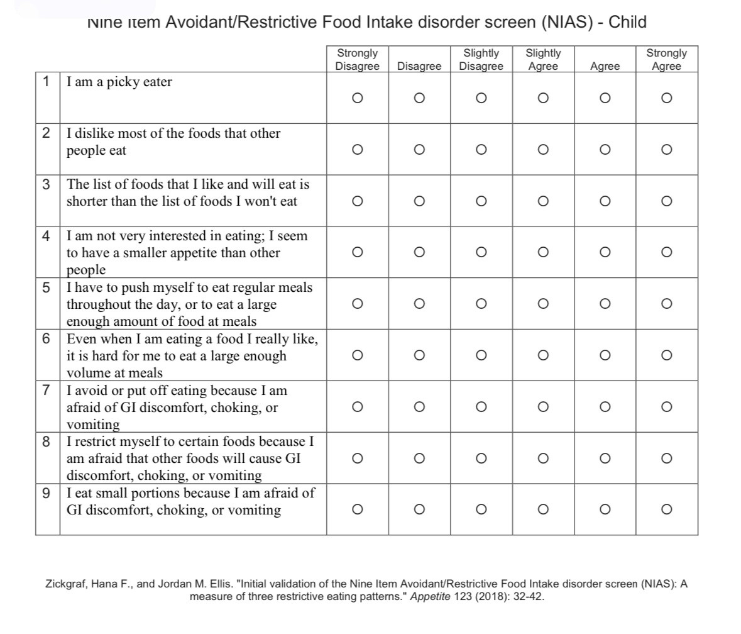
Nine Item Avoidant/Restrictive Food Intake Disorder SCREEN (NIAS)
Range of scores for subscales
(0 to 15):
Picky eating (cutoff 10)
Lack of appetite (cutoff 9)
Fear (cut off 7)

Slide 26

What can you do if you think there is an ED:
Safety Assessment (Psychiatric and Medical)
Psychiatric vs medical safety (e.g., physical exam findings)
Suicidal ideation, Self-Injurious Behaviors? (e.g., lethality, plan)
Danger to others?
Purging: several times a week vs sporadic? (k+/ lytes)
Symptomatic Vital sign changes?
How low is BMI/weight?
Brief symptom screens and working diagnoses help focus the treatment plan and to prioritize evaluating medical and psychiatric stability.
Consider Screeners such as for mood or anxiety or ADHD and suicidality (like Columbia suicide screener)

Slide 27
Psychiatric and Medical Factors that Increase the Risk of Morbidity/Mortality in ED patients:
PSYCHIATRIC FACTORS associated with high morbidity/ mortality:
  Suicidal thinking
  Depression
  Poor insight into illness and need for treatment , leading to ambivalence or refusal to comply with the treatment.
  More than mild (1-3 times weekly) purging leading to electrolytic abnormalities (thus cardiac arrythmia risk etc)
-----> Anorexia with purging has very high morbidity/mortality risk.
MEDICAL FACTORS associated with high morbidity/ mortality:
  Hypokalemia with purging; risk of arrythmia
  Bradycardia and syncope
  Increased QTc or other arrythmia or orthostasis
  Hypoglycemia with refeeding
  --->DM Type 1 with AN has much greater mortality than either disorder alone

Slide 28
Refeeding Syndrome
A clinical and metabolic derangement that can occur during the refeeding of a malnourished patient, and can cause fluid shifts and potentially fatal electrolytic shifts
Hypophosphatemia is typically seen. Electrolytic shifts (phosphorus, Potassium, Magnesium) can within 5 days of nutrition -- can be mild to moderate severity.
Also monitor glucose: can have postprandial hypoglycemia sometimes
Highest risk are those with:
Malnourishment: Highest risk for youth < 70% treatment goal weight & Increase risk if history of significant alcohol intake
Rapid weight loss regardless of weight (including post bariatric surgery)
No or negligible intake for > 7 days
A history of misuse of medications to purge or lose weight
Abnormal pre-feeding electrolyte results
Younger age

Slide 29
First Line Action Options for Suspected Eating Disorder
Building a relationship with the patient and family
Blood pressure (lying and standing), pulse.
Temperature, weight (kg),
Possibly electrocardiogram.
Bloodwork: full blood count, urea and electrolytes, liver function tests, bone profile, phosphate, glucose, thyroid function tests, magnesium, creatine kinase.
Assessment and management of medical emergencies in eating disorders: guidance for GPs. Mughal F , De Lusignan S, Schmidt U et al. British Journal of General Practice 2023; 73

Slide 30
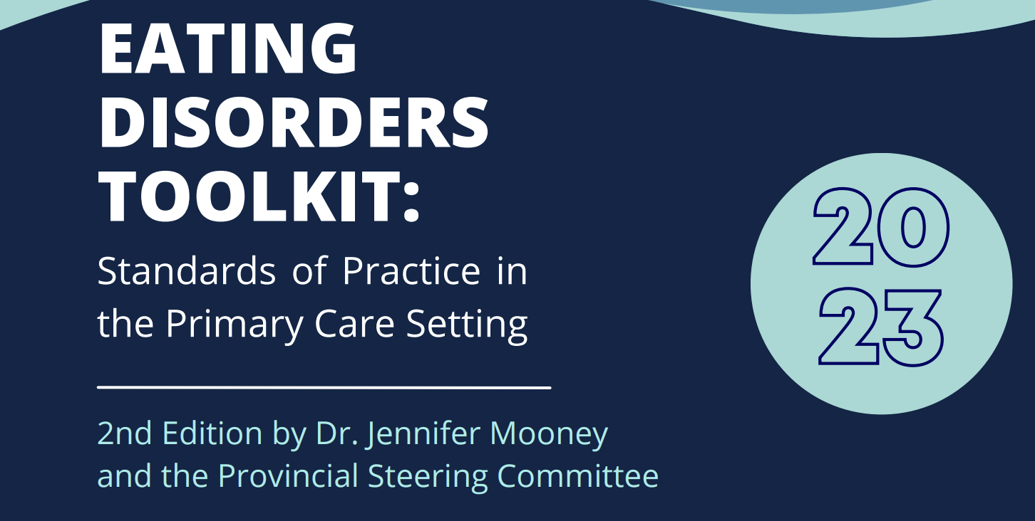
Eating Disorders Toolkit
chrome-extension://efaidnbmnnnibpcajpcglclefindmkaj/https://ubccpd.ca/sites/default/files/documents/Eating-Disorders-Toolkit-for-PCP-2018

Slide 31
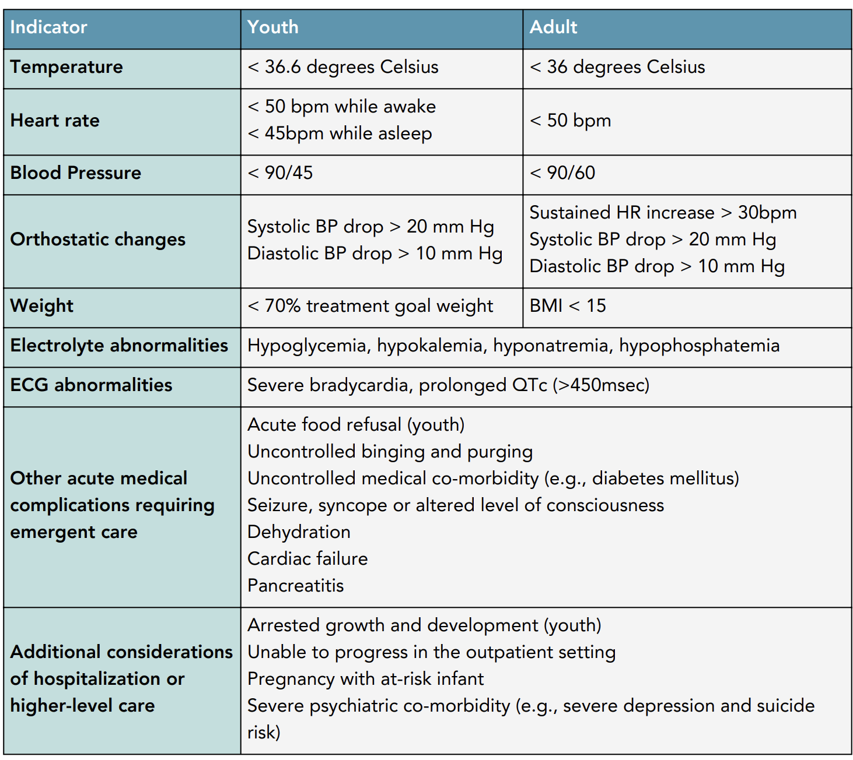
When might Medical Evaluation/Stabilization be Indicated (i.e., Inpatient /Higher Level of Care)?

Slide 32
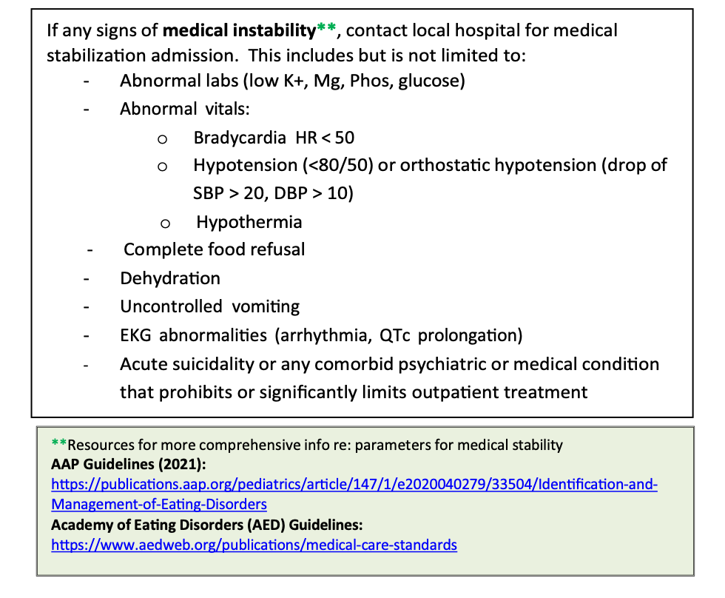
Medical Instability
Partain et al. Pediatrics; vol 152(5); Nov 2023.

Slide 33
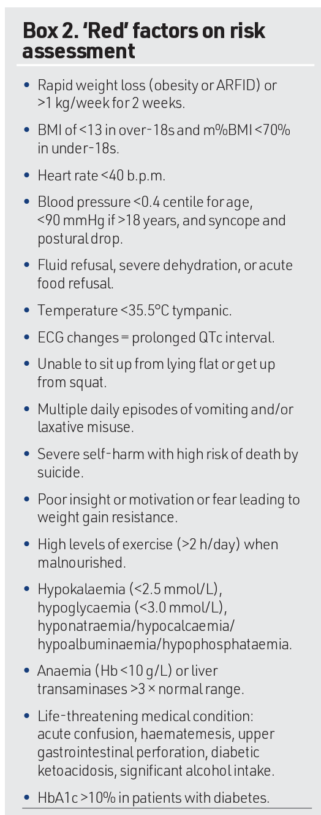
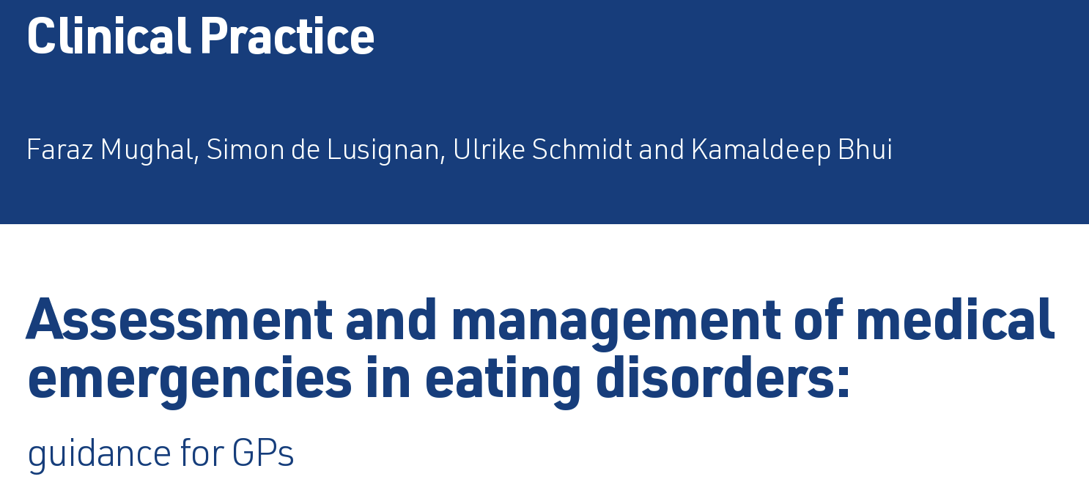
Assessment and Management of Medical Emergencies in Eating Disorders
Red Factors are risk factors that a higher level of care may be indicated as are referred to—
British Journal of General Practice 2023; 73: 232–233. DOI: https://doi.org/10.3399/bjgp23X732849

Slide 34
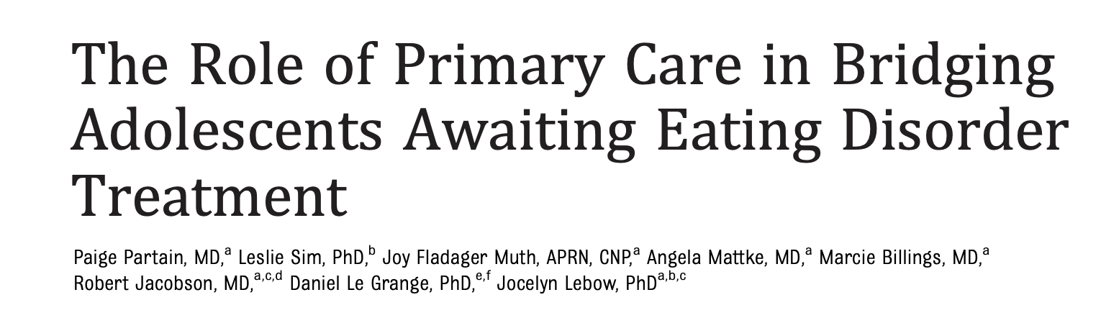
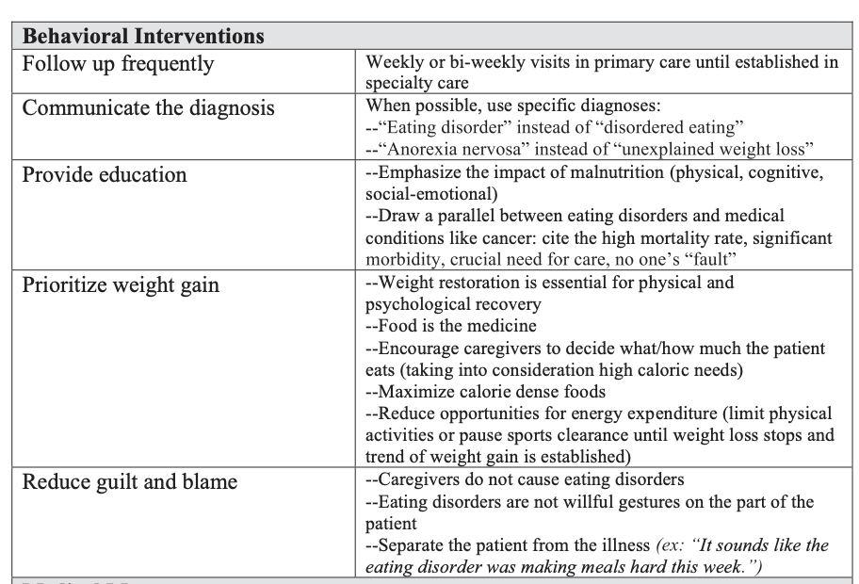
Pediatrics; vol 152(5); Nov 2023.

Slide 35
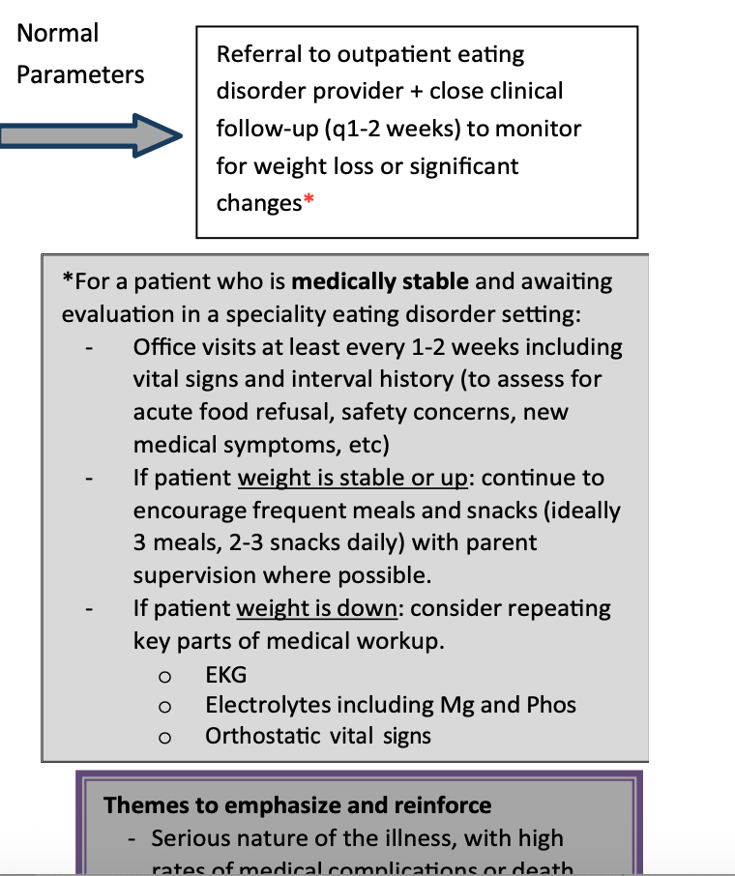
Pediatrics; vol 152(5); Nov 2023.
symptoms,
Pediatrics; vol 152(5); Nov 2023.

Slide 36
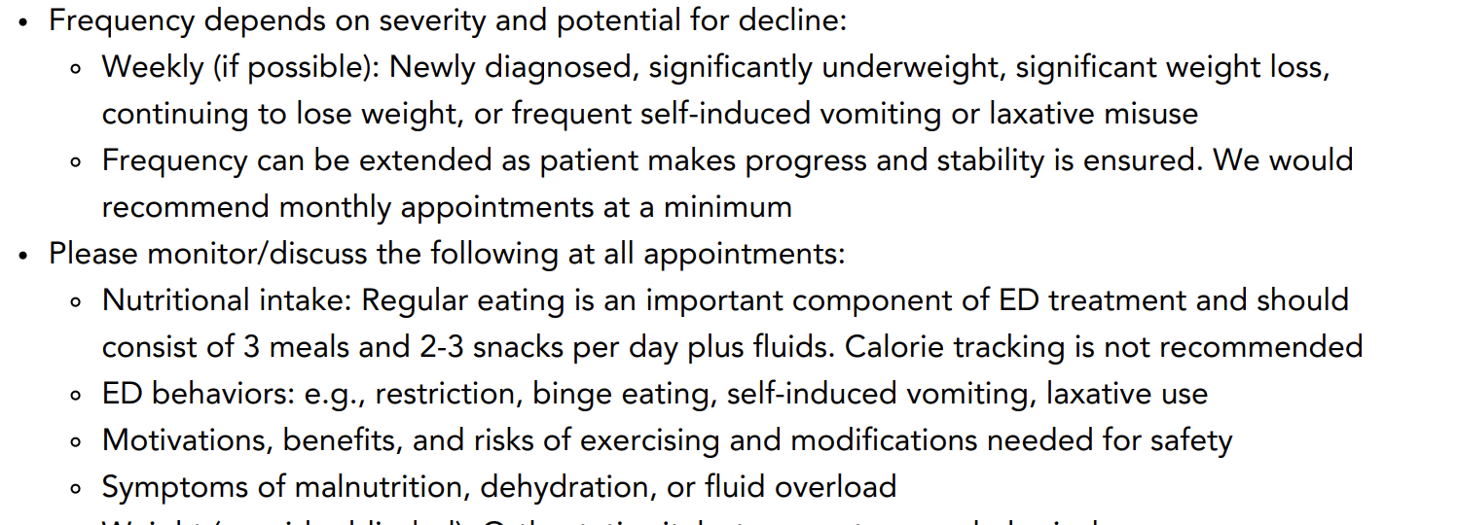
Acute Medical Monitoring/Bridging Care for ED at Outpatient Level: Examples of Frequency and Content (BC Toolkit)
SUICIDAL THOUGHTS and Safety concerns: Review suicidal ideation, lethality, plan....
In conjunction with the nutritionist aim 0.5 lb (to 1 lb MAX a week) if possible as outpatient if underweight, and follow for refeeding

Slide 37
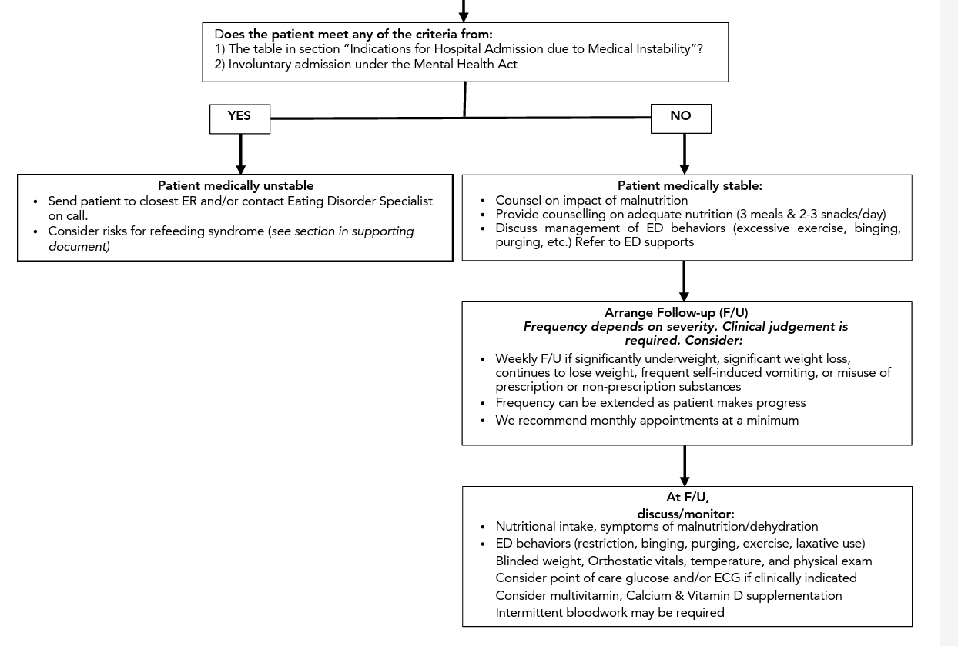
Idea of Toolkit from Canada a re; Management as a Clinical judgement flowchart option in BC, Canada

Slide 38
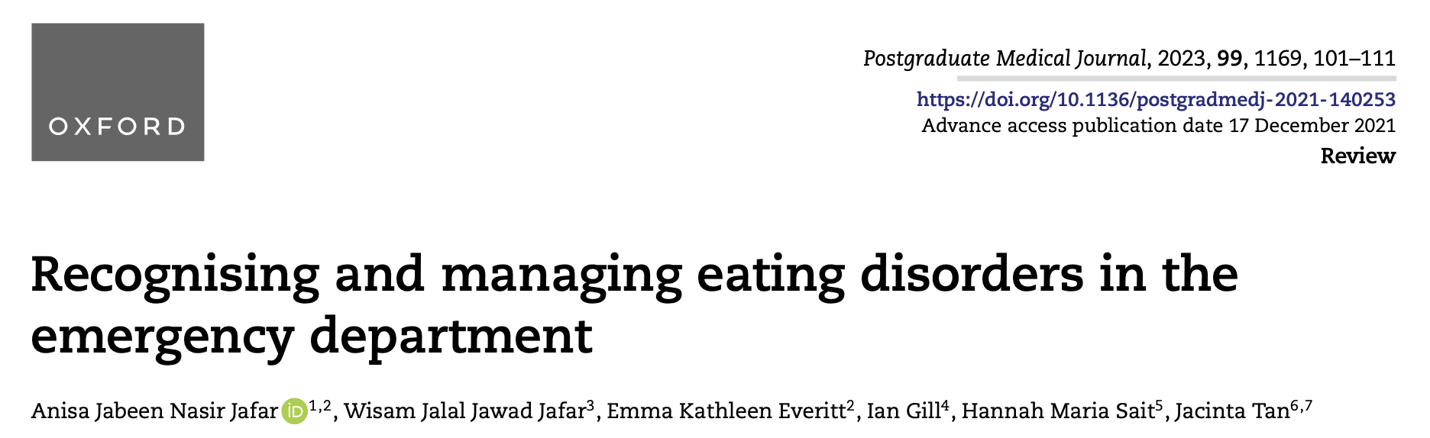
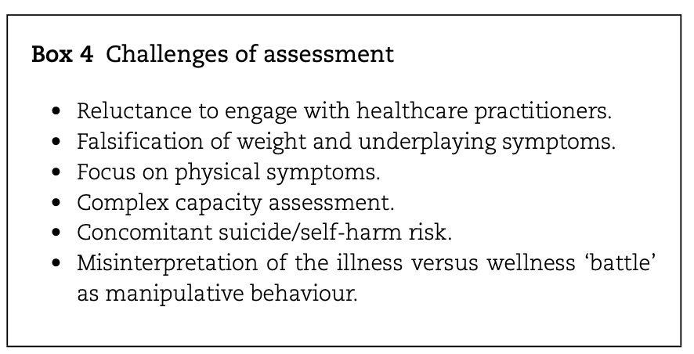

Slide 39
Other Psychological Approaches
Using tools from motivational interviewing:
Empathy
Engage youth
Validate emotions
Support change
Engage parents to avoid splitting and help with Family Based Approach (FBT) with ED therapist preferably
Support from family for appropriate meals with help from nutritionist

Slide 40
Anorexia Nervosa- What can the PCP do?
If outpatient, while awaiting referral to specialist or inpatient:
Promote a team approach (nutritionist, therapist).
Refer to Nutritionist: Slower refeed but we still monitor refeeding syndrome →Monitoring LFTs, rebound low glucose and hydration.
Refer to Therapist: CBT in adults vs family-based treatment in youth
Screen for Medical Complications: If purging type, monitor lytes prn
Screen for Psychiatric safety: (Suicidal ideation/plan as reviewed earlier) Attia et al AmJ Psych 2019; Klein et . Am Fam Phys2021; 103(1)

Slide 41
What can a PCP do if ARFID or Another Restrictive Disorder is Thought to be Present?
Evaluate how severe the low weight is and evaluate medically to be sure there is no underlying cause and also if a nutritional supplement may be needed.
Evaluate the level of care (safety concerns)
Refer to a nutritionist (experienced in eating disorders)
Refer to a therapist (experienced in eating disorders)
Treat psychiatric comorbidities and consider referral to a psychiatrist

Slide 42
Bulimia Nervosa(BN)- What can a PCP do?
If outpatient, while awaiting referral to specialist or inpatient:
Screen for medical complications such as electrolyte abnormalities or EKG /cardiac issues. Also other somatic complications such as (caries from purging etc)
Refer to Nutritionist experienced in BN
Refer to Therapist experienced in BNCompensatory mechanisms (like purging) and weight loss
Screen for Psychiatric safety (basic assessment questions)
Promote a team approach

Slide 43
Binge Eating Disorder (BED)- What can a PCP do?
If outpatient, while awaiting referral to specialist or inpatient:
Refer to Nutritionist: Intake
Screen for medical complications of overweight/obesity
Refer to Therapist (someone experienced in eating disorders)
Screen for psychiatric safety (basic assessment questions)
Promote a team approach

Slide 44
Take Home Points
The three most common eating disorders typically feature some type of preoccupation with weight and shape concerns (unlike ARFID). Also reviewed compensatory mechanisms
Factors increasing need for inpatient level of care include: low weight under 70%ile ideal body weight, cardiac complications (e.g., long QTc), frequent purging, risk for refeeding syndrome
Risk factors for increased mortality with EDs include Suicidal ideation presence, frequent purging, , and especially AN-Binge/Purge subtype These are all acute safety concerns to address.
Other medical risk factors include: refeeding syndrome (including low glucose), low potassium, QTc or bradycardia, electrolyte abnormalities among others.
Also much increased mortality of DM type 1 with AN.

Slide 45
References
Swanson SA, Crow SJ, Le Grange D, Swendsen J, Merikangas KR. Prevalence and correlates of eating disorders in adolescents. Results from the national comorbidity survey replication adolescent supplement. Arch Gen Psychiatry. 2011 Jul;68(7):714-23. doi: 10.1001/archgenpsychiatry.2011.22. Epub 2011 Mar 7. PMID: 21383252; PMCID: PMC5546800.
Morgan JF, Reid F, Lacey JH. The SCOFF questionnaire: assessment of a new screening tool for eating disorders. BMJ 1999; 319:1467
Cotton MA, et al. Four Simple Questions Can Help Screen for Eating Disorders. J Gen Intern Med 2003.
Shapiro JL, Woolson SL, Hamer RM et al. Evaluating binge eating disorder in children: development of the Children's Binge Eating Disorder Scale (C-BEDS). Int J Eat Disord 2007 Jan 40(1): 82-9.
American Psychiatric Association (2013) Diagnostic and Statistical Manual fo Mental Disorders, 5th ed. DSM-5.
Rome ES, Ammerman S, Rosen DS, Keller RJ, Lock J, Mammel KA, O'Toole J, Rees JM, Sanders MJ, Sawyer SM, Schneider M, Sigel E, Silber TJ. Children and adolescents with eating disorders: the state of the art. Pediatrics. 2003 Jan;111(1):e98-108. doi: 10.1542/peds.111.1.e98. PMID: 12509603.
Tanofsky-Kraff M, Goossens L et al. A Multisite Investigation of Binge Eating Behaviors in Children and Adolescents. J Consult Clin Psychol. Dec 2007: 75(6): 901-913.
Eating disorders ToolKit BC Canada: verified May 5, 2025
chrome-extension://efaidnbmnnnibpcajpcglclefindmkaj/https://ubccpd.ca/sites/default/files/documents/Eating-Disorders-Toolkit-for-PCP-2018
Partain et al. The Role of Primary Care in Bridging Adolescents Awaiting Eating Disorders Treatment. Pediatrics; vol 152(5); Nov 2023.
Jafar et al. Recognizing Eating disorders in the Emergency Department. Postgraduate Medicine 2023; 99; 1169.
Mughal et al. Assessment and Management of Eating disorders in the Emergency Department. British Journal of General Practice 2023; 73: 232–233

Slide 46
Thank You!
Maryland Behavioral Health Integration in Pediatric Primary Care (BHIPP)
1-855-MD-BHIPP (632-4477)
www.mdbhipp.org
Follow us on Facebook, LinkedIn, and Twitter! @MDBHIPP

