Slide 1
Suicide Prevention: Standard Operating Procedures for the Primary Care Office Mary Cwik, PhD Meghan Crosby Budinger, LCPC

Slide 2
Who We Are – Maryland BHIPP
Offering support to pediatric primary care providers through free:
Telephone consultation (855-MD-BHIPP)
Resource & referral support
Training & education
Regionally specific social work co-location (Salisbury University and Morgan State University)
Project ECHO®
Direct telemental health services:
Care coordination
Psychiatry
Psychology
Counseling
Notes:
Maryland Behavioral Health Integration in Pediatric Primary Care or BHIPP is a Child Psychiatry Access Program that supports the capacity of primary care providers in Maryland to manage pediatric mental health concerns.
BHIPP offers free behavioral health telephone consultation, resource and referral networking, training and educational opportunities, Web-based longitudinal learning through Project ECHO, telemental health services, care coordination, and social work co-location in select primary care practices in collaboration with Salisbury University (SU) and Morgan State University (MSU).
BHIPP also recently received additional funding to expand warmline consultation services to select hospital Eds, and to provide Technical Assistance to select primary care practices with goal of practices becoming mental health hubs.

Slide 3
Partners & Funding
BHIPP is supported by funding from the Maryland Department of Health, Behavioral Health Administration and operates as a collaboration between the University of Maryland School of Medicine, the Johns Hopkins University School of Medicine, Salisbury University, Morgan State University, and the University of Maryland Eastern Shore.
This program is supported by emergency COVID funding from the Substance Abuse and Mental Health Services Administration (SAMHSA).
BHIPP is also supported by the Health Resources and Services Administration (HRSA) of the U.S. Department of Health and Human Services (HHS) as part of an award totaling $433,296 with approximately 20% financed by non-governmental sources. The contents of this presentation are those of the author(s) and do not necessarily represent the official views of, nor an endorsement, by HRSA, HHS or the U.S. Government. For more information, visit www.hrsa.gov.

Slide 4
Disclosures
None

Slide 5
Learning Objectives
1) Describe the rationale for screening for suicide in pediatric care settings
2) Select appropriate screening tools for evaluating suicidal ideation in pediatric primary care
3) Create standard operating procedures for suicide prevention in a pediatric care setting

Slide 6
Suicide in the United States
Over 48,000 Americans die by suicide each year (CDC, 2021)
11th leading cause of death (CDC, 2021)
Suicide surpassed motor vehicle accidents as leading cause of injury-related death (Rockett, 2012)
Provisional data from CDC’s National Center for Health Statistics indicate that both the number and the rate of suicides in the United States increased 4% from 2020 to 2021, after two consecutive years of decline in 2019 and 2020.
The largest increase in the rate of suicide occurred among males ages 15-24 – an 8% increase (CDC, Press release: September 30, 2022)

Slide 7
Youth Suicide in the U.S.
Serious public health threat
2nd leading cause of death for youth ages 10-14 years
3rd leading cause of death for ages 15-24
6,642 suicide deaths among U.S. youth in 2020
,900 suicide deaths among U.S. youth in 2013
CDC WISQARS, 2020

Slide 8
Youth Suicide in the US, trends over time
Death rate per 100,000
Crude rate
Ages 10-24
CDC WISQARS, 2020

Slide 9
Younger Children and Suicidality
Children under 12 yrs plan, attempt and die from suicide
2nd leading cause of death for 12-year-olds
6th leading cause of death for children 12 and under
2016 (underestimates)
5-14 yr olds
443 deaths
121 were 12 and under
CDC 2012; Tishler, Reiss, & Rhodes, 2007; Natl Vital Stat Rep, 2006; CDC WISQARS, 2020

Slide 10
CDC: Suicide Rates, Ages 10–24 Years, by Race/Ethnicity and Sex, United States, 2020
CDC, WISQARS, 2020

Slide 11
Increase in Hanging/Suffocation in the US, 2000-2010, Baker et al., 2013

Slide 12
Suicidal Behavior
~2 million young people attempt suicide annually
8.5% of high school students made an attempt
Prevalence range: (5.5-14.3)
3% made an attempt resulting in medical treatment
Prevalence range: (1.4 – 5.6)
ED visits for attempted suicide in children <14 is same as adults >50
SAMHSA, 2012; CDC, 2014

Slide 13
Suicidal Ideation
Youth
In 2013:
2.5 million (17%) high school students reported “seriously considered suicide” in the past 12 months
Prevalence range: (12.0% – 19.2%)
2 million (13.6%) high school students made a plan
Prevalence range: (9.8% – 17.4%)
12% of children ages 6 to 12 have suicidal thoughts
CDC, 2013, 2014; SAMHSA, 2012

Slide 14
Suicide Prevention: Key Elements of Office SOPs
Screen
Assess risk level
Safety plan

Slide 15
Why screen in primary care?
Majority of those who die by suicide have contact with a medical professional within 3 months of killing themselves
80% of adolescents contact within 3 months
50% of youth had been to ED within 1 year
Frequently present with somatic complaints
For those at risk for suicide, a visit with their PCP may be the best opportunity to access intervention.
Ahmedani, B. K., Simon, G. E., Stewart, C., Beck, A., Waitzfelder, B. E., Rossom, R., Solberg, L. I. (2014). Health care contacts in the year before suicide death. Journal of General Internal Medicine, 29(6), 870–877.
Suicide Prevention Resource Center

Slide 16
Who should we screen for suicide risk?
Several studies have refuted myths about iatrogenic risk of asking youth questions about suicide, such as the worry about “putting ideas into their heads.” (Suicide Risk Screening Toolkit, NIMH)
Universal screening for adolescents ages 12+ is recommended by:
USPSTF
American Academy of Pediatrics
American Academy of Child and Adolescent Psychiatry
American Foundation for Suicide Prevention
The Guidelines for Adolescent Depression in Primary Care (GLAD-PC)
Indicated screening for 8-11 yo (NIMH, Blueprint for Youth Suicide Prevention)
When there are other significant risk factors

Slide 17
Risk Factors: Key Symptoms
Ideation (Threatening to hurt or kill self)
Substance Abuse (Increased or excessive substance use)
Purposelessness (No reason for living)
Anxiety (Anxiety, agitation, unable to sleep)
Trapped (Feeling trapped - like there's no way out;)
Hopelessness (Hopelessness about the future)
Withdrawal (Withdrawing from friends, family and society)
Anger (Rage, uncontrolled anger, seeking revenge)
Recklessness (Acting reckless or engaging in risky activities)
Mood Changes (Dramatic mood changes)
American Association of Suicidology
Notes:
Command hallucinations

Slide 18
PHQ-A
Ages 11-17
Self-report, past two weeks
Modified version of Patient Health Questionnaire-9
Nine item adult depression screening and severity measure, closely related to DSM-IV criteria , (Kroenke, 2001)
Item 9: “Thoughts that you would be better off dead or of hurting yourself in some way.”

Slide 19
PHQ-9 Modified for Adolescents (PHQ-A)

Slide 20
Scoring the PHQ-A

Slide 21
Risks outside of Depression
Other psychiatric conditions at greater risk:
Substance use disorders
Schizophrenia & psychotic disorders
OCD
PTSD & trauma disorders
Anxiety disorders
Fazel & Runeson, 2020, NEJM

Slide 22
Suicide Prevention: Key Elements of Office SOPs
Screen
Assess risk level
Safety plan

Slide 23
The Big Question
Do the patient and their parent/guardian(s) feel that they can keep from seriously harming themselves with appropriate supervision and do the parents/caregivers feel that they can provide adequate supervision to keep their child safe?
If yes – proceed to safety planning
After safety planning, reconsider the above question to ensure that all parties feel the safety plan can be realistically followed
If no – further evaluation is needed immediately
Consider ED (or alternate setting) referral
Notes:
Appropriate = the typical amount of supervision that is developmentally appropriate for a kid

Slide 24
Columbia Suicide Severity Rating Scale (C-SSRS)
Provides framework for asking questions to help determine risk
Addresses full spectrum of suicidality in one instrument
Tracks frequency and severity of suicidal thoughts and behaviors over time (both rated on a 0-5)
Classifies types of ideation and behavior
Ideation: From “No ideation” to “Active Suicidal Ideation with Specific Plan and Intent”
frequency, duration, controllability, deterrents, and reasons for ideation, likelihood of attempt
Behavior: From “Absence of Suicidal Behavior” to “Multiple Attempts”
Dr. Kelly Posner

Slide 25
More on C-SSRS
Severity of Ideation Subscale
A positive answer to question 4 or 5 indicated presence of ideation with at least some intent to die in the past one month
Indicates severe risk and clear need for further evaluation and clinical management
Suicidal Behavior Subscale
Presence of ANY suicidal behavior in past three months indicates a severe risk and clear need for further evaluation and clinical management
Full C-SSRS with additional sections available
“Since last contact” version available
Additional training available through website http://www.cssrs.columbia.edu/

Slide 26
Columbia Suicide Severity Rating Scale (C-SSRS)

Slide 27
Suicide Prevention: Key Elements of Office SOPs
Screen
Assess risk level
Safety plan

Slide 28
Safety Planning
Not a no-suicide contract
Developed in a collaborative manner with child/teen
Step-wise increase in level of intervention from “within self” strategies up to ED
Hierarchically-arranged coping strategy list
Can be used as a stand-alone intervention or part of longer, more comprehensive treatment
Written document
Brief, easy-to-read format
Greg Brown & Barbara Stanley
Notes:
-Development and implementation of a safety plan IS treatment
-Should be the first intervention with a suicidal patient
-Helps to immediately enhance patients’ sense of control over suicidal urges and thoughts and conveys a feeling that they can “survive” suicidal feelings
-Similar to fire drill or rehearsal
-Although the plan is stepwise, patients need to know that if one step is unavailable that they don’t stop and wait till it is available

Slide 29
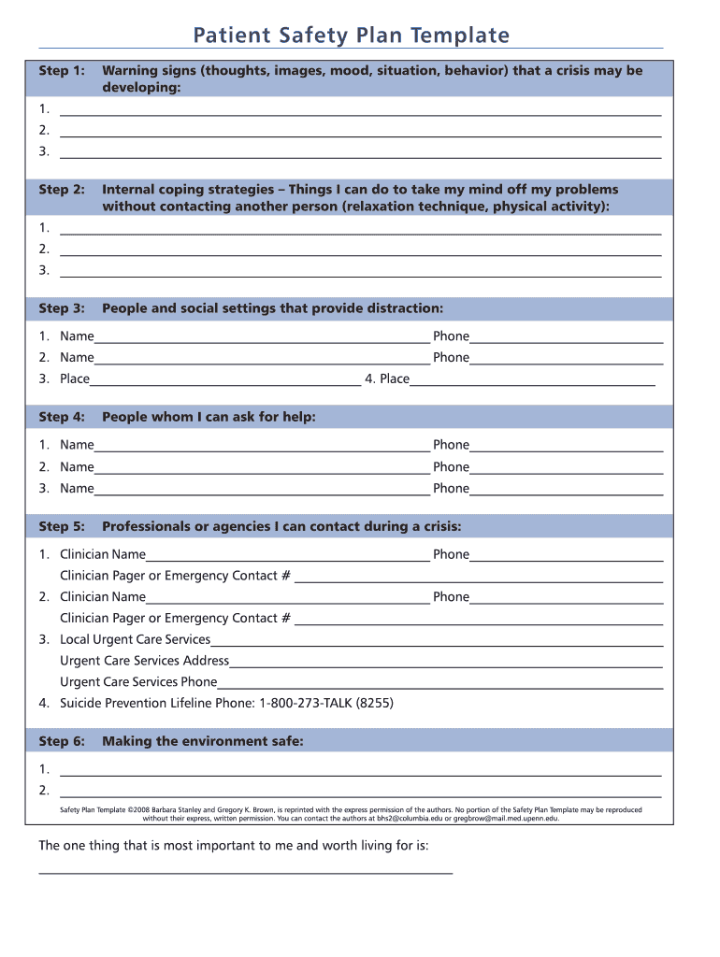

Slide 30
Notes:
Remove exacto knives, razors and scissors (Cleanse environment)
Go online and play Tetris (Internal)
Listen to IPOD (skip morbid tunes)
Go for walk in park
cont’d…………………..
Call friends to check in and as distraction: Jennifer, Amy, Joanie (External people as distractors)
6. Contact grandmother or aunt Joanie to ask for help (External---low level, natural support group)
7. Contact therapist to ask for help---Phone and Pager #’s (External)
8. Contact mother (External)
9. Go to ER---Name of closest hospital and address (External---Professional)

Slide 31
Safety Planning: Making the Environment Safe
Counseling on Access to Lethal Means (CALM)
Involve family
May be temporary
Examples:
Firearms
Ideally remove from home, lock up
Medications
Limit quantity, remove unneeded, consider less lethal alternatives, lock and parents administer
Alcohol
Ideally remove from home, lock up

Slide 32
Safety Planning: Additional Considerations for Youth
Plan for increased level of supervision at home
Limiting time left alone, increased time spent with family, social media monitoring, etc.
Parents should make this explicit
Devise a “check-in system” for parents and kids
There should be limits on both ends
Supportive concern =/= nagging
The goal is to assess safety and not (primarily) to manage parent anxiety
Fine to adopt means of checking in beyond explicit verbal statements as long as it’s predetermined
Can use codes (“red zone”) or a chart if needed

Slide 33
Comprehensive Approach to Suicide Prevention in Primary Care Office (SPRC)
Establish clear, written standardized protocols for managing when a patient presents with active suicidal ideation
Train all staff (this includes front desk, medical assistants, etc.) in the established standard protocols
Implement a “dry run” with a mock patient to ensure that the protocol can be followed seamlessly
Consider having all staff participate in an evidence-based suicide prevention training
Many available for free through your local health department
Create referral relationships with behavioral health practices that will take on pediatric patients with suicidal ideation
Keep paper and/or electronic copies of screening/assessment tools handy
Maintain up-to-date list of crisis resources
988
Local crisis services including mobile crisis teams and walk-in clinics
Emergency departments

Slide 34
Considerations when drafting your SOPs
Who
Who on your staff will call mobile crisis/911 if necessary?
Who on your staff will be responsible for the patient until they leave the office?
It is helpful if one member of the team who knows the patient and family can stay with them until they leave the office.
Ensure all staff understand that a patient with active suicidal ideation should not be left alone
Other patients may need to be rescheduled
Does anyone else need to be contacted?
Example: Medical Director
Parents/guardians of patient
Ensure you keep up to date emergency contact information on all patients.
What
What will the parent/guardian say when they arrive at the hospital?
Provide them with a print-out of your most recent encounter to take with them to the hospital.
Ideally this will detail your assessment and include a copy of any screening tools/assessments.
Have parents sign a release so you can speak to hospital staff before they leave.
What will happen after the patient leaves the office?
Example: Will the patient’s provider call the hospital to ensure they arrived?

Slide 35
Considerations when drafting your SOPs cont.
When
When can parents expect a check-in call from the provider to check on the patient?
Where
Keep an up-to-date list of local walk-in clinics and hospitals
Call ahead to alert them your patient is en route and establish contact if consultation is necessary
How
How will the patient be transported to the hospital?

Slide 36
If patient cannot stay safe
If based upon your risk assessment you feel a higher level of care is necessary to keep the youth from attempting suicide:
Share your determination with the family
Determine where patient will go
Walk-in clinic
Emergency Department
Determine how patient will be transported:
Can the parent/guardian transport them safely?
Is a mobile crisis team available to transport?
If no, call 911
Be aware that if you call 911 the youth may be transported in the back of a police car

Slide 38
Documentation
Screening/assessment results
Risk level and rationale
Treatment plan to address/reduce current risk
Firearm instructions, if relevant
Follow up plan
For youth, treatment plan should include roles for parent/guardian
Notes:
(e.g., setting, medication, psychotherapy, E.C.T., contact with significant others, consultation);

Slide 39
Questions?

Slide 40
Thank You!
Mary Cwik, PhD: mcwik1@jhu.edu
Center for Indigenous Health, Johns Hopkins School of Public Health
Meghan Crosby Budinger, MS, LCPC: mcrosbybudinger@som.umaryland.edu
Maryland Behavioral Health Integration in Pediatric Primary Care (BHIPP)

