Slide 1
Maryland Behavioral Health Integration in Pediatric Primary Care (MD BHIPP) Friday, April 14th, 2023 Autism Spectrum Disorder and the PCP’s Role in Coordinating Care Antonia Girard, PsyD, BCBA, LBA
Maryland BHIPP Resilience Break Presentation
855-MD-BHIPP (632-4477)
www.mdbhipp.org
Follow us on Facebook, LinkedIn, and Twitter! @MDBHIPP

Slide 2
Who We Are – Maryland BHIPP
Offering support to pediatric primary care providers through free:
Telephone consultation (855-MD-BHIPP)
Resource & referral support
Training & education
Regionally specific social work co-location (Salisbury University and Morgan State University)
Project ECHO®
Direct Telespsychiatry & Telecounseling Services
Care coordination

Slide 3
Partners & Funding
BHIPP is supported by funding from the Maryland Department of Health, Behavioral Health Administration and operates as a collaboration between the University of Maryland School of Medicine, the Johns Hopkins University School of Medicine, Salisbury University and Morgan State University.
This program is supported by the Health Resources and Services Administration (HRSA) of the U.S. Department of Health and Human Services (HHS) as part of an award totaling $433,296 with approximately 20% financed by non-governmental sources. The contents of this presentation are those of the author(s) and do not necessarily represent the official views of, nor an endorsement, by HRSA, HHS or the U.S. Government. For more information, visit www.hrsa.gov.

Slide 4
BHIPP is Available to Provide Support to PCPs During the Pandemic
Ways to Connect:
Visit our COVID-19 Resource Page:
www.mdbhipp.org
Sign up for our newsletter:
https://mdbhipp.org/contact.html
Follow us on Facebook:
https://www.facebook.com/MDBHIPP/
Follow us on Twitter:
https://twitter.com/MDBHIPP

Slide 5
Meet The Presenter
Antonia Girard, PsyD, BCBA, LBA is an Assistant Professor and Licensed Psychologist within the Division of Child and Adolescent Psychiatry at the University of Maryland School of Medicine. She graduated from Nova Southeastern University in Ft. Lauderdale, FL in 2014 and completed her postdoctoral fellowship at Mt. Washington Pediatric Hospital in Baltimore, MD. During her time there following her fellowship she developed an Early Intervention Program and psychology’s role within multidisciplinary pediatric clinics.
She currently conducts psychological evaluations through the Center for Infant Study and the Maryland BHIPP TAP and supervises HealthySteps specialists (early childhood development experts) embedded in pediatric primary care and family medicine practices.

Slide 6
Disclosures
Dr. Girard has no potential conflicts of interest
Faculty at the University of Maryland School of Medicine

Slide 7
Learning Objectives
Identify when and how to screen for autism spectrum disorder
Determine how to discuss screening results with families
Review next steps in terms of referrals for early intervention services and further evaluation

Slide 8
Autism Screening
Notes:
When and why to refer patients for testing

Slide 9
Surveillance and Screening
Screening is the first step in getting children the support or services needed
Continuum from developmental guidance and watchful waiting to referral for assessment and treatment
Notes:
Surveillance (or monitoring patient's behavior and development) should occur at all visits and providers should encourage caregivers to do so between visits. Screening should occur at regular intervals during WCV based on American Academy of Pediatrics (AAP) guidelines, as well as when specific concerns are endorsed by caregivers or observed by providers. Screening is often the first step to initiating referral for assessment and intervention.

Slide 10
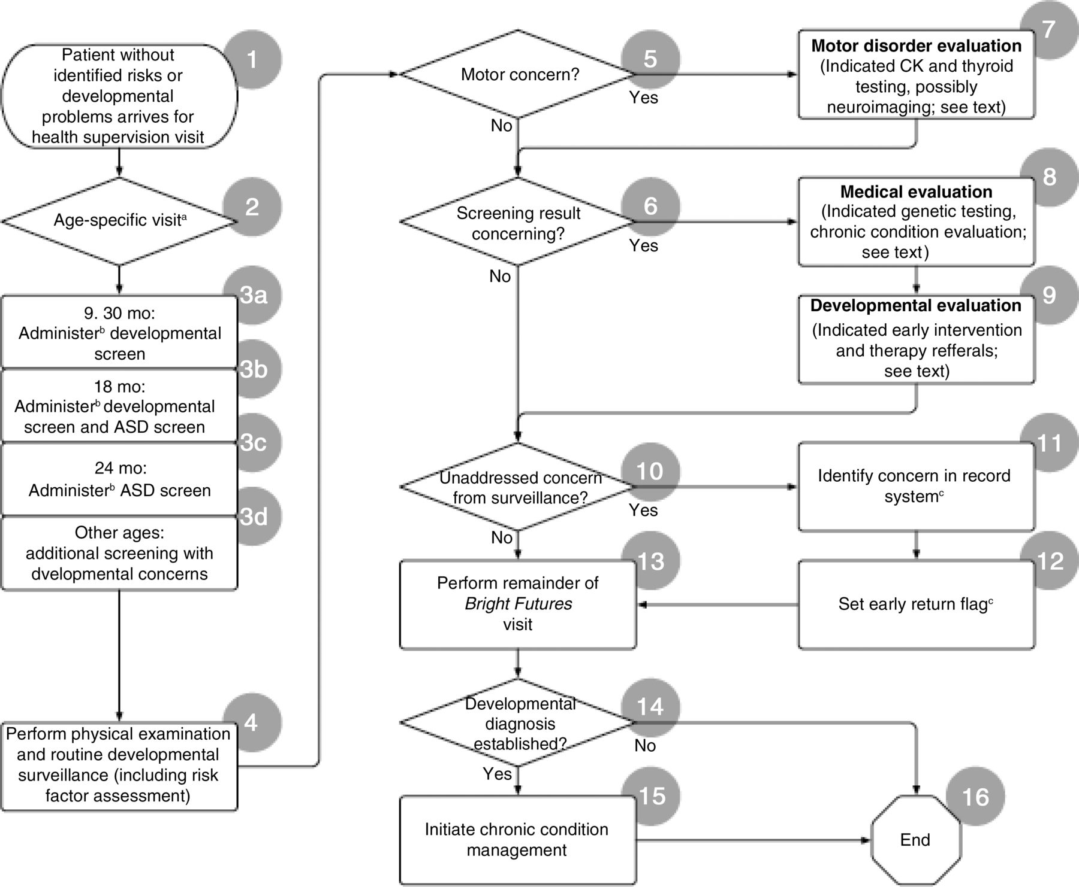
Date of Download: 7/28/2022
Copyright © 2022 American Academy of Pediatrics. All rights reserved.
Notes:
Figure Legend:
Algorithm for screening a patient without identified risks for developmental problems at a health supervision visit. Numbers and headings refer to steps in the algorithm. ªTo identify problems not previously recognized during earlier screenings, clinicians should pay particular attention to developmental surveillance at the age 4- or 5-year visit, before entering kindergarten. Developmental surveillance should continue throughout childhood. ^{b}Screening instruments may be administered through a previsit process initiated by the practice or by the family. ^{c}Providers should create methods in their record system (paper or electronic) to ensure that these facts are visible to clinicians in future visits and in the appointment scheduling process. CK, creatine kinase.

Slide 11
MYTH
vs
FACT
There are no adequate screening tools for preschoolers
Many screening tools have sensitivities and specificities greater than 70%
A great deal of training is required to administer screening tools accurately
Training requirements are not extensive for most screening tools. Most can be administered by nurses, office staff and paraprofessionals.
Many screening tools take less than 15 minutes to complete and less than 2 to score
Screening takes a lot of time
Tools that rely on parent report are not valid
Parent concerns are generally valid and predictive of developmental delays
Notes:
This may be a helpful interactive slide (float in fact after introducing myth—use poll everywhere or discussion).
MYTH: There are no adequate screening tools for preschoolers
FACT: Many screening tools have sensitivities and specificities greater than 70%
MYTH: A great deal of training is required to administer screening tools accurately
FACT: Training requirements are not extensive for most screening tools. Most can be administered by nurses, office staff and paraprofessionals.
MYTH: Screening takes a lot of time
FACT: Many screening tools take less than 15 minutes to complete and less than 2 to score.
MYTH: Tools that rely on parent report are not valid
FACT: Parent concerns are generally valid and predictive of developmental delays

Slide 12
Selecting the Right Screening Tool
Reliability and validity
Sensitivity and specificity
Evidence-based
Administration time
Literacy levels
Notes:
Reliability and validity
Reliability-scores on the tool will be stable regardless of when, where, and by who the test is administered
Validity-scores on the tool accurately capture what the tool is meant to capture in terms of content…is the tool assessing what it is supposed to assess.
Reliability coefficient value/interpretation
.90 and up-excellent
.80-.89-good
.70-.79-adequate
Below .70-may have limited applicability
Validity Coefficient value
Above .35-very beneficial
.21-.35-likely to be useful
.11-.20-depends on circumstances
Below .11-unlikely to be useful
Sensitivity and specificity
Sensitivity refers to how well the tool identifies children who do indeed have a developmental delay. Specificity refers to how well the measure guards against misclassifying children as needing additional screening for developmental delay who are, in fact, developing normally.
Evidence-based
Administration time
Literacy levels

Slide 13
Autism Screening

Slide 14
When to Screen for ASD
Routine ASD surveillance should happen at every well-child visit.​ The AAP recommends that all children receive a standardized developmental screener at:​
9 months​
18 months​
30 months​
In addition, all children should be screened specifically for ASD at:​
18 months​
24 months
Notes:
Routine ASD surveillance should happen at every well-child visit.​
The American Academy of Pediatrics (AAP) recommends that all children receive a standardized developmental screener during regular well-child doctor visits at:​
9 months​
18 months​
30 months​
Additional screening might be needed if a child is at high risk for developmental problems because of preterm birth or low birth weight or for ASD specifically (e.g., having a sibling with ASD).​
In addition, all children should be screened specifically for ASD during regular well-child doctor visits at:​
18 months​
24 months
The US Preventative Task Force guidelines actually recommended no ASD screening but CDC and AAP says there is a benefit and they still recommend it. This recommendation made by the US Preventative Task Force was primarily due to long wait lists for ASD and stress for families on the wait list. Using the MCHAT r/F should help (rather than just MCHAT). And, families can go to schools right away for evaluation for educational verification even if they are on wait lists for a medical diagnosis. https://www.uspreventiveservicestaskforce.org/uspstf/recommendation/autism-spectrum-disorder-in-young-children-screening

Slide 15
Social Communication Questionnaire (SCQ)
Description
Age range
Administration
Access information
Parent –completed
Identifies children at risk for autism
4+ years
40 items
5-10 minutes
Available for purchase via www.wpspublish.com
Notes:
The SCQ is based on items in the Autism Diagnostic Interview, Revised (ADI-R).
Sensitivity: 0.85 (moderate)
Specificity: 0.75 (moderate)
Varies by age. Sensitivity can be improved with lowering cutoff for children less than 5 years old and 5-7 years, specificity poor for younger children.

Slide 16
Modified Checklist for Autism in Toddlers, Revised with Follow-Up (M-CHAT-R/F)
Description
Age range
Administration
Access information
Parent –completed
Identifies children at risk for autism
Follow-up clinician administered questions
16-30 months
20 items
5-10 minutes
Available for free download via www.mchatscreen.com
Notes:
Sensitivity: 0.91
Specificity: 0.95 for low-risk 18- and -24-month-olds with follow-up questionnaire and interview
Parent –completed
Identifies children at risk for autism
Follow-up clinician administered questions
16-30 months
20 items
5-10 minutes
Available for free download via www.mchatscreen.com

Slide 17
Instructions for Use
M-CHAT-R/F designed to be used with M-CHAT-R
Once parent completes M-CHAT-R
Score instrument
Select Follow-Up items to administer based on which items the child failed on the M-CHAT-R
Follow flowchart format and ask questions until a PASS or FAIL is scored
Notes:
For most items, YES is a typical response, and NO is an at-risk response. HOWEVER, items 2, 5, and 12 are reverse scored, meaning that NO is a typical response and YES is an at-risk response. To score the M-CHAT-R, add up the number of at-risk responses, and follow the algorithm below:
Total Score 0-2: The score is LOW risk. No Follow-Up needed. Child has screened negative. Rescreen at 24 months if the child is younger than 2 years old (or after 3 months has elapsed), and refer as needed if developmental surveillance or other tools suggest risk for ASD.
Total Score 3-7 : The score is MODERATE risk. Administer the M-CHAT-R Follow-Up items that correspond to the at-risk responses. Only those items which were scored at risk need to be completed. If 2 or more items continue to be at-risk, refer the child immediately for (a) early intervention and (b) diagnostic evaluation.
Total Score: 8-20 : The score is HIGH risk. It is not necessary to complete the M-CHAT-R Follow-Up at this time. Bypass Follow-Up, and refer immediately for (a) early intervention and (b) diagnostic evaluation.

Slide 18
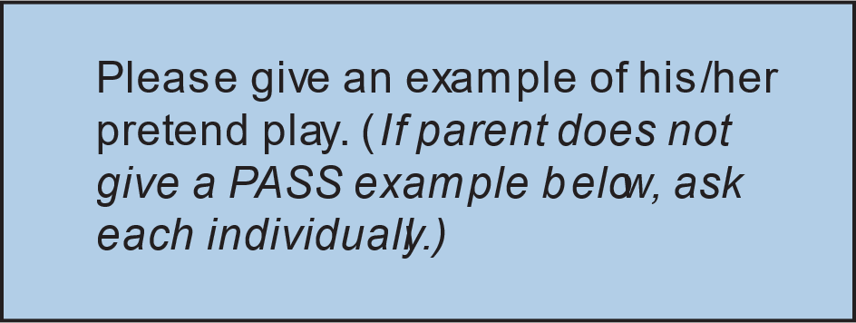
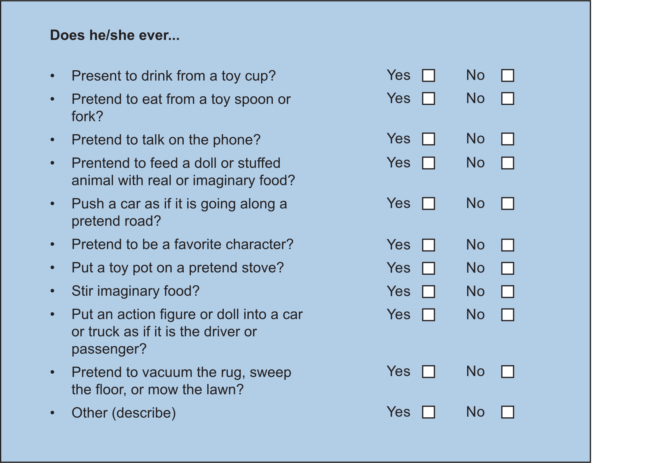
Matthew
3. Does _________ play pretend or make-believe?
FAIL
PASS
Notes:
From cdc.gov

Slide 19
Problems relying on the “cutpoint”
High rates of false positives
Test characteristics vary with population
Many false negatives, especially when asked separately about parental concerns
Physicians are also more likely to identify concerns for ASD in children of educated parents
Notes:
There can be high rates of false positives, they may have problems but not the ones you think they have, and the test could miss some true positives
There can also be false negatives, especially if we don’t ask about parental concerns during the administration
Test characteristics vary with population due to variations in cultural norms, literacy, etc.
Robins, D. L., Casagrande, K., Barton, M., Chen, C. M. A., Dumont-Mathieu, T., & Fein, D. (2013). Validation of the Modified Checklist for Autism in Toddlers, Revised With Follow-up (M-CHAT-R/F). Pediatrics, 133(1), 37–45. https://doi.org/10.1542/peds.2013-1813
High rates of false positives
They may have problems but not the ones you think they have
Test still misses some true positives
Many false negatives, especially when asked separately about parental concerns
Test characteristics vary with population
At least in part because of variations in cultural norms, literacy, etc.
Physicians are also more likely to identify concerns for ASD in children of educated parents

Slide 20
Reviewing Screening Results

Slide 21
How to discuss results:
Focus on concerns
Don’t be definitive
Explain why they are referred
Notes:
Focus on the areas of concern and emphasize that a diagnosis is not being made at this time, but it is recommended that the child receiver further assessment. Ensure that family knows why they are getting referred for an evaluation.
Focus on concerns
Some of these behaviors are often seen in children with …
You only did a screener and cannot say anything definitively
We want to refer for further assessment to get more information
Getting more information helps us know what services are going to be best for her
It is important that they know why they are referred

Slide 22
Reviewing Results
Regardless of results
Restate your motivation to ask them to fill it out, and that it’s a place to start a discussion
Ask if they had any ideas or concerns while filling it out
Follow up with them if “yes”
Can probe for misunderstanding or confusion about any items
If everything is negative
Comment on this and ask one more time for concerns
Can say that we know we can’t ask every question so don’t always capture every possible issue
State your willingness to talk about these things in the future
Notes:
When reviewing the results of screeners with families it’s important to remind them why you asked them to fill out the form and that it’s a place to start a discussion. Ask caregivers if they had any ideas or concerns while completing the screener and follow up on any responses.
If caregivers don’t endorse any concerns on the screener, ask again if they have any concerns and acknowledge that the screener may not capture every possible issue. Make sure to express your willingness to continue to discuss the topics associated with the screener in the future.

Slide 23
If there are some positive items or an overall positive score
“I see that you’ve marked ______, can you tell me more about that?”
Ask about impact on function (school, home, peers)
Notes:
Positive here meaning that there are concerns. It’s important to ask for clarification regarding the concerns and ask how this is impacting the child in various environments.

Slide 24
Screening isn’t diagnosing!
If screener is positive, it does not mean child will receive a diagnosis
If screen is normal, but you still have worries, refer for further evaluation
Notes:
It is important to remember that diagnoses cannot be made on a screener alone. If a screener is positive, it does not necessarily mean a child will receive a diagnosis, and the opposite can be true as well.
If a screener is negative, but the family or you still have concerns, refer for further evaluation.
Screening is the first step in getting children the support or services needed
A full psychological evaluation can then be administered to confirm or rule-out a diagnosis.
Continuum from developmental guidance and watchful waiting to referral for assessment and treatment
A full evaluation is needed for diagnosis
Observation
Detailed history
Test administration

Slide 25
Pediatric Developmental Screening Flowchart
Immediate action required
Provider discusses results and concerns with parents
Performs more specific medical & developmental assessment and/or refers for further assessment
Provides anticipatory guidance
Referral to appropriate early intervention services if child is not yet 3 years old or special education program if the child is 3 years or older
Scores Positive
Parent completes screening tool in waiting room
Clinical staff scores, reviews screening tool answers
Provider discusses results and concern with parents
Further Concerns
Provides anticipatory guidance
Monitor development
Rescreen at next well-child visit
No Concerns
Concerns
Provider discusses results with parents
Provides anticipatory guidance
No immediate action required
Rescreen at next well-child visit
Scores Negative
No Concerns
Notes:
This diagram demonstrates the decision tree for determining follow-up steps after a caregiver completes a screener.
Often times parents can be given screeners to complete while in the waiting room.
Clinical staff can then score and review the results.
If the screener is negative and no additional concerns were endorsed by the family, results can discussed with the family, anticipatory guidance can be provided, and rescreening should occur at the next WCV.
If the screener is negative, but additional concerns were endorsed by the family or observed by the provider, depending on the severity of the concerns, the provider should consider continued monitoring, providing anticipatory guidance, rescreening at next WCV. Referrals for additional services should be made based on the severity of the concerns.
If the screener is positive, provider should discuss the results with the family and take immediate action, including providing referrals for further assessment and/or intervention services.

Slide 26
Referrals for further evaluation and services
Notes:
Now what?

Slide 27
IDEA Part C
Provides free early intervention services to children with disabilities from birth to age 3.
Eligibility requirements:
Delay of 25% or more
Atypical development
Diagnosed condition that is likely to affect development
Notes:
*Optional to add state-specific information or just remove
Provides early intervention services to children with disabilities from birth to age 3 at no cost to families
Eligibility requirements
Delay of 25% or more in development or is developing in an “atypical” way in comparison to most same-aged peers
Diagnosed condition that is likely to affect development (e.g., genetic disorder, deafness, blindness)
Part C services are generally provided in the home and providers teach parents how to use the skills.

Slide 28
How to Initiate Early Intervention Services
Submit a referral to the local early intervention program.
Can be submitted by primary care provider, caregiver, childcare provider, etc.
Contact information by state can be found at: https://www2.ed.gov/policy/speced/guid/idea/monitor/state-contact-list.html
Notes:
Referrals can be submitted by anyone, including pcp, caregiver, daycare providers, etc.

Slide 29
Early Intervention Services
Special Instruction
Speech and Language Services
Physical Therapy
Occupational Therapy
Hearing and Vision Screenings/Services
Social Work
Family Counseling
Nursing Care
Nutrition Counseling
Notes:
Early intervention services can include one or more of these services, depending on the needs of the child.

Slide 30
IDEA Part B and Individualized Education Programs (IEP’s)
Notes:
Transition Slide

Slide 31
Child Find
Special education services provided to identify children from ages 3 to 21 suspected of having an educational disability and may be eligible for special education and related services.
Notes:
Child Find is a program responsible for identifying and evaluating children with disabilities who need special education and related services.

Slide 32
Related Services
A child may require any of the following related services in order to benefit from special education:
Audiology services
Counseling services
Early identification and assessment of disabilities in children
Medical services
Occupational therapy
Orientation and mobility services
Parent counseling and training
Physical therapy
Psychological services
Recreation
Rehabilitation counseling services
School health services
Social work services in schools
Speech-language pathology services
Transportation
Notes:
Discussion question: What are examples of “related services” referenced in IDEA?
Services are not limited to just this list
IEP goals can include child needs not specifically related to the eligibility criteria (for example, a child with a speech delay could also access supports for social skills or behavior supports even though it is not directly related to verification).

Slide 33
IDEA Part C Contact List by State
https://www2.ed.gov/policy/speced/guid/idea/monitor/state-contact-list.html

Slide 34
Psychological Evaluations
Notes:
Transition Slide

Slide 35
Referral Guidelines
Psycho-Educational | Psychological | Neuropsychological
Presenting concern is related to academics/learning disability | Cognitive/developmental concerns Autism spectrum disorder Mood disorders (anxiety, depression) Behavior disorders (e.g., ODD) Trauma Giftedness | Cognitive/developmental concerns are present In addition to a known medical, genetic, developmental condition or brain dysfunction is suspected cause of cognitive/behavioral difficulties Examples: TBI, genetic disorders, epilepsy, tumors, leukemia, stroke, CNS infection, hydrocephalus, congenital heart disease, history of prematurity
Notes:
Psycho-educational
*appropriate when challenges only occur in academic settings or particular subjects
Psychological
*help when the cause of problems are less clear and occur in multiple settings
Neuropsychological
*warranted when there is a known medical, genetic, developmental condition or suspected brain dysfunction
*Insurance will typically only cover these evaluations if there is a history of some sort of medical/genetic disorder
*Neuropsychological testing is not appropriate for patients who are not stable (e.g., active psychosis) b/c cognitive and other functioning can't be adequately assessed

Slide 36
Developmental Pediatricians
Notes:
Transition Slide

Slide 37
Developmental Pediatricians
Board certified in General Pediatrics and sub-board certification in Developmental-Behavioral Pediatrics
Evaluate and monitor progress in children at risk for developmental and behavioral disorders on basis of biological and social factures.
Typical evaluations include:
Detailed history of child
Medical exam
Observe and talk with child
Ask about child’s behavior in various settings
Seek feedback from schools/daycares
Notes:
Board certified in General Pediatrics and receive a sub-board certification in Developmental-Behavioral Pediatrics
Their role is to evaluate and monitor progress in children at risk for developmental and behavioral disorders on the basis of biological and social factures
Typical evaluations include:
Detailed history of child
Medical exam
Observation and talk with child
They’ll ask about child’s behavior in various settings
Seek feedback from schools/daycares

Slide 38
Developmental Pediatricians
May make a diagnosis
May refer for additional evaluations with specialists
(e.g., Neuropsychologist, occupational therapist)
Can prescribe and monitor medication

Slide 39
Developmental Pediatricians
Address a variety of developmental and behavioral difficulties, including:
Learning disorders
ADHD
Tics, Tourette syndrome
Regulatory disorder (e.g., sleep, feeding, toilet-training issues)
Developmental disabilities (ID, ASD, cerebral palsy, spina bifida, visual and hearing impairments
Delayed development of language and motor skills
Behavioral and developmental problems complicated by chronic illness and disabling conditions (e.g., genetic disorders, prematurity, epilepsy)

Slide 40
Genetic Testing
Consensus that genetic testing should be offered to all patients with global developmental delay, intellectual disability, and/or autism spectrum disorder.
Data suggest that a minority of children with ASD and ID have undergone genetic testing.
Pediatric providers (general practitioners, neurodevelopmental pediatricians) can order genetic testing.
Notes:
Given the diagnostic yield of genetic testing and the potential for clinical and personal utility, there is consensus that genetic testing should be offered to all patients with global developmental delay, intellectual disability, and/or autism spectrum disorder. Despite this recommendation, data suggest that a minority of children with autism spectrum disorder and intellectual disability have undergone genetic testing.
https://www.frontiersin.org/articles/10.3389/fped.2021.526779/full

Slide 41
Genetic Testing
Identification of an underlying genetic etiology for a child's neurodevelopmental diagnosis can provide both clinical and personal utility to patients and their families, including:
Information about prognosis.
An understanding of potential areas of need and opportunities for increased support.
Access to etiology-specific treatments.
Risk counseling for the family to inform reproductive decision making.
Notes:
Identification of an underlying genetic etiology for a child's categorical neurodevelopmental diagnosis can provide both clinical and personal utility to patients and their families. Establishing a genetic basis for a child's neurodevelopmental phenotype can provide additional information about their prognosis and enable caretakers to understand potential areas of need and opportunities for increased support, may facilitate acquisition of educational, disability, and employment services , might provide access to etiology-specific treatments, and allow for risk counseling for families to inform reproductive decision making.

Slide 42
Genetic Testing
Identifying an etiology can also provide psychosocial benefit to families, including:
Explanation for child's developmental history may bring an end to the child's “diagnostic odyssey” that might have included years of uncertainty, anxiety, and evaluations.
Guide patients and families to condition-specific resources and supports.
Receival of a diagnosis has been shown to increase knowledge, provide a sense of empowerment, result in peace of mind, increase parental quality of life, decrease parental guilt, and foster increased acceptance.

Slide 43
Speech-Language Pathologists
Notes:
Transition Slide

Slide 44
Speech Therapy
Primary care provider’s (PCP’s) play an integral role in identifying language delays.
Before initiating speech therapy services, a referral indicating medical necessity is required from a PCP.
Notes:
PCP’s are often the first providers that parents voice concerns regarding their child’s language development. They are also in a position to observe a child and gather information during WCV’s regarding a child’s language development to identify children who may be behind in meeting their milestones. Therefore, they play an integral role in identify language delays and referring for speech therapy. Additionally, most insurance companies require a letter of medical necessity from the PCP before they will cover speech therapy services. PCP’s should also follow up with families to ensure that they followed through with initiating these services and identify any barriers that may be preventing them from doing so. Additionally, they can monitor a child’s progress in developing their language skills during visits.

Slide 45
Occupational Therapists
Notes:
Transition Slide

Slide 46
Occupational Therapy
Occupational therapy (OT) helps people work on cognitive, physical, social, and motor skills.
Goal: improve everyday skills to increase independence
For autism specifically, interventions typically target:
Play skills
Learning strategies
Self-care
Sensory sensitivities

Slide 47
Occupational Therapy
Primary care provider’s (PCP) play an integral role in identifying fine motor delays and sensory processing challenges.
Before initiating occupational therapy services, a referral indicating medical necessity is required from a PCP.
Notes:
Similar to speech and language development, PCP’s are often the first providers to identify fine motor deficits and sensory processing challenges. As such, they play an integral role in identify these delays and challenges and referring for an occupational therapy evaluation. Most insurance companies also require a letter of medical necessity from the PCP before they will cover occupational therapy services. PCP’s should follow up with families to ensure that they followed through with initiating these services and identify any barriers that may be preventing them from doing so. Additionally, they can monitor a child’s progress in developing their fine motor skills during visits.

Slide 48
Physical Therapists
Notes:
Transition Slide

Slide 49
Physical Therapy
Infants and children may benefit from physical therapy if they display any of the following:
They are behind on developmental skills (crawling, rolling, walking, jumping)
Head shape appears flattened or asymmetrical
Preference of one side (turning their head only to the left, rolling only to their right, difficulties feeding on one side, only using one hand to play with toys)
Walks on tip-toes, trips over their feet, or walks in an atypical/awkward manner
Appears clumsy, frequently falls or walks into objects, or not aware of their surroundings
Coordination difficulties (throwing, catching, kicking, hopping, skipping, jumping jacks)
Avoids running, playgrounds, climbing, swings, or can’t keep up with their peers
Appears to have muscle weakness or is “double-jointed”
Tends to “slouch” over instead of sitting or standing straight
Recent injury /surgery or frequently complains of/appears to be in pain

Slide 50
Medical Conditions Often Requiring Physical Therapy
Autism Spectrum Disorder
ADHD
Torticollis, Plagiocephaly, Brachycephaly
Neurological conditions
Genetic syndromes
Orthopedic conditions
Walking difficulties
Heart and lung conditions
Vision or hearing impairments
Childhood obesity
Notes:
Autism Spectrum Disorder
ADHD
Torticollis, Plagiocephaly, Brachycephaly
Neurological conditions (e.g., Cerebral Palsy, Spina bifida, or Concussions)
Genetic syndromes (Muscular Dystrophy, Down syndrome)
Orthopedic conditions (Scoliosis, leg pain, sports injuries, foot deformities, arthritis)
Walking difficulties (walking on tip-toes, frequent falling, other abnormal walking patterns)
Heart and lung conditions (Asthma, Cystic Fibrosis)
Vision or hearing impairments
Childhood obesity

Slide 51
Physical Therapy
Primary care providers (PCP) play an integral role in identifying gross motor delays.
Before initiating physical therapy services, a referral indicating medical necessity is required from a PCP.
PTs also consult with other disciplines, including medical, psychology, and school personnel about an IEP.
Notes:
As with other developmental milestones, PCP’s are often the first providers to identify gross motor deficits in children and play an integral role in identify these delays and referring for a physical therapy evaluation. Most insurance companies also require a letter of medical necessity from the PCP before they will cover physical therapy services. PCP’s should follow up with families to ensure that they followed through with initiating these services and identify any barriers that may be preventing them from doing so. Additionally, they can monitor a child’s progress in developing their gross motor skills during visits.
A child does not have to have a medical diagnosis (such as torticollis, cystic fibrosis) to be eligible for physical therapy services.

Slide 52
Feeding Programs
Notes:
Transition Slide

Slide 53
When to refer to a Feeding Program
If a provider or parent notices that an infant/child:
Is not gaining weight or growing
Refusing to eat or drink
Frequently spits up or throws up
Cries or fusses during meals
Arches their back when feeding
Has trouble breathing while eating or drinking
Has problems chewing, coughs, or gags during meals
Has a gurgle, breathy, or hoarse voice during or after meals
Eats less than 10 different foods
Conditions that may lead to feeding and swallowing disorders:
Being premature or having a low birth weight
Reflux or other stomach problems
Breathing problems (e.g., asthma)
Cleft lip or palate
Muscle weakness in the face and neck
Medicines that suppress appetite
Autism or sensory issues
Medical/genetic diagnoses (e.g., cerebral palsy, cystic fibrosis, Down’s Syndrome, meningitis)
Notes:
If a provider or parent identifies one or more of the following symptoms related to eating, a referral to a feeding program would be beneficial. While the conditions listed here increase the likelihood of having symptoms requiring feeding therapy, this is not always the case. However, providers should closely monitor these patients and regularly ask caregivers whether their child is experiencing any of these symptoms related to eating.

Slide 54
Feeding Therapy
Primary care providers (PCP) play an integral role in identifying feeding problems (e.g., failure to thrive, food selectivity related to texture).
Before initiating physical therapy services, a referral indicating medical necessity is required from a PCP.
Notes:
PCP’s are also often the first providers to identify feeding challenges in children and play an integral role in identify these delays and referring for a feeding therapy evaluation. As with other services, most insurance companies require a letter of medical necessity from the PCP before they will cover feeding therapy services. PCP’s should follow up with families to ensure that they followed through with initiating these services and identify any barriers that may be preventing them from doing so. Additionally, they can monitor a child’s progress in improving their eating skills/decreasing food selectivity during visits.

Slide 55
Collaborative Care
Notes:
Transition Slide

Slide 56
Addressing Practice/Systemic Barriers
In order to best meet the needs of their patients, providers should:
Assume accountability for coordinating their patients’ care
Reach out to care partners to build relationships and clarify their roles and services
Track referrals to ensure they are up to date and meet the needs of the patient
Use a shared electronic medical record to easily communicate and access/share information with other providers
Notes:
(1) Assume accountability for coordinating their patients’ care: coordinating care requires deliberate action on the part of a PCP to ensure the quality and safety of their patients’ referrals and transitions. These include efforts to identify key partner providers and organizations in their patients’ care, and tracking patients as they navigate to their next destination.
(2) They reach out to key care partners to build relationships and agreements so that they understand each others’ expectations and preferences: a clear and shared understanding of the roles, responsibilities, and expectations of all parties involved in the care of a patient is vital—especially in this era when many referrals and transitions involve providers who are strangers to each other. Our best-practice organizations tended to initiate conversations with providers and institutions used frequently by the practice and providers, and valued by both groups in an effort to build relationships, try to understand each other’s practice style and preferences, and reach agreement. An increasing number of practices are finding it useful to write down what has been agreed to in a compact or contract.¹⁴
(3) They support their patients when they go elsewhere for care: organizations that coordinate care well track referrals and transitions so that they can detect and address problems in information transfer, the appointment process, or the many other things that can go wrong when patients receive services from multiple practices.
(4) They establish connectivity for transmitting standardized information and communicating with care partners: successful care coordination includes the timely transfer of relevant information. Providers missing crucial patient information when needed account for many of the problems associated with referrals or transitions. Connectivity may be established through a shared electronic medical record, a web-based e-referral system,¹⁵ or agreements to use standardized referral request forms and consultation notes.

Slide 57
Case Study: What's Next?
Follow up with the family in a few weeks.
Make sure that the family has followed through on the referral.
If not, identify the family's barriers and problem solve.
Reassess developmental milestones at next visit.

Slide 58
Thank you!
Questions?

Slide 59
Thank you!
Maryland Behavioral Health Integration in Pediatric Primary Care (BHIPP)
1-855-MD-BHIPP (632-4477)
www.mdbhipp.org
Follow us on Facebook, LinkedIn, and Twitter! @MDBHIPP
For resources related to the COVID-19 pandemic,
please visit us at BHIPP Covid-19 Resources.
Notes:
You will a copy of these slides

