Slide 1
Maryland Behavioral Health Integration in Pediatric Primary Care (MD BHIPP) Crisis Training June 16th, 2022 Suicide Prevention Part 2: Safety and Crisis Planning Robert Paine, DO
855-MD-BHIPP (632-4477)
www.mdbhipp.org

Slide 2
Conflict of interest disclosure
No potential conflicts of interest
Faculty at the University of Maryland School of Medicine
Salary funding from the State of Maryland (BHIPP)
Member of the American Academy of Child & Adolescent Psychiatry (AACAP)

Slide 3
Learning Objectives
Learn evidence-based treatments for nonsuicidal self-injury in children and adolescents
Describe the specific components of an evidence-based safety plan intervention
Discuss additional elements to consider specifically for kids when engaging in safety planning

Slide 4
Acknowledgement
A special thanks to Dr. Hal Kronsberg of the BHIPP team who created the majority of the slide content presented today!

Slide 5
Case
In the privacy of his bathroom, Alejandro, 15, prepared to cut his wrist. He knew it would hurt and knew people would wonder why. But he didn’t care. It hurt the first few moments of cutting, but soon he felt no pain. He felt only relief.
Then he looked down at his wrist. The amount of blood in the bathroom sink shocked him. He wrapped his wrist in a towel and told his mother. She took him immediately to the hospital, where the doctor stitched up his wound.
The ER Social Worker was concerned. She asked Alejandro “When you cut your wrist, how much did you want to die?” He responded “I didn’t want to die, I just wanted to feel better.”
He explained that his girlfriend had broken up with him that day at school. “I couldn’t stop crying. When I cut myself, it calms me down. I swear, I wasn’t trying to kill myself.”
Freedenthal, 2018

Slide 6
Case (continued)
The social worker believed him, but only after completing a suicide risk assessment and talking with Alejandro’s mother for corroboration. Alejandro had not previously revealed any signs of suicidal thoughts or behaviors. There was no sign that he had undertaken preparations to end his life.
For safety planning, the social worker helped Alejandro come up with safer things he could do to relieve emotional pain, as well as places and people he could turn to for distraction and help.
He was referred to an outpatient psychotherapist and was discharged home with his mother.
Freedenthal, 2018

Slide 7
NSSI: Treatments that Work

Slide 8
Therapy helps
Strongest evidence and largest effect sizes:
Dialectical Behavioral Therapy
Cognitive-Behavioral Therapy
Mentalization Based Therapy
Key ingredients in treatment:
Focus on family interactions
Frequent meetings with the adolescent
Emphasize self-care: sobriety, sleep, increasing positive experiences
Ougrin, D., Tranah, T., Stahl, D., Moran, P., & Asarnow, J. R. (2015). Therapeutic interventions for suicide attempts and self-harm in adolescents: systematic review and meta-analysis. Journal of the American Academy of Child & Adolescent Psychiatry, 54(2), 97-107.
Brent, D. A., McMakin, D. L., Kennard, B. D., Goldstein, T. R., Mayes, T. L., & Douaihy, A. B. (2013). Protecting adolescents from self-harm: a critical review of intervention studies. Journal of the American Academy of Child & Adolescent Psychiatry, 52(12), 1260-1271.
Notes:
Think back to the EE data that shows high parental criticism can be a risk factor for self-harm. Good treatment will help families communicate in a more validating way.

Slide 9
DBT vs CBT
Dialectical Behavioral Therapy
Cognitive Behavioral Therapy
Strongest evidence base
Mix of group and individual treatment
Parent component
Emphasis on “skills” to replace self-injury
“On-call” skills coaching
Hard to find treatment in rural areas
Weaker evidence base
Individual and parent treatment
Emphasis on thoughts and behaviors
No “skills coaching”
Much more commonly found treatment
Treats many comorbid conditions

Slide 10
DBT Skill Example
https://dialecticalbehavioraltherapy.wordpress.com/distress-tolerance-tipp-skills/

Slide 11
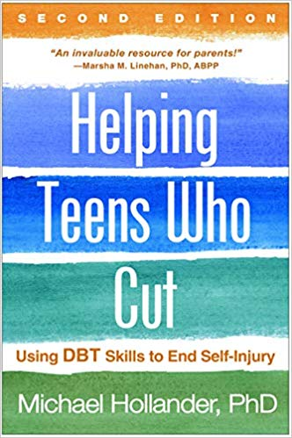
Educating Parents
Book intended for lay audiences by a major DBT authority
Explains the concepts and skills of DBT
May help parents respond to emotional distress more effectively

Slide 12
Educating Parents
www.selfinjury.bctr.cornell.edu

Slide 13
Your patient is suicidal. Now what?

Slide 14
The Big Question
Does the patient feel that they can keep from seriously harming themselves with appropriate supervision and do the parents/caregivers feel that they can provide adequate supervision to keep their child safe?
If yes – proceed to safety planning
After safety planning, reconsider the above question to ensure that all parties feel the safety plan can be realistically followed
If no – further evaluation is needed immediately
Consider ED (or alternate setting) referral
Notes:
Appropriate = the typical amount of supervision that is developmentally appropriate for a kid

Slide 15
Safety Planning
Few robust studies in safety planning alone in pediatric populations
Safety Planning Intervention + single phone check-in reduced 6-month suicide behaviors by 45% among adults with ED visits for suicide-related concerns (Stanley et al 2018)
Intervention took 15-45 minutes to conduct
Safety plans are often combined into a comprehensive treatment approach (such as in CBT or DBT)

Slide 16
Safety Contract vs Safety Plan
With a no-suicide contract aka safety contract, the patient promises (either orally or in writing) not to act on their suicidal thoughts within a specified period of time.
Safety planning offers a concrete way to collaborate with the suicidal person about ways to resist acting on suicidal urges.
Freedenthal, 2018

Slide 17
Safety Planning Principles
Provide kids and families with a prioritized and specific set of coping strategies and contacts should suicidal thoughts emerge
Sees suicidal crises as intense but temporary challenges
Crafted in close collaboration with the individual who will use it
A good safety plan is concrete, detailed, and within the patient’s ability to achieve

Slide 18
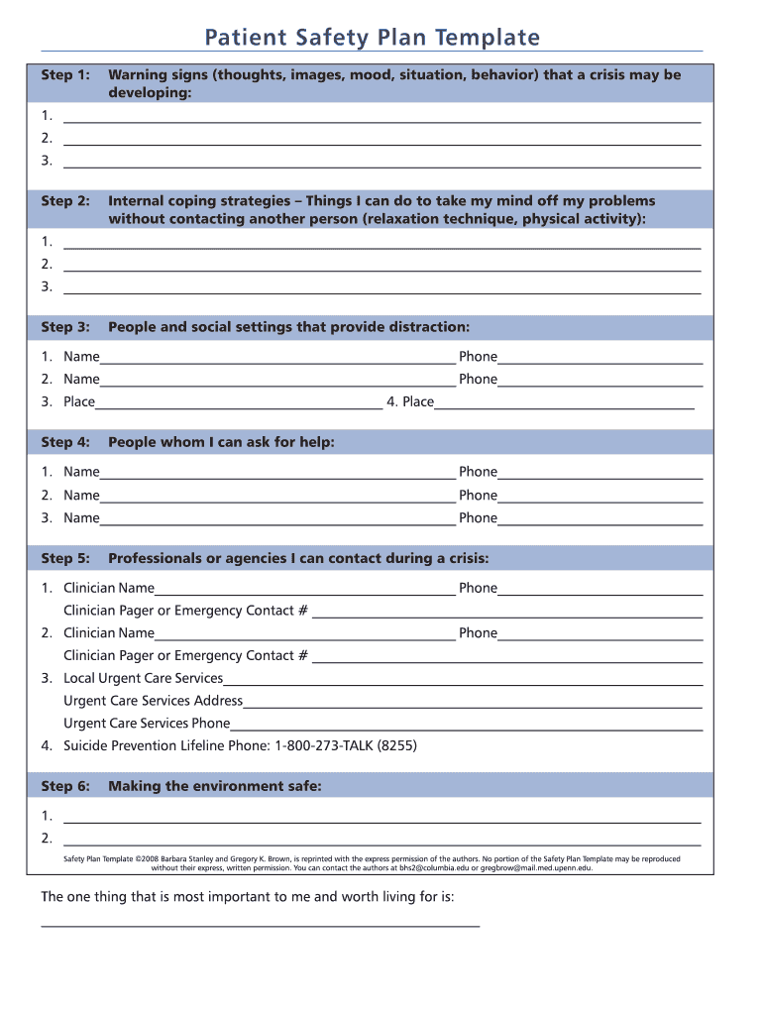
Safety Plan adapted from Safety Planning Intervention
https://suicidepreventionlifeline.org/wp-content/uploads/2016/08/Brown_StanleySafetyPlanTemplate.pdf
Moves from internal coping to external coping to reaching out for help
Additional considerations for kids:
Plan for increased supervision
Establishing a check-in system

Slide 19
Step 1: Warning Signs
Emphasize thoughts, feelings, and behaviors that the adolescent can identify on their own
Include observable behaviors as well that parents, caregivers, or other informed adults might be able to recognize without the adolescent saying that they are present

Slide 20
Step 2: Internal Coping Strategies
Initial step, meant to enhance self-efficacy
Often are distraction techniques (going for a walk, taking a shower, etc)
DBT skill example: ACCEPTS (https://www.dbtselfhelp.com/html/accepts.html)
These strategies should be usable at any time by the individual

Slide 21
Step 3: Utilize social contacts as a means of distraction from suicidal thoughts
May identify individuals or places where socializing occurs
Not meant to be emotional supports, but rather people around whom you can be and feel safe
Places may be private (a walk in the woods) or public (a trip to the Zoo)
Aim is still to focus on self-efficacy

Slide 22
Step 4: Contacting family members or friends who may help with the crisis
Inform trusted contacts of the suicidal crisis
These individuals should know that they may be contacted in a crisis
Individuals should adults
At this stage, the actual crisis is meant to be discussed openly
Sometimes, validation and support is sufficient to alleviate suicidality, but distress and other psychiatric symptoms may remain

Slide 23
Step 5: Contact mental health professionals or agencies
At this stage, clinician involvement is necessary
This should be discussed in advance with outpatient providers to ensure that conditions for being emergently contacted are clear

Slide 24
Step 6: Reduce the potential use of lethal means
Some aspects of this should be Step 0 (i.e. firearm safety)
Firearms used in pediatric suicides come from the youth’s home in approximately 9 of 10 deaths (Monuteaux et al. 2019)
The association of firearms ownership and suicide was 2x stronger in adolescents than adults and child access prevention laws (“safe storage laws”) may reduce adolescent firearm suicide by 13% (Kivisto et al. 2021)
While the AAP recommends all firearms should be securely stored in a locked location, unloaded, and separate from ammunition, only 3 in 10 households with children and firearms do this (Monuteaux et al. 2019)
Other aspects should be done on an as needed basis
Consider locking medications and preferred objects for self-injury

Slide 25
Additional Considerations for Kids
Plan for increased level of supervision at home
Could be anything from limiting time left alone, increased time spent with family, social media monitoring, etc.
Parents should make this explicit
Devise a “check-in system” for parents and kids
There should be limits on both ends
Supportive concern =/= nagging
The goal is to assess safety and not (primarily) to manage parent anxiety
Fine to adopt means of checking in beyond explicit verbal statements as long as it’s predetermined
Can use codes (“red zone”) or a chart if needed

Slide 26
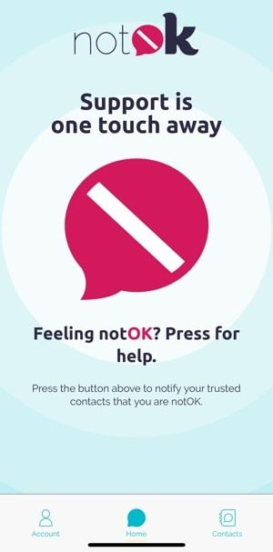
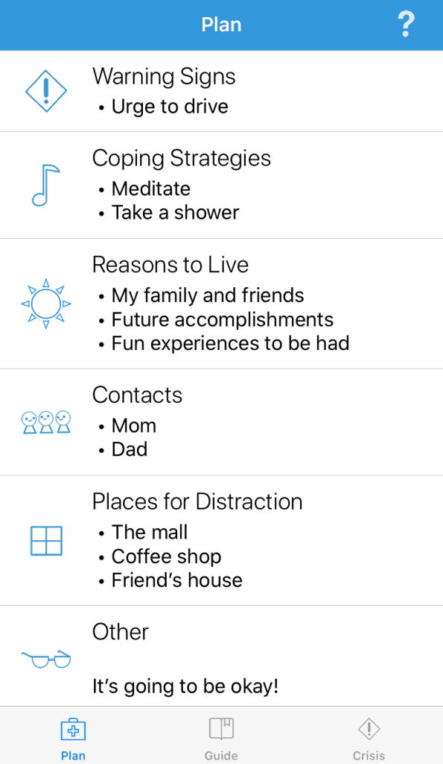
There’s An App For That!
1) notOK: Free app that contains a large red button that, when tapped, alerts close trusted contacts that the user is in urgent need of help.
The app will send an alert to pre-selected friends, family members, and supporters with a GPS location and a message letting them know that the user needs them to reach out.
https://www.notokapp.com/
2) Suicide Safety Plan: Free app that allows users to program safety plan and easily contact help if needed.
https://www.suicidesafetyplan.app/

Slide 27
Possible Alternatives to ED Referral
Walk-In Behavioral Health Services
Non-ED settings to evaluate mental health crises (not necessarily open 24/7)
Frederick – Mental Health Association - https://fcmha.org/how-we-help/behavioral-health
Harford County – Harford Crisis Center - https://harfordcrisiscenter.org/
Montgomery County – Montgomery County Crisis Center - https://www.montgomerycountymd.gov/HHS-Program/Program.aspx?id=BHCS/BHCS24hrcrisiscenter-p204.html
Sheppard Pratt Walk-In Clinics – Towson and Elkridge - https://www.sheppardpratt.org/care-finder/crisis-walk-in-clinic/

Slide 28
An Emerging Crisis-Based Treatment
Family-based Crisis Intervention (Wharff et al 2019)
60-90 minute single session for suicidal adolescents and their families
Studied and implemented in pediatric emergency rooms
Involves elucidating the “crisis-narrative,” psychoeducation, brief CBT intervention, safety planning
In ED study, reduced the need for hospitalization of suicidal adolescents by about half (68% vs 38%)
Not yet adapted to primary care settings but this is in progress!

Slide 29
Recommended Readings
Berk, M: Evidence-Based Treatment Approaches for Suicidal Adolescents: Translating Science Into Practice. Washington DC, American Psychiatric Association Publishing, 2019.
Chiles, JA, Strosahl, KD, and Roberts, LWR: Clinical Manual for Assessment and Treatment of Suicidal Patients, Second Edition. Washington DC, American Psychiatric Association Publishing, 2019
Choi-Kain, LW and Sharp, C: Handbook of Good Psychiatric Management for Adolescents with Borderline Personality Disorder. Washington DC, American Psychiatric Association Publishing, 2022.
Freedenthal S: Helping the Suicidal Person: Tips and Techniques for Professionals. New York, Routledge, 2017
Miller AL, Rathus JH, Linehan MM: Dialectical Behavior Therapy With Suicidal Adolescents. New York, Guilford, 2007
Rathus JH, Miller AL: DBT Skills Manual for Adolescents. New York, Guilford, 2015

Slide 30
Resource for Patients
988
A new crisis hotline number
Patients experiencing mental health crises can call or text 988 and will be directed to the National Suicide Prevention Lifeline.
Coming July 16th nationwide!
Learn more at https://suicidepreventionlifeline.org/current-events/the-lifeline-and-988/

Slide 31
Thank you!
Maryland Behavioral Health Integration in Pediatric Primary Care (BHIPP)
1-855-MD-BHIPP (632-4477)
www.mdbhipp.org
Follow us on Facebook, LinkedIn, and Twitter! @MDBHIPP
For resources related to the COVID-19 pandemic,
please visit us at BHIPP Covid-19 Resources.
Notes:
You will a copy of these slides

