Slide 1
Parenting Skills Maryland Behavioral Health Integration in Pediatric Primary Care Sarah Edwards, DO Assistant Professor Director and Medical Director Division of Child and Adolescent Psychiatry University of Maryland School of Medicine Carisa Parrish, PhD Associate Professor, Psychiatry & Behavioral Sciences Director of Training, Pediatric Psychology Fellowship Co-Director, Pediatric Medical Psychology Program Johns Hopkins School of Medicine Division of Child & Adolescent Psychiatry
1-855-MD-BHIPP (632-4477)
www.mdbhipp.org
Follow us on Facebook, LinkedIn, and Twitter! @MDBHIPP

Slide 2
Objectives
Discuss:
Rationale for strengthening parenting skills to prevent and treat behavior problems
How parenting skills training programs work as a treatment modality, using the Chicago Parent Program as an example
Common strategies taught in parenting skills training programs
How to incorporate parenting skills content into your practice

Slide 3
Parenting Skills Training (PT) Defined
A treatment modality for improving parent-child relationships and reducing child behavior problems such as:
Noncompliance
Tantrums
Aggression
School avoidance
Can be used to prevent AND treat child behavior problems
Underlying assumption - parents can be taught to become change agents for their children’s behavioral difficulties by changing their own behavior
Notes:
PT is a strategy for changing child behavior by strengthening parenting skills

Slide 4
Evidence-based Approach to Improving Parenting and Child Behavior
Meta-analyses and systematic reviews have found
consistent benefits of PT
Examples:
Epstein, RA et al (2015). Psychosocial interventions for child disruptive behaviors: A meta-analysis. Pediatrics, 136(5), 947-960.
Furlong, M et al. (2012). Behavioral and cognitive-behavioral group-based parenting programmes for early-onset conduct problems in children aged 3 to 12 years. Cochrane Database of Systematic reviews. Issue 2. Art. No: CD008225
Kaminski, JW et al. (2008). A meta-analytic review of components associated with parent training program effectiveness. J of Abnormal Child Psychology, 35, 567-589.
Notes:
Epstein conclusion: The 3 intervention categories were more effective than the control conditions. Interventions with a parent component, either alone or in combination with other components, were likely to have the largest effect.
Furlong conclusion: Behavioural and cognitive‐behavioural group‐based parenting interventions are effective and cost‐effective for improving child conduct problems, parental mental health and parenting skills in the short term.

Slide 5
Effective approach to strengthening parenting skills
PT is first line treatment for preschoolers with ADHD
American Academy of Pediatrics (2011). ADHD: Clinical Practice Guidelines for the Diagnosis, evaluation, and treatment of Attention-Deficit/Hyperactivity Disorder in children and adolescents. Pediatrics, 128(5), 1007-1022.
Charach A et al. (2011) Attention Deficit Hyperactivity Disorder: Effectiveness of treatment in at-risk preschoolers; long-term effectiveness in all ages, and variability in prevalence, diagnosis, and treatment. Comparative Effectiveness Review No. 44. www.effectivehealthcare.ahrq.gov/reports/final.cfm
PT is well-established treatment for ODD and Conduct Disorder for children <13 years old
Kaminski, J. & Claussen, A.H. (2017) Evidence Base Update for Psychosocial Treatments for Disruptive Behaviors in Children, Journal of Clinical Child & Adolescent Psychology, 46:4, 477-499, DOI: 10.1080/15374416.2017.1310044

Slide 6
Common Elements of all PT programs
Similar underlying theory
Use of positive reinforcement to build parent-child relationship
Effective limit setting strategies
Problem-solving skills
Managing stress/negative affect
“Homework” to practice new skills
Notes:
There are hundreds of evidence-based parenting skills programs. They all are based on a similar underlying theory and cover strategies focused on positive reinforcement to strengthen the parent child relationship as well as limit setting skills. Many also include a focus on problem-solving skills, managing parent’s own stress and employ practice assignments

Slide 7
Examples of Parenting Skills Programs by Format
Format | Characteristics | Examples of evidence-based programs
Individualized parent—child coaching | Clinician works with parent and child | Parent-Child Interaction Therapy
Group-based parent programs | Clinician works with parents; may include separate child group | Chicago Parent Program
 |  | Incredible Years Program
 |  | Parent Management Training (PMTO)
Leveled programs based on family need | Intervention intensity based on severity of child behavior problems and family need | Triple P
 |  | Family Check-up
 |  | Familias Unidas
Digital/online parenting programs | Individually administered parenting skills education | ezParent
 |  | Infant Net
 |  | Triple P
Notes:
Here are some different examples of parenting skills programs by format. One of the most common individualized parent-child coaching models is PCIT.

Slide 8
Theory underlying PT Programs: Coercive Family Process Model
Parents inadvertently reinforce undesired behaviors in their children
Example:
Child has a tantrum in the grocery store because he is bored and wants to leave. Embarrassed, parent gives the child some candy to quiet him and quickly leaves the grocery store.

Slide 9
Theory underlying PT Programs: Coercive Family Process Model
Children inadvertently reinforce undesired behaviors in their parents
Example:
Child does not put her toys away after being told repeatedly to do so. Parent now threatens with a spanking and child quickly puts her toys away.

Slide 10
Role of Provider in PT Programs
Help parents clarify the child behaviors they really like -- make a plan for consistently reinforcing those desired behaviors
Help parents identify the most problematic behaviors -- make a plan for:
reducing the attention they give to those behaviors,
setting effective limits on those behaviors
following through on their limits
Notes:
Role of the provider in the context of implementing a PT program is to help parents clarify the behaviors they really like and learn the necessary strategies to reinforce those desired behaviors. Its also to help parents identify the misbehaviors they are most concerned about and to identify and practice the strategies to address the misbehaviors by reducing the attention they give to them, setting effective limits on them, and following through on those limits.

Slide 11
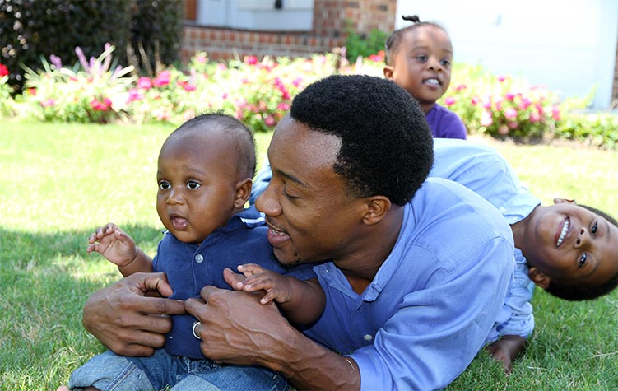
The Importance of Parents’ Cultural Values and Beliefs
Parents differ in what they consider to be desirable and problematic child behaviors
Honor parents as experts on their children
Provide guidance on child development as needed
Bright Futures: https://brightfutures.aap.org
Focus first on strengthening a positive parent-child relationship, before tackling the problematic behavior.
Notes:
When working with parents to strengthen their parenting skills it is important to keep a few things in mind:
First, Parents will differ in what they consider to be desirable and problematic child behaviors.
Second, it is important to value parents as the experts on their children. You are the expert on a particular strategy, but they know their child best and so its about leveraging both sets of knowledge to help parents be the best parents they can
Third, there will be times in the context of PT that providing appropriate guidance on child development is needed because parents may have expectations for their child that are not developmentally appropriate and that may be contributing to the difficulties they are having with managing the behavior
Finally, its important to focus first on strengthening the positive parent child relationship before working on addressing the misbehaviors. When you focus first on giving more attention to the behaviors you want to see more of, one clear effect is that you actually start to see less of the problematic behaviors

Slide 12
Strengthening the Parent-Child Relationship: 4 Strategies
“Child-centered” time
“Following the child’s lead”
“Descriptive commenting”
Establishing routines
Strategic use of praise
“Labeled” praise
“Unlabeled” praise
Reward programs
Notes:
So now we are going to dig into some strategies. I’m going to give you examples of 4 common strategies for strengthening the parent-child relationship.

Slide 13
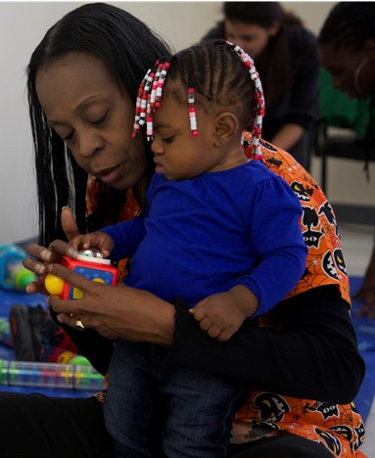
Spending “child-centered time”
What is “child-centered” time?
Time parent spends with their child focused on what the child wants to do
Follow the child’s lead
Can be as brief as 10-15 minutes/day
How does this help?
Reduces likelihood children will use negative behavior to gain parent’s attention
Promotes feelings of love, warmth, positive self-esteem
Notes:
This also sometimes referred to as 1:1 time.

Slide 14
Video example: Child-centered time
https://vimeopro.com/jhunursing/ccp2018/video/33234781

Slide 15
Child-centered time: Using “descriptive commenting”
What is “descriptive commenting”?
Parent describes what the child is doing
Like a sports announcer narrating a game
How does this help?
Allows parents to teach without controlling the interaction
Keeps the focus on the child’s interests and ideas
Notes:
Mention about how many questions we ask and how that controls the interaction

Slide 16
Video example: Descriptive Commenting
https://vimeopro.com/jhunursing/ccp2018/video/33257134

Slide 17
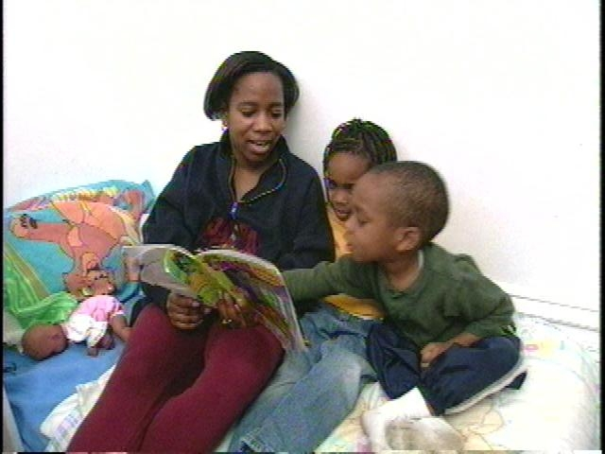
Establishing Routines
What are routines?
Behaviors that are regularly practiced
Examples: reading before bed, eating dinner together
How does this help?
Help children feel safe and in control of their lives
Reduces stress

Slide 18
Praise
What is “praise”?
Verbal statements that convey warm, positive feelings to a child
Be sincere
Praise effort AND performance
Should not be mixed with criticism (“I love it when you make your bed. Why can’t you make your bed every morning?”)
How does this help?
Gives attention to desirable behaviors
Increases the likelihood desired behavior will occur again
Reinforces self-esteem, feelings of competence
Notes:
Gives attention to the behaviors you want to see more of.

Slide 19
Types of Praise
“Labeled Praise”
Positive statements that identify the specific behavior the child is doing or did that the parent likes
Example: “I love how hard you are working to clean up your toys”
“Unlabeled Praise”
Positive but general statements of approval
Example: “Good job!” or “You’re such a good boy!”
Labeled praise more powerful than unlabeled praise

Slide 20
Using Reward Programs for Challenging Behaviors
What are reward programs?
Something the child receives to reinforce a specific behavior
Tangible rewards: stickers, star chart, earning points toward desired reward
Social rewards: extra time with the parent
How do reward programs help?
For some challenging behaviors, praise alone may not be effective
Examples: toilet training, reducing aggression, sleeping in their own bed
Focuses specific attention on the behavior
Acknowledges to child that parent is aware the behavior is a challenge
Notes:
Bribes are rarely effective because the desired behavior has not yet occurred.

Slide 21
Video example: Complicated Reward Program
https://vimeopro.com/jhunursing/ccp2018/video/33257076

Slide 22
Effective Limit Setting: 6 Strategies
Give clear commands
Reduce the number of commands to those that are truly important
Use if/then statements
Use when/then statements
Ignore those behaviors that are “ignorable”
Strategic use of distraction
Notes:
Now we are going to turn to 6 strategies that help parents to effectively set limits on their children’s misbehaviors.

Slide 23
Give Clear Commands
What are clear commands?
State what the parent wants the child to do; “DO” commands
Brief
Clear
Don’t communicate that following the command is optional, unless it is optional
How does this help?
Clearly establishes parent’s expectations for child

Slide 24
Examples of Common Unclear Commands
Unclear Command | Example | Why this is less effective
Negative command | “Don’t leave your toys out” | States what you don’t want child to do rather than what they should do.
Question command | “Could you put your toys away?” | Communicates child’s compliance is optional
Chain commands | “It’s time for school. Put on your shoes, put on your coat, grab your lunch, grab your backpack, and lets go.” | Child does not have the chance to comply with first command before having to comply with several more
Critical commands | “Stop being lazy and get off the couch.” | Causes children to feel badly about themselves and angry about being told to do something
Notes:
There are a number of commands that parents give that are unclear.
Colleagues of mine in the Johns Hopkins School of Nursing, observed hundreds of parents playing with their 2, 3, and 4 year old children, each for about 15 minutes. Interestingly, they found that the during these 15- minute free play sessions, the average number of commands parents give their young children is 64 commands! That’s more than 4 commands a minute.
Surely, no parent can follow through on that many commands and no child can comply with all those commands. As a result, many children learn to tune their parents out. This isn’t good. But worse is when children can’t tune their parent out and, instead become anxious and overwhelmed. These children respond to their parents’ excessive commands with anger, frustration, defiance, and tantrums.

Slide 25
Video example (question command)
https://vimeopro.com/jhunursing/ccp2018/video/33257052

Slide 26
Examples of Clear Commands
“Put your coat on.”
“Take your shoes off when you come into the house, please.”
“You must get into the car seat.”
“Please put your toys away now.”
“Turn off the TV now and start your homework.”

Slide 27
If/then Statements: Logical Consequences
Logical consequences (for children 2+ years)
If/then statements describing what the parent will do if the child continues the misbehavior.
Consequences should be consistent with misbehavior (i.e., “logical”)
Children need to understand cause/effect relationships to benefit from this strategy
Examples:
“If you color on the table, then I will take the crayons away.”
“If you two keep fighting, then you will both have to take a time out.”
How do logical consequences help?
Give children a warning of what will happen if they continue with the misbehavior
Give children control over their choices
Reduces yelling and nagging

Slide 28
If/Then Statements: Logical Consequences
Challenging for parents to do well, especially when they are stressed
Help parents anticipate common misbehaviors to use this strategy to address
Example: fighting with siblings
Plan appropriate logical consequences and how to state it when it occurs
Example: “If you two continue to fight over the toys, then I will take the toys away”
To be effective, Parent MUST follow through on consequence if misbehavior persists

Slide 29
When/Then Statements
What is a “When/Then” Statement?
Statements that tell the child what they must do in order to get something that the child desires. Then it is up to the child to comply with the original command.
“Win/Wins”
Examples:
“When you clean up the toys, then we can go outside.”
“When you say ‘please,’ then I will help you.”
How do when/thens help?
Establish clear expectations for children while giving them control over their choices

Slide 30
Ignoring Misbehavior
What is “ignoring”?
Act of not responding to undesired behavior
Involves not talking to, looking at, or responding to the behavior while it is occurring
Once misbehavior stops, parent immediately gives back their attention
Best used to reduce “annoying” behaviors (e.g., whining, tantrums)
How does ignoring help?
Removes parent’s reinforcement of misbehavior
Reserved only for misbehaviors that are safe to ignore (e.g., strategy cannot be used for dangerous or destructive behavior)

Slide 31
Video example – ignoring a tantrum
https://vimeopro.com/jhunursing/ccp2018/video/33257002

Slide 32
Effective use of Ignoring
Help parent identify ignorable behaviors
Parents will differ on what is “ignorable” based on childrearing values, culture
Help parent choose 1 misbehavior; practice ignoring that misbehavior every time it occurs.
Warn parents when first using ignore, misbehavior may get worse before it gets better
Help parent identify misbehaviors they would not ignore?
Unsafe behavior(e.g., running away from them by the street)
Destructive behavior (e.g., hurting a sibling or pet).
Help parents identify alternative strategies to address misbehaviors that cannot be ignored

Slide 33
Effective Use of Distraction
What is it?
Draws child’s attention away from something likely to lead to misbehavior before misbehavior has occurred.
Useful when misbehavior a result of boredom, fatigue (e.g., grocery shopping, long car rides)
How does this help?
Reduces the likelihood of misbehavior and parent-child conflict
Parents need to anticipate situations likely to lead to boredom or fatigue and be prepared with distractions (e.g., games, toys, crayons, etc.)

Slide 34
Video example of distraction from impending tantrum
https://vimeopro.com/jhunursing/ccp2018/video/33235113

Slide 35
What about spanking?
Corporal punishment linked to negative child effects:
Harsh physical punishments (i.e., pushing, grabbing, shoving, slapping, hitting) linked to more child mental health problems (Afifi et al., 2012)
Spanking at age 5 linked to more child behavior problems, lower child vocabulary scores at age 9 (MacKenzie et al., 2013)
Countries that prohibit corporal punishment have lower youth violence rates (Elgar et al., 2018)
However, spanking is a common and generally accepted practice
Nationally, 76% of men and 65% of women agree that children sometimes need “a good hard spanking” (Child Trends, Nov 2015)
Notes:
Research shows that corporal punishment is linked to negative child outcomes such as mental health problems, lower vocabulary, and youth violence
However, spanking remains quite common and many parents will say that they were spanked and they were fine.

Slide 36
8 Keys to Effective Discipline (from The Chicago Parent Program)
Regardless of the discipline strategy the parent uses, discipline should:
Be tied to a specific behavior
Be safe and age appropriate
Be predictable
Be Controlled
Be without rage
Be without humiliation
Have a positive ending
Should make clear to children they are loved, even though the misbehavior is not

Slide 37
Parenting Skills: Final Points
Support parents as experts of their children
Listen to their concerns and find out what their goals are, what they want to see change
Offer a range of parenting skill “options” to choose from
Every child is different; the same strategy may not work for every child
Parent mental health affects parent and child behavior; this may need to be treated first

Slide 38
Thank you!
Maryland Behavioral Health Integration in Pediatric Primary Care (BHIPP)
1-855-MD-BHIPP (632-4477)
www.mdbhipp.org
Follow us on Facebook, LinkedIn, and Twitter! @MDBHIPP
For resources related to the COVID-19 pandemic,
please visit us at BHIPP Covid-19 Resources.
Notes:
You will a copy of these slides

