Slide 1
Maryland Behavioral Health Integration in Pediatric Primary Care (MD BHIPP) BHIPP Resilience Break: Managing Anxiety in the Primary Care Setting June 17th, 2021, 12:30 – 1:30 PM Sneha Jadhav, MD Child and Adolescent Psychiatrist Consultant for BHIPP Kennedy Krieger Institute Johns Hopkins Medical Institutions
1-855-MD-BHIPP (632-4477)
www.mdbhipp.org
Follow us on Facebook, LinkedIn, and Twitter! @MDBHIPP

Slide 2
Who We Are – Maryland BHIPP
Offering support to pediatric primary care providers through free:
Telephone consultation (855-MD-BHIPP)
Resource & referral support
Training & education
Regionally specific social work co-location (Salisbury University and Morgan State University)
Project ECHO®
Direct Telespsychiatry & Telecounseling Services
Care coordination
Notes:
Maryland Behavioral Health Integration in Pediatric Primary Care or BHIPP is a Child Psychiatry Access Program that supports the capacity of primary care providers in Maryland to manage pediatric mental health concerns. We do this, currently, in a number of ways: 1. We offer a free behavioral health telephone consultation service, including resource and referral support, 2. education and training, 3. Through our partnership with Salisbury and Morgan State University, we offer co-location of social work interns at select primary care sites, 4. Web-based longitudinal learning through Project ECHO similar to today’s event, 5. Direct telepsychiatry and telecounseling services (coming soon) , 6. Care Coordination (coming soon)

Slide 3
Partners & Funding
BHIPP is supported by funding from the Maryland Department of Health, Behavioral Health Administration and operates as a collaboration between the University of Maryland School of Medicine, the Johns Hopkins University School of Medicine, Salisbury University and Morgan State University.
This program is supported by the Health Resources and Services Administration (HRSA) of the U.S. Department of Health and Human Services (HHS) as part of an award totaling $433,296 with approximately 20% financed by non-governmental sources. The contents of this presentation are those of the author(s) and do not necessarily represent the official views of, nor an endorsement, by HRSA, HHS or the U.S. Government. For more information, visit www.hrsa.gov.

Slide 4
No Conflicts of Interest
Off-label prescribing may be discussed

Slide 5
Objectives
Differentiating between anxious thoughts and disordered anxiety
Discussing expectations from medication
Role of self-help resources, therapy/therapist, and the school

Slide 6
Developmental Anxiety
Typical fears by age
Infants and toddlers | Separation from caregivers, strangers, loud noises
2-3 yrs | Animals, darkness, thunder and lightning, fire, water
4-5 | Bugs, getting lost, monsters, death
5-7 | Germs/illness, natural disasters, school
7-12 | Performance anxiety, social situations, burglars and kidnappers, war
Age appropriate
Situation appropriate
Temperament appropriate
Intense
Intrusive
Worry becomes a problem when it causes a problem
Adol- peer opinion and performance, world crisis

Slide 7
How children grow out of it
Babies- peek a boo, realize that separation is temporary, say good bye
Kids-
Better expression of their fears as language develops
Facts and reassurance
Play
Transitional objects

Slide 8
Is it a Disorder?
Know the baseline/ change from baseline
How many issues/ how bad? (spectrum of symptoms)
How long? (duration)
How does it affect their day? (dysfunction)
Worry becomes a problem when it causes a problem

Slide 9
Early Detection
Majority of anxiety disorders experienced across the lifespan emerge in childhood or adolescence

Slide 10
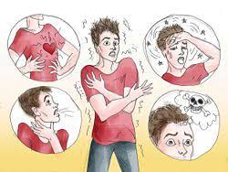
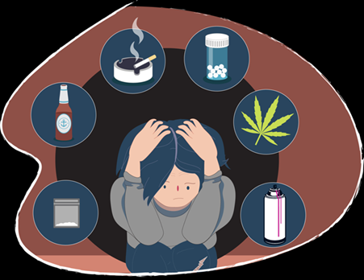
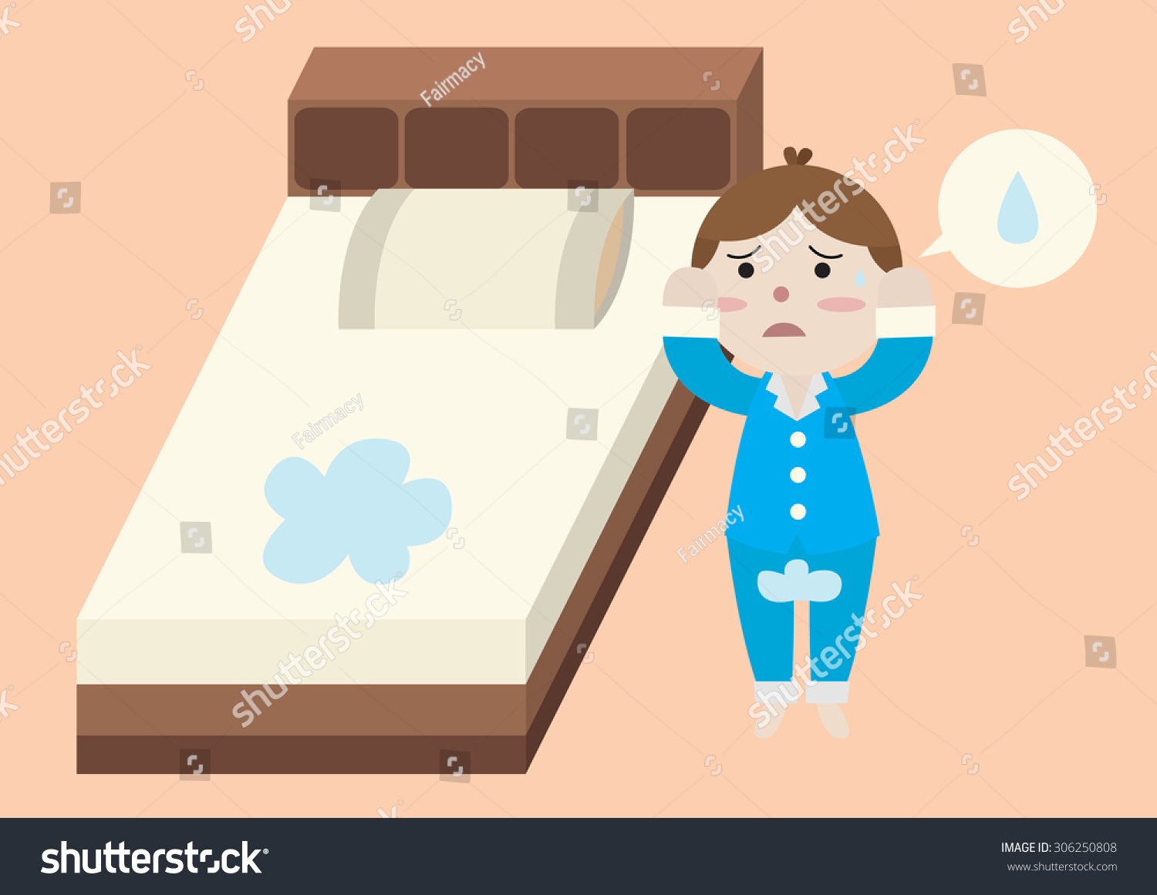
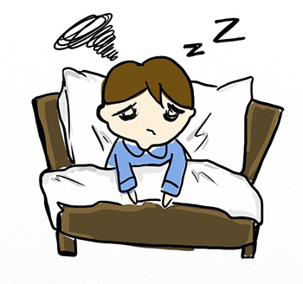
Anxiety Disorder- Worry , Fear, Somatic, Regression

Slide 11
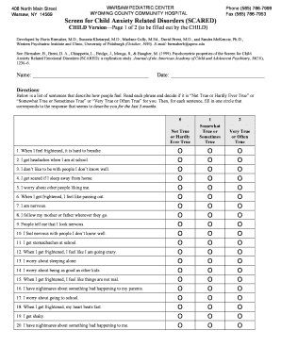
Anxiety Assessment
Clinical Assessment
Trauma screen
Anxiety Scales
Family history
Medical workup
GAD 7 scale
SCARED scale

Slide 12
DSM diagnoses
Generalized Anxiety
Social Anxiety
Separation Anxiety
Phobias
Panic attacks/ disorder

Slide 13
Management
Environment
Therapy
Medication
Facts/ Control
Keep a routine
Self care
Calming exercises
Physical exercise
Anxious children often have anxious parents
Therapy
Psychotherapy- CBT, play therapy, supportive therapy
Response to CBT: 55-80%
SSRIs (best evidence)
SNRIs (limited data)
Hydroxyzine
Anticholinergics
Buspar
Benzos- probably not!

Slide 14
Expectation from treatment
Manage not eliminate
Hard work and homework
Parent participation
Therapy: meds- 70:30

Slide 15
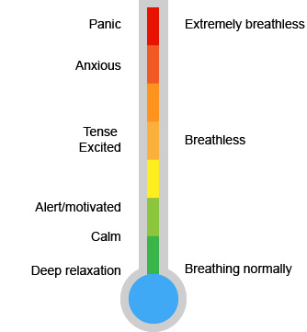
At home
Normalize
Avoid avoidance
Routine
Self care/sleep
Social bonds
Parental Anxiety
Child directed activity
Relaxation/Breathing
Daily check in

Slide 16
Therapy
Supportive- life events
CBT- negative thought patterns
Behavioral modification/ Parent management Training- disruptive behaviors
Exposure /response prevention- compulsive/ avoidant behaviors
CBT-I
Trauma focused- fixation on a difficult event or time

Slide 17
Medication Discussion
Support success of therapeutic behaviors
Improve tolerance of anxiety*
Time to therapeutic effect
Black box warning
Sexual side effects
Discontinuation syndrome
Serotonin syndrome

Slide 18
Medication
SSRI (FDA approval) | Start (mg) | Maximum (mg) | Increments (mg)
Sertraline (6+) | 12.5- 25 | 200 | 12.5-25
Fluoxetine (6+OCD) (8+MDD) | 5-10 (2.5) | 60 | 5-10
Escitalopram (12+) | 5-10 (2.5) | 20 | 5
SNRI | Start (mg) | Maximum (mg) | Increments (mg)
Duloxetine (7 and up) | 30 (15) | 60 | 15-30

Slide 19
Other Anti anxiety
Citalopram- less safe than Lexapro
Fluvoxamine rarely used; FDA approval (8+)for OCD
Paroxetine- nonlinear kinetics
Venlafaxine- more side effects than Duloxetine
Buspirone- 5HT1A partial agonist/ may help till SSRI works
Antihistamines- can be sedating, anticholinergic
Benzo- addictive

Slide 20
SSRIs – How to?
Start Low –Go slow
some results in 4-8 weeks
Adequate trial or reassess ‘match’
Effect size – 0.7 for anxiety
NNT- 3 for non-OCD anxiety
Time to therapeutic effect and max dose

Slide 21
Treatment- Side Effects
Usually, none
Stomachache, nausea, diarrhea
Headache
Sexual (decreased libido, delayed orgasm, ED)
Activation
hypomania
Suicidality/ Black Box warning
Serotonin syndrome
Discontinuation syndrome
All effects (good and bad) seem ‘bigger’ to anxious children.

Slide 22
BBW- 2004
Increased risk of suicidal ideation (not attempts or completion) from 2% to 4%
Decrease in prescription after the warning led to increase in suicide rates (14% increase in the U.S between 2003-2004- largest recorded increase)
CAMS, 2008- Adverse events such as suicidal ideation were no more frequent in sertraline group than in placebo group

Slide 23
Serotonin Syndrome
GI: nausea, vomiting, diarrhea
Mental Status: agitation, delirium, hallucinations, coma
Autonomic Instability: tachycardia, labile blood pressure, diaphoresis, hyperthermia, flushing, dizziness
Neuromuscular: tremor, hyperreflexia, rigidity, myoclonus, hyperreflexia, incoordination

Slide 24
Discontinuation syndrome
Flu-like symptoms
GI symptoms – nausea, vomiting, diarrhea
--------------------
Dizziness, vertigo
Tingling/numbness
--------------------
Sleep disruption
Anxiety, agitation
Irritability, low mood

Slide 25
Resources
AACAP anxiety resource center: https://www.aacap.org/AACAP/Families_and_Youth/Resource_Centers/Anxiety_Disorder_Resource_Center/Home.aspx
AACAP- Facts for families
AACAP- parentsmedguide
AACAP- Practice parameter for Assesment and Treatment of Children with Anxiety Disorders.
https://www.aacap.org/App_Themes/AACAP/docs/practice_parameters/JAACAP_Anxiety_2007.pdf
Major studies
Child/ Adolescent Anxiety Multimodal study- walkup et al, 2008
Pediatric Obsessive Compulsive Disorder Treatment Study (POTS)- March et al, 2004

Slide 26
Books

Slide 27
School Accommodations
Gradual transition to school
Crisis pass
Buddy system
Scheduled check ins with counsellor
Teacher’s assistant
Social skills group
Assessment of learning difficulties
School Avoidance
Bullying
Anxiety about academics
Perfectionism
OCD
Social anxiety at school

Slide 28
Role of Physician/ provider
Developmental stage vs anxiety disorder
Contribution of child’s environment.
What is the most effective (appropriate) measure at this stage
Set expectations from treatment
Match with relevant therapy- get updates
Involve school early- get updates
Time to wean medication

Slide 29
Summary
Developmentally normal v/s pathological anxiety
Use a variety of assessment tools
Include parents in treatment
Treatment plan- Environment+ Therapy+ Meds
Thank you for your attention!

Slide 30
Thank you!
Maryland Behavioral Health Integration in Pediatric Primary Care (BHIPP)
1-855-MD-BHIPP (632-4477)
www.mdbhipp.org
Follow us on Facebook, LinkedIn, and Twitter! @MDBHIPP
For resources related to the COVID-19 pandemic,
please visit us at BHIPP Covid-19 Resources.
Notes:
You will a copy of these slides

