Slide 1
Maryland Behavioral Health Integration in Pediatric Primary Care (MD BHIPP) Resilience Break
3/19/2021
Understanding Adolescent Self-Injury
Hal Kronsberg MD
1-855-MD-BHIPP (632-4477)
www.mdbhipp.org
Follow us on Facebook, LinkedIn, and Twitter! @MDBHIPP

Slide 2
Conflict of interest disclosure
No potential conflicts of interest
Faculty at the Johns Hopkins School of Medicine
ECHO funding through the Health Resources and Services Administration

Slide 3
Definitions
Self-harm/self-injury (also known as “NSSI”)
  Deliberate inducement of pain or tissue damage without suicidal intent
  Often refers to “cutting” or “scratching”

Slide 4
Learning objectives
Identify conditions and characteristics associated with self-injury
Identify 4 risk factors for when self-injury is most associated with suicide attempts
Know how to ask about self-injury to understand its function and assess its dangerousness
Identify the 2 most common treatments most help kids who self-harm

Slide 5
Self-harm as a behavior
Why see it that way?
  Self-harm is not necessarily a treatable disorder itself but can signal the presence of other disorders
  Something reinforces self-harm to enable the behavior to persist
  To stop self-harm, you must address the antecedents and consequences
Notes:
Unlike a diagnosis, which is sort of the endpoint of an investigation, with self-harm this is often where our investigation has to begin

Slide 6
Prevalence, Risk Factors, and Characteristics

Slide 7
Self-harm: By the numbers: Pooling the Data
261 studies of adolescent self-harm
31,000 children and adolescents reviewed

Slide 8
By the Numbers: Rates of NSSI
Lifetime prevalence: 23%
Females 1.72x more likely than males to self-harm
Mean age at the first instance is 13 years
47% of kids self-harm once or twice
5% of kids self-harm more than ten times
Rates have been increasing since 1990
Gillies, D., Christou, M. A., Dixon, A. C., Featherston, O. J., Rapti, I., Garcia-Anguita, A., ... & Christou, P. A. (2018). Prevalence and characteristics of self-harm in adolescents: meta-analyses of community-based studies 1990–2015. Journal of the American Academy of Child & Adolescent Psychiatry, 57(10), 733-741.
Notes:
In most kids, self-injury is fairly self-limited, even without treatment, though that doesn’t mean that we can ignore it

Slide 9
Self-Harm: By the Numbers - Increasing over time

Slide 10
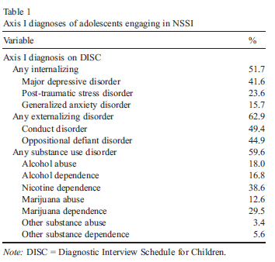
Other things to treat: Associated conditions
Inpatient participants
  Reported NSSI in the last 12 months
  Age 12-17
Comorbidities:
  High rates of depression
  High rates of trauma
  High rates of problems with “self-regulation”
  High rates of substance use
Nock, M. K., Joiner, T. E., Gordon, K. H., Lloyd-Richardson, E., & Prinstein, M. J. (2006). Non-suicidal self-injury among adolescents: Diagnostic correlates and relation to suicide attempts. Psychiatry research, 144(1), 65-72.
Notes:
Study of inpatients who engage in self-harm (in general, kids likely have greater severity of illness than outpatient community samples)
The purpose is not to use these numbers to guide us as much as it is to see how self-harm can be associated with many different conditions
MDD – 52%
PTSD – 42%
MJ use disorder – 30%

Slide 11
NSSI and Suicide
Just how worried should we be?

Slide 12
Self-harm and suicide
Predictors of self-harm and suicide attempts:
  Multiple methods of self-injury
  Hopelessness
  Parental conflict
  Depressive symptoms
Asarnow, J. R., Porta, G., Spirito, A., Emslie, G., Clarke, G., Wagner, K. D., ... & Mayes, T. (2011). Suicide attempts and nonsuicidal self-injury in the treatment of resistant depression in adolescents: findings from the TORDIA study. Journal of the American Academy of Child & Adolescent Psychiatry, 50(8), 772-781.

Slide 13
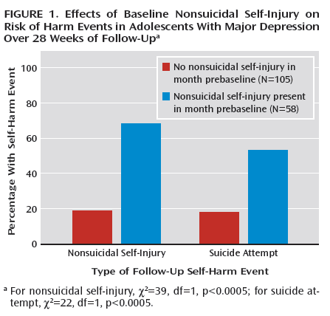
Self-harm and suicide
Study of depressed adolescents on SSRI treatment
Six months after assessment:
  No history of self-harm
    1 in 5 self-harm
    1 in 5 attempt suicide
  History of self-harm
    3x risk of self-harming again
    2x risk of suicide attempt
Wilkinson, P., Kelvin, R., Roberts, C., Dubicka, B., & Goodyer, I. (2011). Clinical and psychosocial predictors of suicide attempts and nonsuicidal self-injury in the Adolescent Depression Antidepressants and Psychotherapy Trial (ADAPT). American Journal of Psychiatry.
Notes:
Large treatment study of British adolescents
Even when depression is treated, self-harm can persist – it’s a “sticky” behavior
When self-injury and depression co-occur, we need to really emphasize safety planning around suicidal thoughts and urges

Slide 14
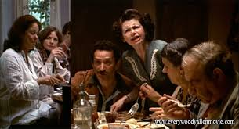
Do families have a role?
Expressed Emotion and criticism

Slide 15
Self-harm and families
Expressed Emotion (EE) – extent to which family members express criticism and hostility toward and are emotionally over-involved with a specific person.
EE is determined from the Five Minute Speech Sample
  Asked parents, “I’d like to hear your thoughts and feelings about (child’s name) in your own words and without my interrupting with any questions or comments. When I ask you to begin, I’d like you to speak for 5 minutes telling me what kind of person (child’s name) is and how the two of you get along together.”
Wedig, M. M., & Nock, M. K. (2007). Parental expressed emotion and adolescent self-injury. Journal of the American Academy of Child & Adolescent Psychiatry, 46(9), 1171-1178.

Slide 16
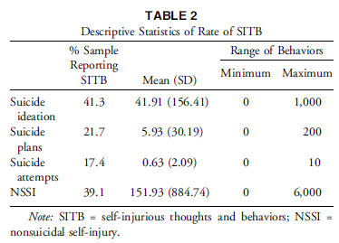
Self-harm and families
Subjects
  12 – 17 year old adolescents recruited from the community and clinics that asked for self-injurers and non-self-injurers
  Total of 36 adolescent-parent dyads

Slide 17
Self-harm and families
Results
  High EE was associated with increased self-harm and suicidal ideation and behavior
    Only high parental criticism (not over-involvement) is associated with SIB
    High adolescent self-criticism does not play a role when parental criticism is low
    High levels of parental criticism, when combined with high levels of adolescent self-criticism was especially predictive and proved to be a toxic mixture that exponentially increased self-harm

Slide 18
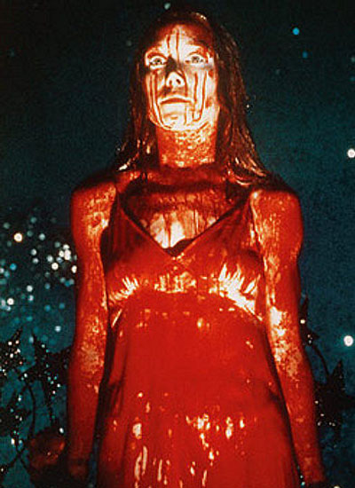
Are These Kids Different?
Challenges in Distress Tolerance and Interpersonal Effectiveness

Slide 19
Nock, M. K., & Mendes, W. B. (2008). Physiological arousal, distress tolerance, and social problem-solving deficits among adolescent self-injurers. Journal of consulting and clinical psychology, 76(1), 28.
Differences in Arousal and Distress Tolerance
Subjects
  Recruited 92 adolescents from newspaper ads
    62 engaged in self-harm and 30 controls
    Between 12 and 19
  No differences in gender, age, race, and IQ
  Of self-harmers: 48% in therapy and 46% on meds and 77% with at least one psychiatric disorder
    No psychiatric data on the control group

Slide 20
Nock, M. K., & Mendes, W. B. (2008). Physiological arousal, distress tolerance, and social problem-solving deficits among adolescent self-injurers. Journal of consulting and clinical psychology, 76(1), 28.
Measures
  Skin Conduction Testing – measure of physiological arousal
    Distress Tolerance Test – a card sorting task that seems to be solvable but isn’t
    Social Problem-Solving Skills Test – subject imagines different scenarios and potential responses

Slide 21
Nock, M. K., & Mendes, W. B. (2008). Physiological arousal, distress tolerance, and social problem-solving deficits among adolescent self-injurers. Journal of consulting and clinical psychology, 76(1), 28.
The Distress Tolerance Test
  Self-harmers had more arousal and no habituation (especially if they typically self-harm for negative reinforcement)
  Self-harmers quit the task earlier

Slide 22
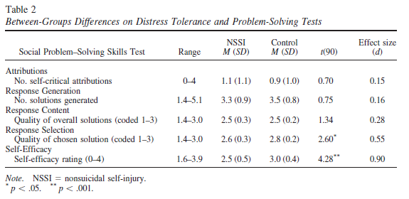
Nock, M. K., & Mendes, W. B. (2008). Physiological arousal, distress tolerance, and social problem-solving deficits among adolescent self-injurers. Journal of consulting and clinical psychology, 76(1), 28.
Social Problem-Solving Test
  Self-harmers generated the same number of solutions
  Self-harmers chose worse solutions and rated their choices more harshly
  Deficits are less about intelligence and more about judgment

Slide 23
Key Take-Home Points
Cutting alone doesn't tell us everything about diagnosis
Kids who cut often cut around 1-2x per week
Kids who self harm struggle more with strong emotions and can be harshly judgmental
Depressive symptoms, hopelessness, and high stress predict self-harm
Social support protects against self-harm
Watch out for different types of self-harm
FAMILIES MATTER

Slide 24
Why Do Kids Self-Harm?
Understanding the problem more fully

Slide 25
Self Harm’s Four Outcomes
How does self-harm “work”?
Increase in desired feelings: self-punishment , self-stimulation, “endorphin release”
Decrease undesired feelings: feel less overwhelmed or sad or angry, reduce the feeling of emptiness
Increase a desired social response: gain attention or support (“manipulation”)
Decrease undesired social response: stop bullying or fighting
Nock, M. K. (2010). Self-injury. Annual review of clinical psychology, 6, 339-363.

Slide 26
What Kids Report
25% to increase a desired feeling
65% to decrease an unpleasant feeling
  35% to escape anxiety (feeling “overwhelmed”)
  24% to escape sadness
  20% to escape anger
  29% to escape a “bad thought” or “bad memory”
4% to create a desired interpersonal outcome
15% to decrease a negative interpersonal outcome
Nock, M. K., Prinstein, M. J., & Sterba, S. K. (2009). Revealing the form and function of self-injurious thoughts and behaviors: A real-time ecological assessment study among adolescents and young adults. Journal of abnormal psychology, 118(4), 816.

Slide 27
Asking About Self-Harm
No Such Thing as a “Stupid Question”
Notes:
Bold are the things you want to prioritize in a 15 minute visit

Slide 28
Guiding Principles
Respond with “supportive concern”
Review confidentiality rules but give yourself some wiggle room (what’s ok, what’s not ok, and what do you and your patient do when there’s something in between)
Keep the Four Outcomes Model in mind
Safety first!

Slide 29
The “What” of Cutting
When did it start?
How do you self-harm?
  Cutting? Burning? Scratching? Purging? Using drugs? How many different ways?
  How often?
  Where do you self-harm?
  With what?
  Ask to see scars
Who knows?
  How do those people feel about it?
  What do your parents know about your self-harm?
Notes:
Bold are the things you want to prioritize in a 15 minute visit

Slide 30
The “Why” of Cutting
In general, how are you feeling before you cut?
What does it do for you?
  Does it help you feel more or less of a particular emotion?
How do other people react to your cutting?
  How do you feel about that reaction?
How “well” does it work?

Slide 31
The “What Next” of Cutting
Assess suicidality (self-harm may not be a suicide attempt, but the person self-harming may still be suicidal)
Figure out what to treat (remember all those comorbid disorders?)
  No medication can treat self-harm
  Many medications can treat comorbid disorders
Be wary of being a “secret keeper”
  “How are we going to talk to your parents about cutting?”
Therapy will be necessary
Notes:
It’s likely you may want a quick return visit to more deeply dive into comorbidities

Slide 32
The “What Next” of Cutting
Helping parents make a Safety Plan
  No such thing as “contracting for safety”
  Remove lethal means (firearms, pills, etc)
  Empower parents to gently ask their kids about suicide
  It may be necessary to monitor social media
  Include written “if → then” contingency plans
Sample template: https://suicidepreventionlifeline.org/wp-content/uploads/2016/08/Brown_StanleySafetyPlanTemplate.pdf
Notes:
Maybe post on fridge etc.

Slide 33
Treatments that Work

Slide 34
Therapy helps
Strongest evidence and largest effect sizes:
  Dialectical Behavioral Therapy
  Cognitive-Behavioral Therapy
  Mentalization Based Therapy
Key ingredients in treatment:
  Focus on family interactions
  Frequent meetings with the adolescent
  Emphasize self-care: sobriety, sleep, increasing positive experiences
Ougrin, D., Tranah, T., Stahl, D., Moran, P., & Asarnow, J. R. (2015). Therapeutic interventions for suicide attempts and self-harm in adolescents: systematic review and meta-analysis. Journal of the American Academy of Child & Adolescent Psychiatry, 54(2), 97-107.
Brent, D. A., McMakin, D. L., Kennard, B. D., Goldstein, T. R., Mayes, T. L., & Douaihy, A. B. (2013). Protecting adolescents from self-harm: a critical review of intervention studies. Journal of the American Academy of Child & Adolescent Psychiatry, 52(12), 1260-1271.
Notes:
Think back to the EE data that shows high parental criticism can be a risk factor for self-harm. Good treatment will help families communicate in a more validating way.

Slide 35
DBT vs CBT
Dialectical Behavioral Therapy
Cognitive Behavioral Therapy
Strongest evidence base
Mix of group and individual treatment
Parent component
Emphasis on “skills” to replace self-injury
“On-call” skills coaching
Hard to find treatment in rural areas
Weaker evidence base
Individual and parent treatment
Emphasis on thoughts and behaviors
No “skills coaching”
Much more commonly found treatment
Treats many comorbid conditions

Slide 36
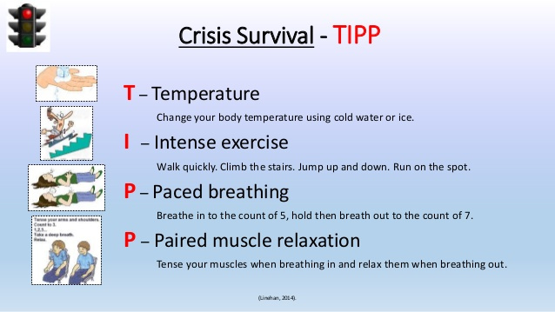
DBT Skill Example
https://dialecticalbehavioraltherapy.wordpress.com/distress-tolerance-tipp-skills/

Slide 37
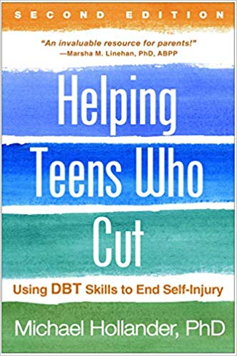
Educating Parents
Book intended for lay audiences by a major DBT authority
Explains the concepts and skills of DBT
May help parents respond to emotional distress more effectively

Slide 38
Educating Parents
www.selfinjury.bctr.cornell.edu

Slide 39
Key Take-Home Points
Whys
  Most kids typically self-harm to make a feeling go away
  Self-harm is rarely “for attention”
What nows
  Assess suicidality
  Determine the function of the self-harm
  Identify comorbidities
What next
  Treatments work!
Whats
Cutting alone doesn't tell us everything about diagnosis
Kids who cut rarely engage in more than 10 discrete episodes in their lives
Kids who self-harm struggle more with strong emotions
Kids who self-harm can have poor social judgment
Non-suicidal self injury is strongly associated with future suicide attempts

Slide 40
References
Asarnow, J. R., Porta, G., Spirito, A., Emslie, G., Clarke, G., Wagner, K. D., ... & Mayes, T. (2011). Suicide attempts and nonsuicidal self-injury in the treatment of resistant depression in adolescents: findings from the TORDIA study. Journal of the American Academy of Child & Adolescent Psychiatry, 50(8), 772-781.
Brent, D. A., McMakin, D. L., Kennard, B. D., Goldstein, T. R., Mayes, T. L., & Douaihy, A. B. (2013). Protecting adolescents from self-harm: a critical review of intervention studies. Journal of the American Academy of Child & Adolescent Psychiatry, 52(12), 1260-1271.
Gillies, D., Christou, M. A., Dixon, A. C., Featherston, O. J., Rapti, I., Garcia-Anguita, A., ... & Christou, P. A. (2018). Prevalence and characteristics of self-harm in adolescents: meta-analyses of community-based studies 1990-2015. Journal of the American Academy of Child & Adolescent Psychiatry, 57(10), 733-741.
Lewis, S. P., Mahdy, J. C., Michal, N. J., & Arbuthnott, A. E. (2014). Googling Self-injury: the state of health information obtained through online searches for self-injury. JAMA pediatrics, 168(5), 443-449.
Nock, M. K. (2010). Self-injury. Annual review of clinical psychology, 6, 339-363.
Nock, M. K., Joiner, T. E., Gordon, K. H., Lloyd-Richardson, E., & Prinstein, M. J. (2006). Non-suicidal self-injury among adolescents: Diagnostic correlates and relation to suicide attempts. Psychiatry research, 144(1), 65-72.
Nock, M. K., Prinstein, M. J., & Sterba, S. K. (2009). Revealing the form and function of self-injurious thoughts and behaviors: A real-time ecological assessment study among adolescents and young adults. Journal of abnormal psychology, 118(4), 816.
Ougrin, D., Tranah, T., Stahl, D., Moran, P., & Asarnow, J. R. (2015). Therapeutic interventions for suicide attempts and self-harm in adolescents: systematic review and meta-analysis. Journal of the American Academy of Child & Adolescent Psychiatry, 54(2), 97-107.
Wedig, M. M., & Nock, M. K. (2007). Parental expressed emotion and adolescent self-injury. Journal of the American Academy of Child & Adolescent Psychiatry, 46(9), 1171-1178.
Nock, M. K., & Mendes, W. B. (2008). Physiological arousal, distress tolerance, and social problem-solving deficits among adolescent self-injurers. Journal of consulting and clinical psychology, 76(1), 28.
Wilkinson, P., Kelvin, R., Roberts, C., Dubicka, B., & Goodyer, I. (2011). Clinical and psychosocial predictors of suicide attempts and nonsuicidal self-injury in the Adolescent Depression Antidepressants and Psychotherapy Trial (ADAPT). American Journal of Psychiatry.

Slide 41
Thank you!
Maryland Behavioral Health Integration in Pediatric Primary Care (BHIPP)
1-855-MD-BHIPP (632-4477)
www.mdbhipp.org
Follow us on Facebook, LinkedIn, and Twitter! @MDBHIPP
For resources related to the COVID-19 pandemic,
please visit us at BHIPP Covid-19 Resources.
Notes:
You will a copy of these slides

