Slide 1

Maryland BHIPP
Improving Treatment of
OUD in Youth
December 18th, 2020 12:30 – 1:30 PM
Marc Fishman, M.D.
855-MD-BHIPP (632-4477)​
www.mdbhipp.org​
855-337-MACS (6227)​
www.MarylandMACS.org

Slide 2
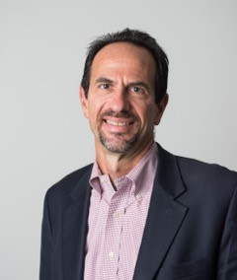

Meet The Presenter
Mark Fishman, M.D.
Marc Fishman, MD, is an addiction psychiatrist, Medical Director of Maryland Treatment Centers, and a member of the Psychiatry faculty of the Johns Hopkins University School of Medicine. Dr Fishman leads Maryland Treatment Centers, a regional behavioral health care provider, which includes Mountain Manor Treatment Centers in Baltimore and Emmitsburg as well as several other inpatient and outpatient programs. In that role he has been involved in development and implementation of innovative programming in addiction and co-occurring disorder treatment. His clinical specialties include treatment of drug-involved and dual-diagnosis youth, opioid addiction in adolescents and adults, and addiction with co-occurring psychiatric disorders. His research work has focused on medication treatment for SUDs as well as, models of care and treatment outcomes in youth, in particular opioid addiction. He has been a president of the MD Society of Addiction Medicine and is currently a member of its Board.

Slide 3
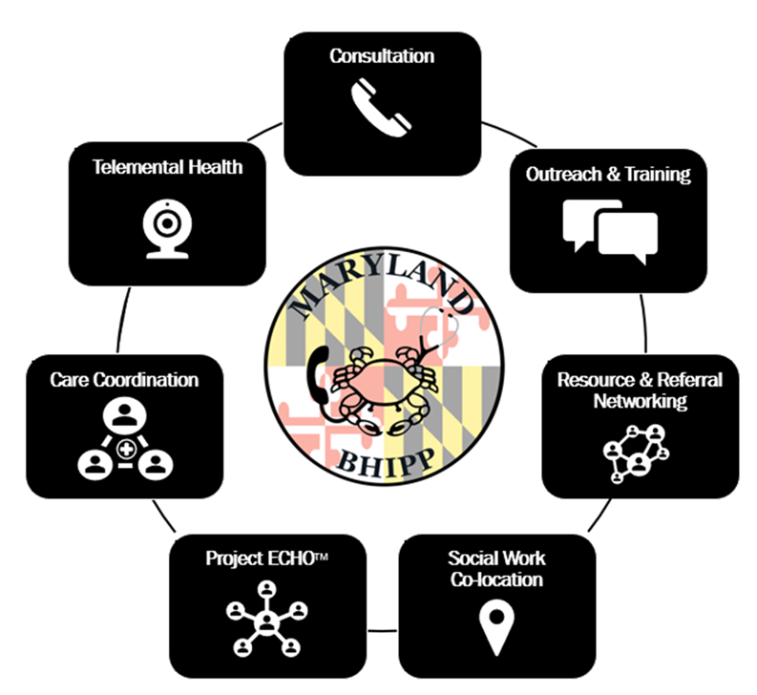
Who We Are – Maryland BHIPP
Offering support to pediatric primary care providers through free:
  Telephone consultation (855-MD-BHIPP)
  Resource & referral support
  Training & education
  Regionally specific social work co-location (Salisbury University and Morgan State University)
  Project ECHO®
  Coming soon!
  Direct Telespsychiatry & Telecounseling Services
  Care coordination
Notes:
Maryland Behavioral Health Integration in Pediatric Primary Care or BHIPP is a Child Psychiatry Access Program that supports the capacity of primary care providers in Maryland to manage pediatric mental health concerns. We do this, currently, in a number of ways: 1. We offer a free behavioral health telephone consultation service, including resource and referral support, 2. education and training, 3. Through our partnership with Salisbury and Morgan State University, we offer co-location of social work interns at select primary care sites, 4. Web-based longitudinal learning through Project ECHO similar to today’s event, 5. Direct telepsychiatry and telecounseling services (coming soon) , 6. Care Coordination (coming soon)

Slide 4




Partners & Funding
BHIPP is supported by funding from the Maryland Department of Health, Behavioral Health Administration and operates as a collaboration between the University of Maryland School of Medicine, the Johns Hopkins University School of Medicine, Salisbury University and Morgan State University.
This program is supported by the Health Resources and Services Administration (HRSA) of the U.S. Department of Health and Human Services (HHS) as part of an award totaling $433,296 with approximately 20% financed by non-governmental sources. The contents of this presentation are those of the author(s) and do not necessarily represent the official views of, nor an endorsement, by HRSA, HHS or the U.S. Government. For more information, visit www.hrsa.gov.

Slide 5

BHIPP is Available to Provide Support to PCPs During the Pandemic
Ways to Connect:
Visit our COVID-19 Resource Page:
www.mdbhipp.org
Sign up for our newsletter:
https://mdbhipp.org/contact.html
Follow us on Facebook:
https://www.facebook.com/MDBHIPP/
Follow us on Twitter:
https://twitter.com/MDBHIPP

Slide 6

Maryland Addiction Consultation Service (MACS)
Provides support to prescribers and their practices in addressing the needs of their patients with substance use disorders and chronic pain management.
All Services are FREE
Phone consultation for clinical questions
Education and training opportunities related to substance use disorders and chronic pain management
Assistance with addiction and behavioral health resources and referrals
Technical assistance to practices implementing or expanding office-based addiction treatment services
MACS TeleECHO™ Clinics: collaborative medical education through didactic presentations and case-based learning
1-855-337-MACS (6227) • www.marylandMACS.org

Slide 7
Disclosures
Consultant for Alkermes, US World Meds, Drug Delivey LLC, Verily Life Sciences, Danya, ASAM
Research funding from Alkermes, US World Meds, NIH, Arnold Foundation, University of MD

Slide 8
Outline
Background and scope of the problem
Barriers to success along the OUD treatment cascade
Treatment: Survey of current evidence and emerging models of care
New directions:
  Engaging families and home delivery
  Primary care integration
  Recovery housing
Conclusions

Slide 9
Background
Opioid use disorder (OUD) is an advanced, malignant form of substance use disorder (SUD), usually beginning in youth
Young adults are disproportionately affected by the opioid epidemic
There is evidence and consensus for medications in OUD (MOUD) in youth, but dissemination is poor due to problems with capacity, misinformation, and prejudice
Developmental vulnerability in youth is prominent
Youth have worse outcomes than mature adults
Improved, developmentally-informed strategies that target engagement, retention and medication adherence could help
The Youth Opioid Recovery Support (YORS) intervention and others have promise as innovative approaches

Slide 10
Intervention for youth substance use is
Prevention for youth OUD
Addiction – a developmental disorder of pediatric onset
The vast majority of youth who initiate opioids have problems with other substances first
Earlier onset associated with worse outcomes
Earlier intervention associated with better outcomes
Opioid addiction as an advanced stage in progression of illness
Prevention of OUD by treatment of non-opioid SUD prior to opioid initiation – cannabis, alcohol, nicotine

Slide 11
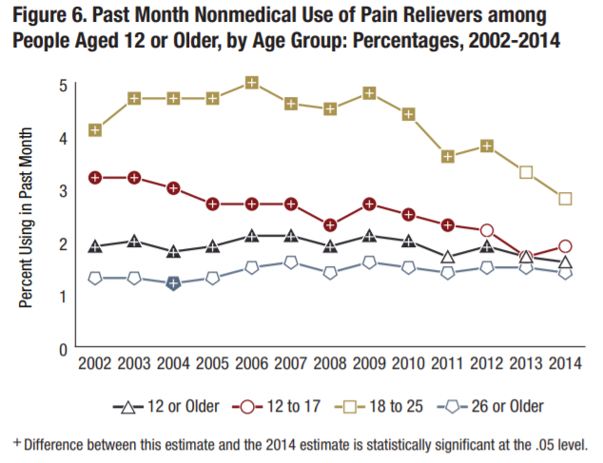
Young adults have the highest prevalence of use of non-medical prescription opioids.
NSDUH, 2014
Notes:
Verify dosing
Notify prescriber/clinic
Discuss plan for pain non judgmental manner
Higher doses, shorter intervals
Continuous scheduled (rather than as needed)
Use of non-opioid analgesics
Ir/sa combination
Adding 2mg buprenorphine for the addition of pain

Slide 12
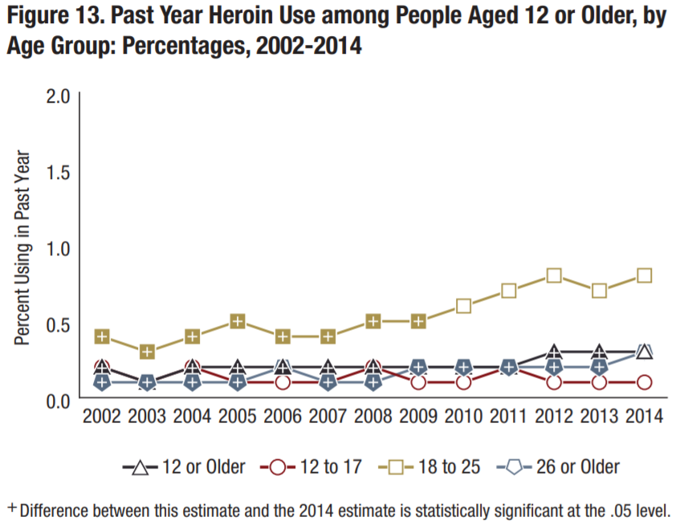
Young adults have the highest prevalence of use of heroin.
NSDUH, 2016
Notes:
Verify dosing
Notify prescriber/clinic
Discuss plan for pain non judgmental manner
Higher doses, shorter intervals
Continuous scheduled (rather than as needed)
Use of non-opioid analgesics
Ir/sa combination
Adding 2mg buprenorphine for the addition of pain

Slide 13
CTN Youth Buprenorphine Study
Opioid Positive Urines: 12 weeks Bup vs Detox
Woody et al JAMA. 2008.
Notes:
Mean age 19
At 9 wk prior to beginning of taper 50 opioid neg vs 25% opioid neg control
12 wk retention 70% vs 21%

Slide 14
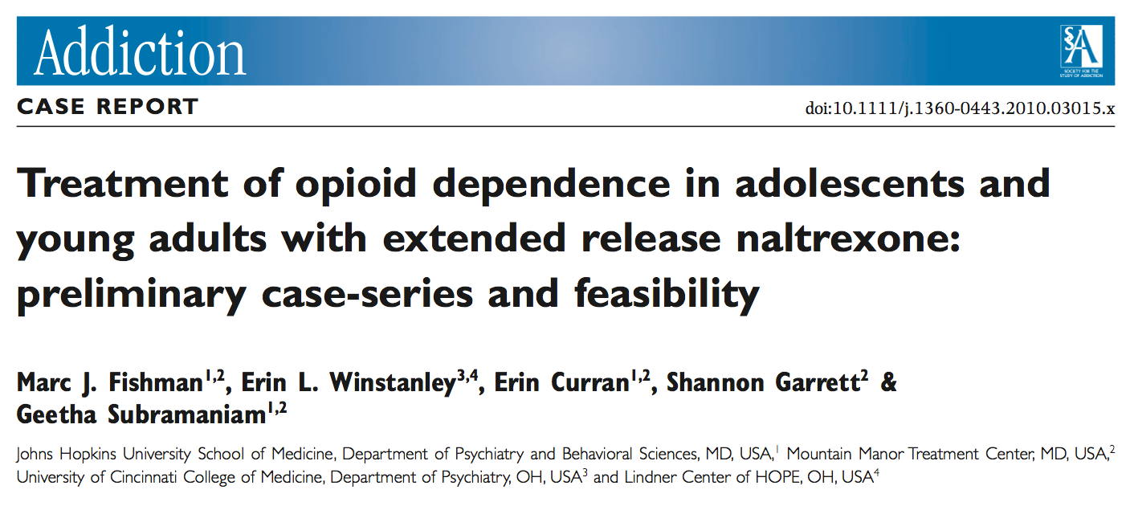
20 youth received extended release naltrexone
16 youth initiated outpatient treatment
10 youth retained at 4 months
9 youth “good outcome”

Slide 15
Medications promote retention for youth (But poor uptake)
Medicaid claims datasets, 11 states, ages 13-22
N = 4837 youths dx OUD (out of 2.4M, 0.2%)
76% received any treatment within 3 months of dx
52% received psychosocial services only
26% received any medication (5% for age <18 yrs).
Hadland et al. JAMA Pediatrics 2018

Slide 16
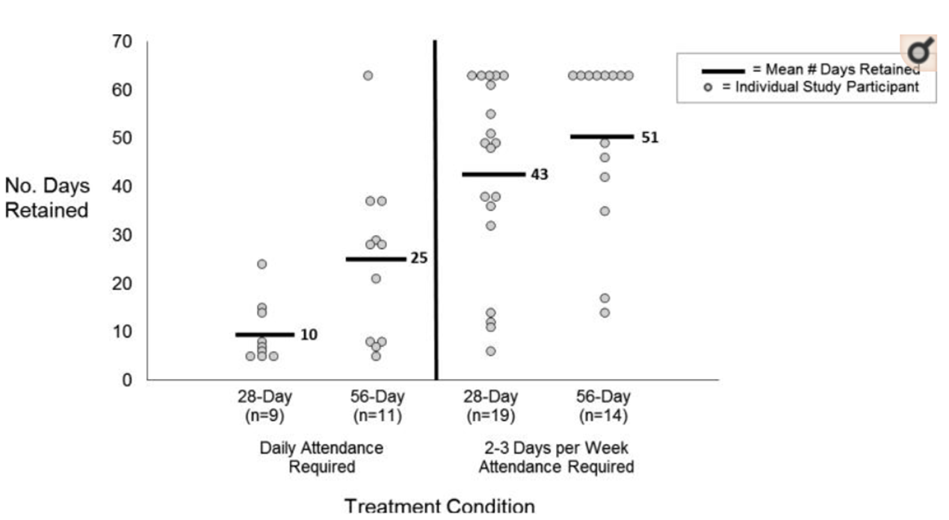
Duration of Treatment
Impact of Treatment Delivery
Participants who received 56-day buprenorphine were retained in treatment significantly longer than participants who received 28-day buprenorphine
Participants who had intermediate program requirements were retained in treatment significantly longer than participants who had very intensive program requirements
Marsch et al. (2016): Addiction: 111(8): 1406-1415

Slide 17
Retention bup treatment
young adults vs older adults

Slide 18
Young adults have worse outcomes vs older adults:
XBOT secondary analysis
Per protocol
49%
OR=1.91
34%
Fishman. J Adol Health 2020. In press.

Slide 19
MOUD for adolescents and young adults
Summary of the evidence
Buprenorphine effective (though outcomes not as good as for older adults)
Longer is better; no evidence for time limitation
XR-NTX promising, but little youth-specific research
MOUD promotes retention in all treatment for youth
No signal for safety problems based on age
MOUD first line; No evidence for fail-first

Slide 20
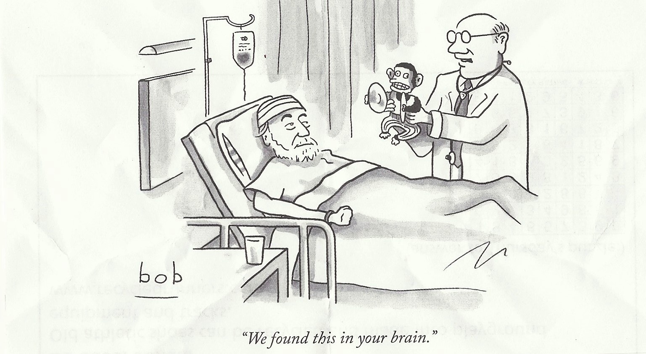
If only it were that easy

Slide 21
How should we help this young person?
22 M
Onset cannabis age 14
Onset prescription opioids 17, progressing to daily use with withdrawal within 8 months
Onset nasal heroin 18, injection heroin 6 months later
3 episodes residential tx, 2 AMA, 1 completed, but no continuing care
Buprenorphine treatment (monthly supply Rx x 4), took erratically, sold half
Presents in crisis seeking detox
  (“Can I be out of here by Friday?”)

Slide 22
Features of youth opioid treatment
Developmental barriers to treatment engagement
  Invincibility
  Immaturity
  Motivation and treatment appeal
  Less salience of consequences
  Strong salience of burdens of treatment
Variable effectiveness of family leverage
Pushback against sense of parental dependence and restriction
Prominence of co-morbidity

Slide 23
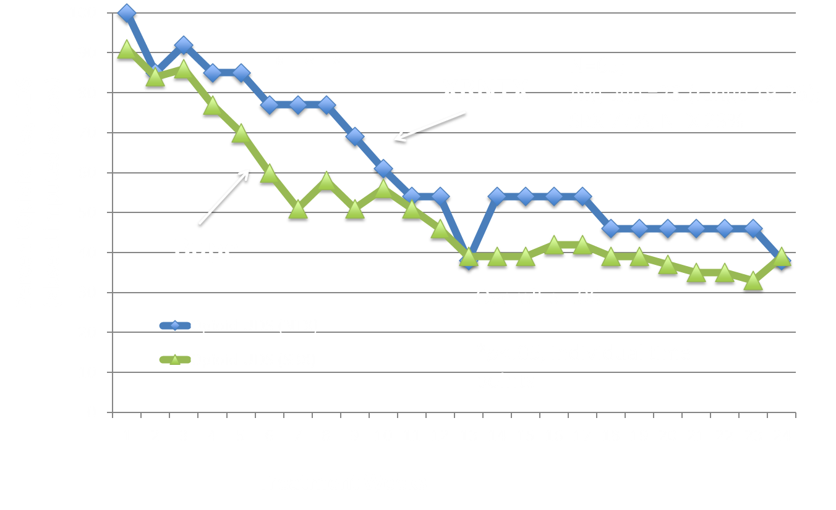
Young Adults
Enrolled in Specialty Intensive Outpatient (IOP)
Treatment Weeks
Vo et al. Relapse Prevention Medications in Community Treatment for Young Adults with Opioid Addiction. Substance Abuse. 2016

Slide 24
MOUD feasible for youth in real world
But poor adherence in community treatment
Treatment received in acute residential followed by multiple community providers, youth 15-21, N=288
    XRNTX 28%, Bup 33%, No meds 39%
Over 6 months following residential discharge low rates of MOUD use:
    XRNTX: mean doses 1.3
      41% 1st OP dose
      12% 3rd OP dose
      2% 6th OP dose
    Bup: mean days 57
Currently receiving MOUD higher for the bup group than XR-NTX or no medication at 6 months
Self-reported opioid use lower for XR-NTX group than bup and no meds at 3 and 6 months
Meeting OUD criteria lower for XR-NTX than no meds at 3 and 6 months, and than bup at 3 months
Mitchell et al. Under review JSAT. 2020.

Slide 25
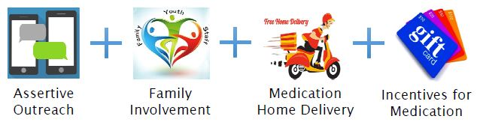
Example of Innovative Intervention
Youth Opioid Recovery Support (YORS)

Slide 26

Assertive Treatment
Well established for treatment of chronic illness in hard-to-reach populations in which medication adherence is a major barrier
  TB, HIV, schizophrenia (ACT)

Slide 27

Family Engagement: Historical Barriers
Normative pushback against sense of parental dependence and restriction
Clinicians: lack of training, competence, comfort
Focus on internal transformation
Preoccupying focus on “enabling”
Over-rigid concern with confidentiality

Slide 28
Rationale
Both families and youth need a recipe for treatment, with role definitions, expectations, and responsibilities
Families have core competence and natural leverage
Encouragement of emerging youth autonomy and self-efficacy is compatible with empowerment of families
Family mobilization – “Medicine may help with the receptors, but you still have to parent this difficult young person”

Slide 29
Family Framework Elements
Family education
3-way treatment plan, collaboration, and contract: youth, family, program
How will family know about attendance and treatment progress?
How will family help support attendance and treatment progress?
How will family help support medications?
What is the back-up or rescue plan if there is trouble?

Slide 30
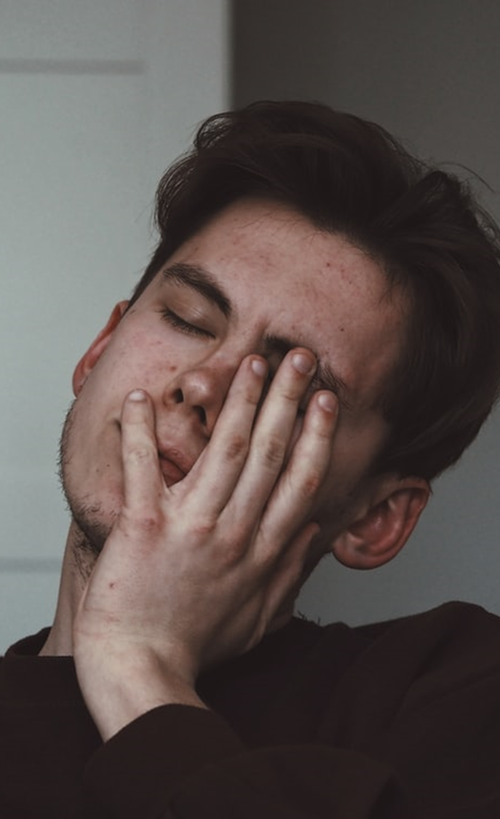
Principles of Family Negotiation
The Art of the Deal
Pick your battles
Know your leverage
You gotta give to get
You have more juice than you realize
Keep your eyes on the prize

Slide 31
Additional Components
Home delivery
Contingency management
Meet them where they are, literally
Prioritization of MOUD
Well established in research but little uptake in real-world care
Best studied target negative UDS
Medication adherence as target less well established but perhaps more generalizable?

Slide 32
Poster Child?
21-year-old male injecting heroin
5 inpatient detox admissions over 1.5 years, each time got first dose of extended-release naltrexone but never came back for 2nd dose
Lives with GM, team shows up with dose, he says no thank you, she says no not an option, done deal, gets 6 doses

Slide 33
Engagement – monitoring

Slide 34
Maintaining therapeutic optimism

Slide 35
Balancing parental and young adult empowerment
Patient: “Mom, you can’t be in here when I’m getting the shot…”
Therapist: “Ma’am I think it’s best if we provide her privacy for the injection.”
Mother: “Are you kidding me? Of course I am. I’m not leaving this room till I see that medicine go in you…”

Slide 36
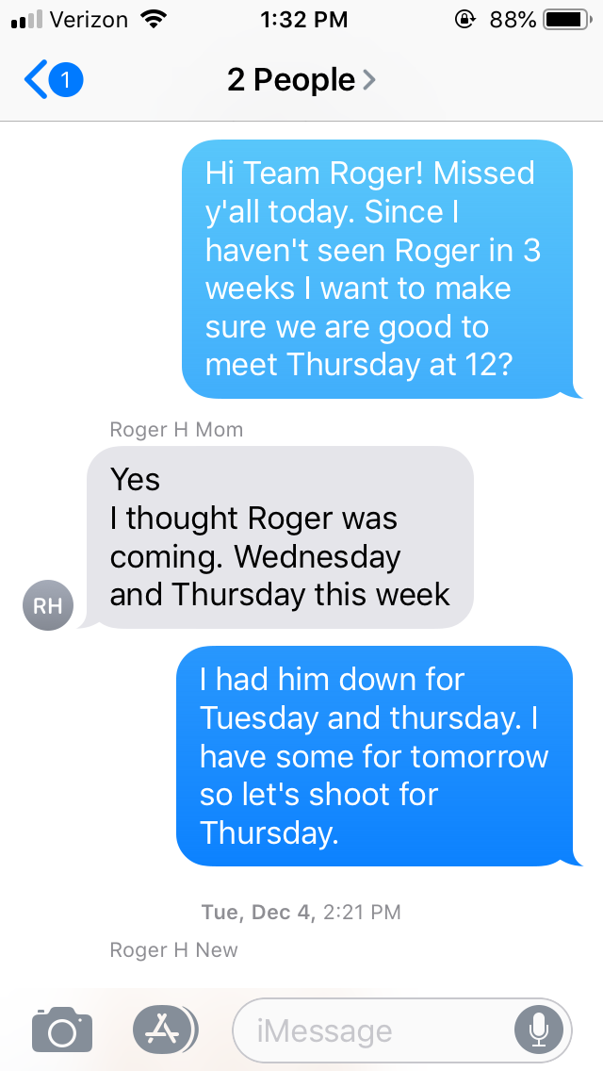
Keep your eyes on the prize

Slide 37
Don’t take no for an answer

Slide 38
YORS Pilot RCT
Ages 18-26, OUD, seeking XR-NTX
Recruitment through index episode of acute residential treatment, with detox
Randomization to YORS vs TAU
6 months duration
N = 38
Outcomes: doses received, opioid relapse (>10d use per 28d, missing imputed pos)
Fishman M, et al. “A pilot randomized controlled trial of assertive treatment including family involvement and home delivery of medication for young adults with opioid use disorder.” Addiction. In Press. 2020.

Slide 39
Receipt of Cumulative XR-MOUD Doses
Received all prescribed doses: 44% vs 0%
Fishman M, et al. Addiction. 2020.

Slide 40
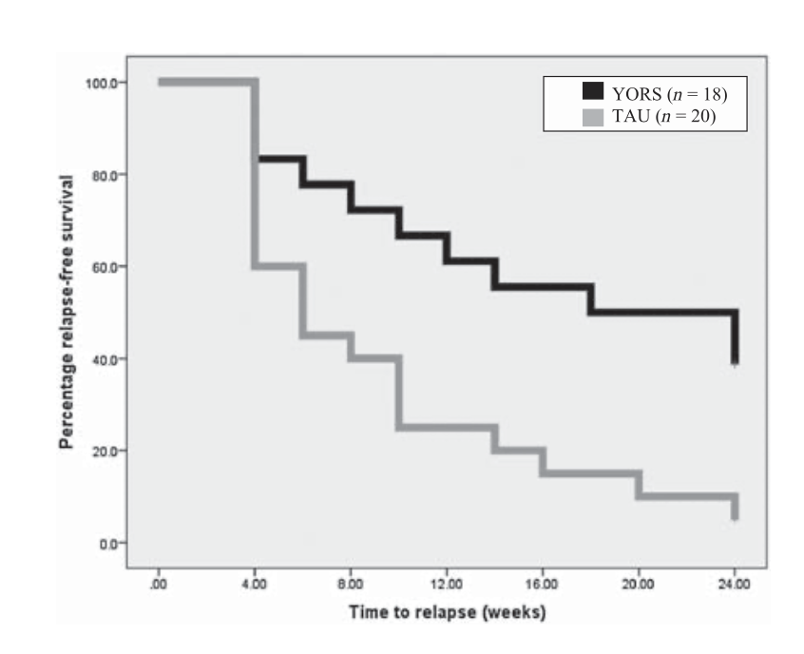
YORS Outcomes: Opiod Relapse-Free Survival
N=18
(HR 2.72,
CI 1.26–5.88)
N=20
Fishman M, et al. Addiction. In Press. 2020.

Slide 41
YORS pilot Study #2
Ages 18-26, OUD, seeking XR-MOUD, choice of XR-NTX or XR-Bup
Recruitment through index episode of acute residential treatment, with detox
Hgistorical comparison TAU group from study #1
Variable duration 12-24 wks
N = 22
Outcomes: doses received, opioid relapse (>10d use per 28d, missing imputed pos)
Wenzel et al. Choice of extended release medication for OUD in young adults (buprenorphine or naltrexone): a pilot enhancement of the Youth Opioid Recovery Support (YORS) intervention. JSAT. Under revision. 2020.

Slide 42
Mean outpatient MOUD doses received
Study 1
(XR-NTX only)
Study 2
(patient choice XR-NTX or XR-BUP)

Slide 43
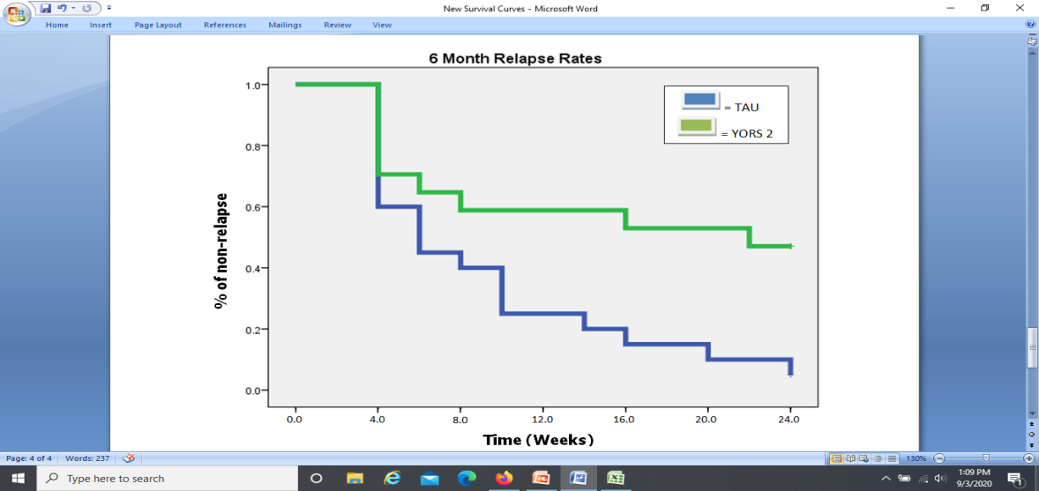
YORS Outcomes: Opiod Relapse-Free Survival
Study 1
(XR-NTX only)
Study 2
(Patient choice XR-NTX or XR-Bup)
N=18
N=22
(HR 2.72,
CI 1.26–5.88)
HR=2.65,
CI: 1.17-6.02
Fishman M, et al. Addiction. In press. 2020.
Wenzel K, et al. JSAT. Under revision. 2020.

Slide 44
YORS HEAL
Yrs 1-2: intervention enhancement, 3 test cycles
Yrs 2-5: larger RCT of enhanced YORS

Slide 45
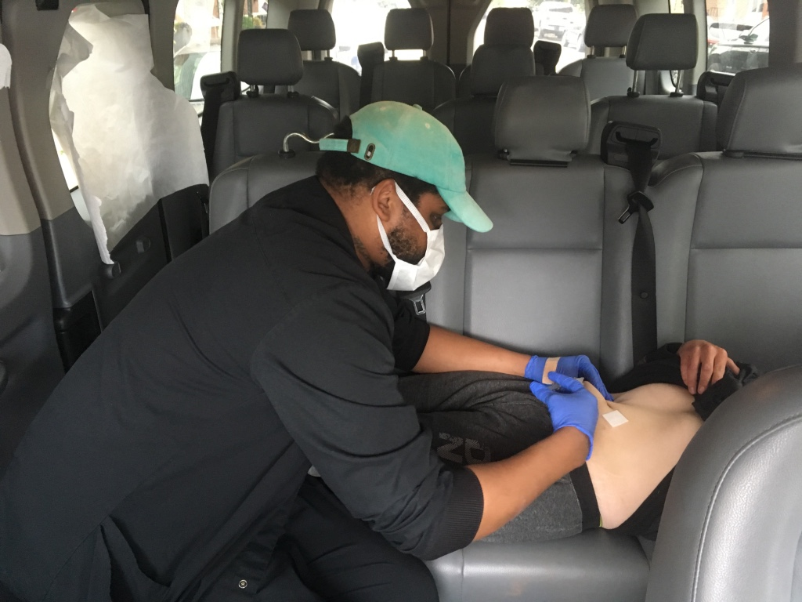
Enhancement test cycles
Test cycle #1: Covid adaptations
  Use of telehealth
  Mobile van delivery
Test cycle #2: reSet m-health app
Future
  Parent peers?
  Parent CM?
  Home (or van) delivered counseling
  Others?
Wenzel and Fishman. Mobile van delivery of extended-release buprenorphine and extended-release naltrexone for youth with OUD: An adaptation to the COVID-19 emergency. JSAT. In press. 2020

Slide 46

Example of Innovative Intervention
Primary Care Delivery, Hub and Spoke
MOUD in youth serving primary care (spokes)
Consultation and support from regional special center (hub)
Levy S, et al. A Novel Approach to Treating Adolescents with Opioid Use Disorder in Pediatric Primary Care. Substance Abuse. 2018

Slide 47
Example of innovative intervention
Youth OUD recovery housing
Youth-specific
OUD-specific
Emphasis on MOUD, co-occurring disorder treatment, and accommodation to youth shenanigans
Embedded in full continuum of care

Slide 48
Recommendations
Low hanging fruit
Youth SUD providers should prioritize OUD treatment including use of MOUD
Youth serving medical providers should identify OUD cases and treat with MOUD
Typical upstream touchpoints should trigger assertive treatment outreach – OD, ED, medical hospitalization, psychiatric hosp

Slide 49
Recommendations
Not-so-low hanging fruit
Development of innovative approaches needed to improve engagement and retention, esp for high-severity, high-chronicity patients

Slide 50
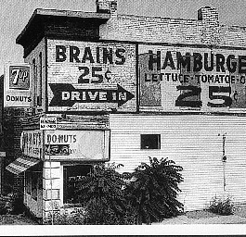
A Call to Action
We are at a crossroads
We have an existing and emerging toolbox but an alarmingly low level of adoption and utilization
Emerging research and clinical consensus support aggressive treatment of youth with OUD including MOUD
Therapeutic optimism remains one of our best tools!
We are saving lives, but we need to do better
Developmentally-informed assertive interventions might help
If not now, then when?
Hypothetical miracle cures?

Slide 51
Selected References
Wenzel et al. Choice of extended release medication for OUD in young adults (buprenorphine or naltrexone): a pilot enhancement of the Youth Opioid Recovery Support (YORS) intervention. JSAT. Under revision. 2020.
Wenzel K and Fishman M. Mobile van delivery of extended-release buprenorphine and extended-release naltrexone for youth with OUD: An adaptation to the COVID-19 emergency. JSAT. In press. 2020
Hogue A, Becker S, Fishman M, Henderson C, Levy S. Youth OUD Treatment During and After COVID: Increasing Family Involvement across the Services Continuum. JSAT. In press. 2020.
Fishman M, Wenzel K, Scodes J, Pavlicova M, Lee J, Rotrosen J, Nunes E. Young adults have worse outcomes than older adults: Secondary analysis of a medication trial for opioid use disorder. J Adol Health. In Press. 2020.
Fishman M, Wenzel K, Vo H, Wildberger J, Burgower R. “A pilot randomized controlled trial of assertive treatment including family involvement and home delivery of medication for young adults with opioid use disorder.” Addiction. In Press. 2020. .
Woody G, Fishman M. “Medication for Opioid-Addicted Youth – What are We Waiting For?” J Adol Health. 67: 9-10. July 2020.
Monico L, Ludwig A, Lertch E, Dionne R, Fishman M, Schwartz R, Mitchell S. “Opioid overdose experiences in a sample of US adolescents and young adults: a thematic analysis." Addiction. In Press. 2020.
Vo H, Burgower R, Rozenberg I, Fishman M. Home-based Delivery of XR-NTX in Youth with Opioid Addiction. J Subst Abuse Treat. 85 (2018) 84–89. PMID: 28867062

Slide 52
Thank you!
Questions?

