Slide 1
Maryland Behavioral Health Integration in Pediatric Primary Care (MD BHIPP) Resilience Break: Helping Families Manage ADHD in Primary Care October 8th, 2021 Mark A. Riddle, M.D.
1-855-MD-BHIPP (632-4477)
www.mdbhipp.org
Follow us on Facebook, LinkedIn, and Twitter! @MDBHIPP

Slide 2
Personal, Professional or Financial Conflicts of Interest
None

Slide 3
Learning Objectives
Be able to screen and assess a child with possible ADHD
Be able to manage the child’s care by working with caregivers and school
Be able to effectively prescribe medication and manage side effects

Slide 4
Outline
Background Information
Clinical Assessment
Illness Education
Treatment Overview
Sleep, Exercise and Substances
Quick and Simple Behavioral Interventions
School Advocacy and Consultation
Medication

Slide 5
Why ADHD?
Most common chronic illnesses in children and adolescents in the U.S. are asthma, obesity and ADHD
Only about 60% of patients with ADHD get medical care
Academic, social and emotion consequences are substantial
Primary care clinicians are best suited to assess and treat ADHD
Treatments can be provided that are time- and cost-effective

Slide 6
ADHD Treatment & COVID-19: Was/Is a Perfect Hot Mess
Sleep Interventions
Disrupted by irregular schedule and less activity
Medication
Minimal useful teacher data for monitoring effect
Behavior Management Training
Parents must manage behavior during school
School Interventions (eg, 504, IEP)
Not as effective during virtual learning

Slide 8
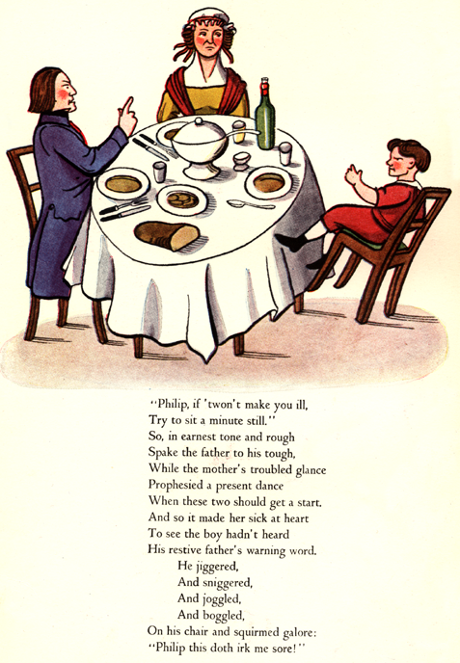

Slide 9
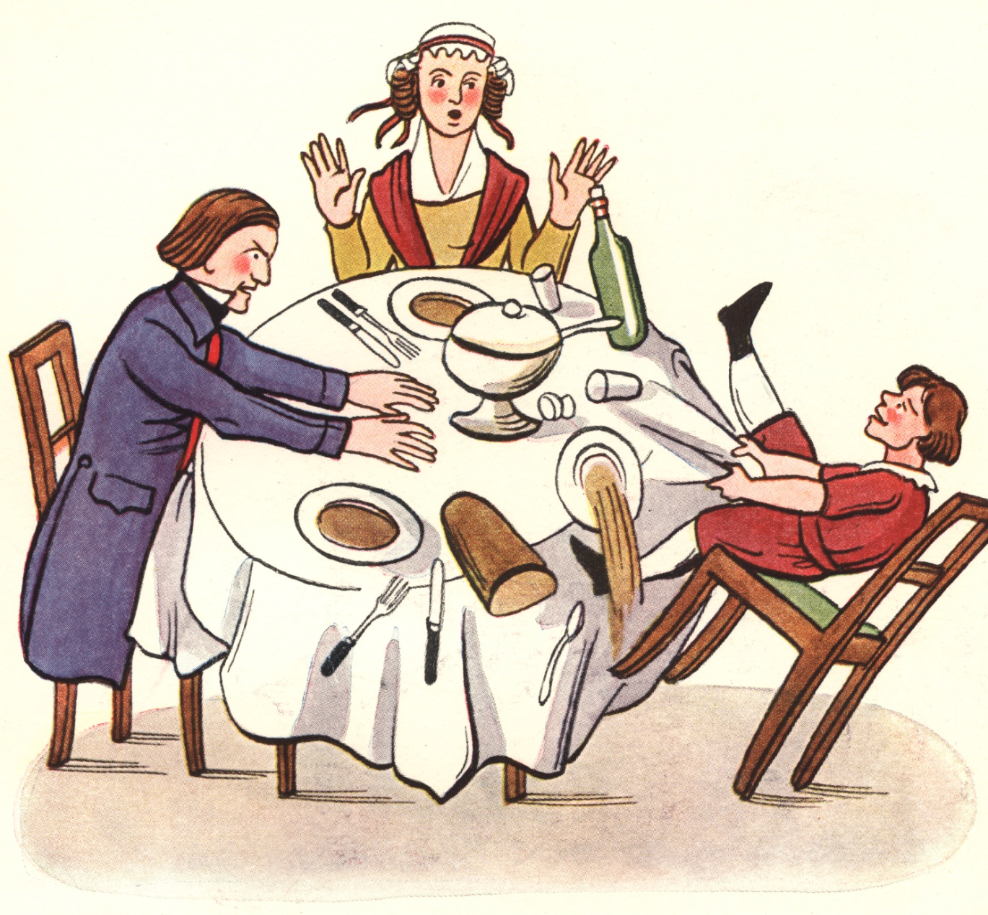

Slide 10
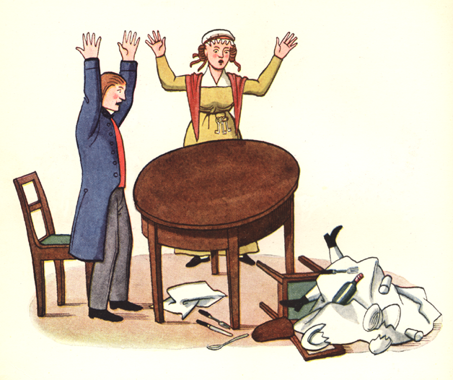

Slide 11
Prevalence and Natural History of ADHD
Diagnosis starts about age 3 & peaks age 8
During normal development, beyond childhood, activity level & impulsivity decrease
But, distractibility usually continues into adulthood.
Natural history: of children diagnosed by age 12:
1/2-3/4 continue into adolescence
1/3-1/2 continue into adulthood
Earlier onset likely associated with stability of ADHD diagnosis over time
Estimated prevalence = 6% to 10% (6-17 yo)
Riddle M et al. The Preschool Attention-deficit/hyperactivity disorder Treatment study (PATS) 6-year follow-up. Journal Of The American Academy Of Child & Adolescent Psychiatry . 2013;52:264-278.

Slide 12
Outline
Background Information
Clinical Assessment
Illness Education
Treatment Overview
Sleep, Exercise and Substances
Quick and Simple Behavioral Interventions
School Advocacy and Consultation
Medication

Slide 13
Screening Options for ADHD
Pediatric Symptom Checklist, 35 or 17 items
Problem because doesn’t just focus on ADHD
Daycare and/or Preschool and/or School concerns
Problem if staff don’t raise valid concerns with parents/caregivers
Annual Well Checks
Problem if parents/ caregivers don’t raise valid concerns
Symptoms, especially inattention, may not be obvious in the office setting

Slide 14
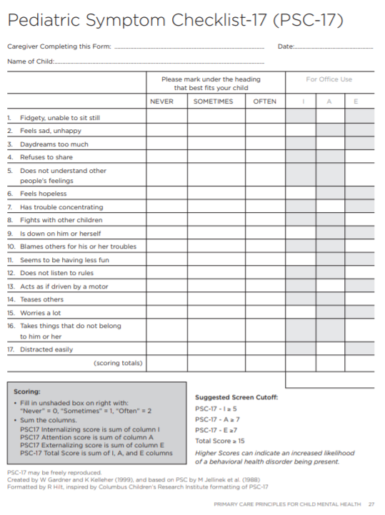
Screen for ADHD & more: Pediatric Symptom Checklist-17 (PSC-17)
For ages 8-15
Child self-report and parent-report versions
Brief version of PSC-35 that correlates well with longer comprehensive measures (e.g., CBCL)
takes approximately 3–5 minutes for parents/caretakers to complete
https://www.seattlechildrens.org/globalassets/documents/healthcare-professionals/pal/ratings/psc-17-rating-scale.pdf → PSC-17
https://www.massgeneral.org/psychiatry/treatments-and-services/pediatric-symptom-checklist
Includes multiple language, cartoon version, PSC-17 and PSC-35
W Gardner, A Lucas, DJ Kolko, JV Campo “Comparison of the PSC-17 and Alternative Mental Health Screens in an At-Risk Primary Care Sample” JAACAP 46:5, May 2007, 611-618

Slide 15
ADHD Items on PSC-17
1 Fidgety, unable to sit still
3 (Daydreams too much)
7 Has trouble concentrating
12 (Does not listen to rules)
13 Acts as if driven by a motor
17 Distracted easily

Slide 16
ADHD: 3 Subtypes in DSM-5
Combined
6 of 9 inattention + 6 of 9 hyperactivity/impulsivity items positive
common
mostly in boys
Inattentive
6 of 9 inattention
less common
mostly in girls and adults
Hyperactive-Impulsive
6 of 9 H/I symptoms
uncommon; may be something else

Slide 17
Child you know well brought by mother for concerns from school
6 yo boy (PJ)
First grade in public school
Struggled some in kindergarten: very active and sometimes inattentive
Primary teacher shared with parents concern that learning may be impaired by PJ’s trouble focusing and behaviors that disrupt the class
Primary teacher has given PJ as much individual attention as possible, but that hasn’t been sufficient
Parents have observed that PJ is more active and impulsive than older sister and brother, but have become concerned because his behavior is now disruptive at home
No history of trauma
No other neurodevelopmental or cognitive concerns

Slide 18
Vanderbilt – Parent – Inattention
Does not pay attention to details or makes careless mistakes, such as in homework.
Has difficulty sustaining attention to tasks or activities.
Does not seem to listen when spoken to directly.
Does not follow through on instruction and fails to finish schoolwork (not due to oppositional behavior or failure to understand).
Has difficulty organizing tasks and activities.
Avoids, dislikes, or is reluctant to engage in tasks that require sustained mental effort.
Loses things necessary for tasks or activities (school assignments, pencils, or books).
Is easily distracted by extraneous stimuli.
Is forgetful in daily activities.

Slide 19
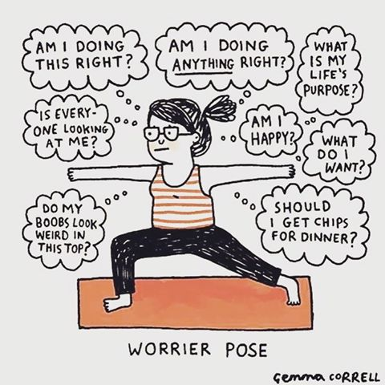
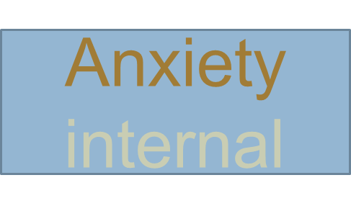
Distraction: external vs. internal
ADHD external

Slide 20
Vanderbilt – Parent – Hyperactivity and Impulsivity
Fidgets with hands or feet or squirms in seat.
Leaves seat when remaining seated is expected.
Runs about or climbs excessively in situations when remaining seated is expected.
Has difficulty playing or engaging in leisure activities quietly.
Is “on the go” or often acts as if “driven by a motor.”
Talks too much.
Blurts out answers before questions have been completed.
Has difficulty waiting his or her turn.
Interrupts or intrudes on others (butts into conversations or games).

Slide 21
Other Dsm-5 ADHD Criteria
Symptoms persist for 6+ months
Symptoms present prior to age 12 years
Symptoms in 2 or more settings
Symptoms impact social, academic or occupational functioning
Symptoms not due to another disorder

Slide 22
Common Comorbidities
Behavioral Disorders (ODD 3-5% [but 50% in those with ADHD] CD, IED)
Learning Disabilities (5-10%)
Intellectual Disability (2.5%)
Autism Spectrum Disorder (1-2%)
Substance Use Disorders
Anxiety Disorders
Depressive Disorders
Demoralization
Parent-Child Interaction Problems
Peer Interaction Problems

Slide 23
Vanderbilt – Parent – Oppositional Defiant Disorder = behavior + mood
Argues with adults
Loses temper
Actively defies or refuses to comply with adults’ requests or rules
Deliberately annoys people
Blames others for his or her mistakes or misbehaviors
Is touchy or easily annoyed by others
Is angry or resentful
Is spiteful and vindictive

Slide 24
Information for Making the Diagnosis
Parent reports (Vanderbilt for past week)
Teacher reports (Vanderbilt for past week)
Observations in office (problem is absence of a symptom doesn’t exclude it)
Discussion with parents about functional impact

Slide 25
Outline
Background Information
Clinical Assessment
Illness Education
Treatment Overview
Sleep, Exercise and Substances
Quick and Simple Behavioral Interventions
School Advocacy and Consultation
Medication

Slide 26
Illness Education (and more) for ADHD
ADHD is a common disorder and is no one’s fault
Over 9% of children in the US have received a diagnosis of ADHD (CDC survey data)
ADHD often runs in families (discuss, again, affected family member’s experience)
Available treatments are effective and outcomes are positive for most children
Even w/o treatment, hyperactivity & impulsivity decrease with age & are less problematic
I will work with you and your son’s school and any other involved clinicians
Questions?

Slide 27
FYI (not for family now) Functional Consequences of ADHD in Children
During Childhood
Reduced school performance
Social rejection
Conduct Disorder in adolescence
During Adulthood
Antisocial Personality Disorder as adult
Subsequent substance abuse disorders
Poorer occupational performance
Higher probability of unemployment
Elevated interpersonal conflict
Unplanned pregnancy
Increased motor vehicle accidents

Slide 28
Outline
Background Information
Clinical Assessment
Illness Education
Treatment Overview
Sleep, Exercise and Substances
Quick and Simple Behavioral Interventions
School Advocacy and Consultation
Medication

Slide 29
Definitive Study: Multimodal Treatment of ADHD (MTA)
Participants: 579 ages 7.0-9.9 years
Diagnosis: ADHD Combined Type
Randomization: to 1 of 4 interventions
Duration: 4 mo. treatment; 10 mo. maintenance
Outcomes in multiple domains
Long-term f/u at 2, 3, & 8 years
A 14-month randomized clinical trial of treatment strategies for attention-deficit/hyperactivity disorder. Archives Of General Psychiatry [serial online]. December 1999;56(12):1073-1086.

Slide 30
MTA Design: Random Assignment to Treatment Arm
Medication (MED; start with stimulant)
Intensive Psychosocial Intervention (BEH)
Combination (COMB = MED + BEH)
Community Control (CC; referral)

Slide 31
MTA Study: Primary Results
All 4 groups showed sizable reductions in ADHD symptoms over time.
For most core ADHD symptoms COMB and MED > BEH and CC.
COMB > MED for: oppositional, aggressive & internalizing symptoms; teacher-rated social skills; parent-child relations; reading achievement.
CONCLUSION: Psychosocial & medication treatment important
JUST DO SOMETHING!

Slide 32
New Medical Treatments
Monarch eTMS (external Trigeminal Nerve Stimulator)
FDA approved 2019 for 7-12 year olds with moderate-to-severe ADHD
Approval based on limited data on 62 participants on active or “placebo” device using ADHD rating scale
AEs: drowsiness, increased appetite, trouble sleeping, teeth clenching, headache and fatigue
EndeavorRX video game (TOVA = Test of Variables of Attention)
FDA approved in 2020 for 8-12 year olds with mild-to-moderate ADHD
Approval based on limited data showing improvement in TOVA but not in academic or behavioral parameters
AEs: frustration, headache, dizziness, emotional reaction, aggression

Slide 33
Outline
Background Information
Clinical Assessment
Illness Education
Treatment Overview
Sleep, Exercise and Substances
Quick and Simple Behavioral Interventions
School Advocacy and Consultation
Medication

Slide 34
Sleep
Children with ADHD have higher rates of insomnia; stimulant medications can worsen difficulty falling asleep if given too late in the day
There is a simple brief psychotherapy (CBT) for insomnia in adults; it has been adapted for use in adolescents
Sleep hygiene counseling works but requires persistence!
Scheduled regular awakening (but a bit later on weekends for teens)
Daytime sleep restriction (no naps) and caffeine restriction
Bedtime stimulus control (lights, electronics, music, etc.)
Melatonin, a sedative at higher doses, is a popular sleep aid, but……

Slide 35
Melatonin
Pineal gland hormone regulates 24-hour sleep-wake cycle and other circadian rhythms
Peak levels during night
Daytime dose in young adults of 0.1-0.3 mg increased plasma melatonin to normal night range
Melatonin has sedative effect at higher doses
Adult data: sleep onset about 30 minutes earlier; this effect wears off in about 4 weeks
OTC melatonin preparations range from 1 to 10 mg
In a study of 31 melatonin preparations, melatonin varied from -83% to + 478% of labeled content
USP verified preps are accurate, but cost more and only available in 3 and 5 mgs dosages

Slide 36
Melatonin and Children
Used by lots of parents with or without recommendation of PCP
Best efficacy data for autism, some for ADHD
“Data supporting use of melatonin in developmentally normal children are limited and its long-term safety is unknown.” (Medical Letter, June 29, 2020)
Long-term melatonin supplementation can suppress the hypothalamic-gonadal axis and may be associated with delayed onset of puberty, possibly by preventing the decline in nocturnal levels of melatonin that occur during the onset of puberty
Melatonin may be the most benign sedative for sleep onset, with above caveats, although no meds preferred, if possible

Slide 37
Exercise
Just do something—some better than none
Child’s choice
Rewards (not Snickers)

Slide 38
Substances
Caffeine in soft drinks and coffee on weekends, if not used on Monday, leads to reduced school performance that day
Stimulant abuse and diversion: eg, amphetamine, Adderall
Marijuana—anxiety treatment that does help while high; but lowers motivation; prevents recovery
Alcohol—another anxiety treatment

Slide 39
Outline
Background Information
Clinical Assessment
Illness Education
Treatment Overview
Sleep, Exercise and Substances
Quick and Simple Behavioral Interventions
School Advocacy and Consultation
Medication

Slide 40
Parenting Skills Training (PT) Defined
A treatment modality for improving parent-child relationships and reducing child behavior problems such as:
Noncompliance
Tantrums
Aggression
School avoidance
Can be used to prevent AND treat child behavior problems
Underlying assumption - parents can be taught to become change agents for their children’s behavioral difficulties by changing their own behavior
Notes:
PT is a strategy for changing child behavior by strengthening parenting skills

Slide 41
Common elements of all PT programs
Similar underlying theory
Use of positive reinforcement to build parent-child relationship
Effective limit setting strategies
Problem-solving skills
Managing stress/negative affect
“Homework” to practice new skills
Notes:
There are hundreds of evidence-based parenting skills programs. They all are based on a similar underlying theory and cover strategies focused on positive reinforcement to strengthen the parent child relationship as well as limit setting skills. Many also include a focus on problem-solving skills, managing parent’s own stress and employ practice assignments

Slide 42
Theory underlying PT Programs: Coercive Family Process Model
Parents inadvertently reinforce undesired behaviors in their children
Example:
Child has a tantrum in the grocery store because he is bored and wants to leave. Embarrassed, parent gives the child some candy to quiet him and quickly leaves the grocery store.

Slide 43
Theory underlying PT Programs: Coercive Family Process Model
Children inadvertently reinforce undesired behaviors in their parents
Example:
Child does not put her toys away after being told repeatedly to do so. Parent now threatens with a spanking and child quickly puts her toys away.

Slide 44
Role of Provider in PT Programs
Help parents clarify the child behaviors they really like -- make a plan for consistently reinforcing those desired behaviors
Help parents to identify most problematic behaviors, and to -- make a plan for:
reducing the attention they give to those behaviors,
setting effective limits on those behaviors
following through on their limits
Notes:
Role of the provider in the context of implementing a PT program is to help parents clarify the behaviors they really like and learn the necessary strategies to reinforce those desired behaviors. Its also to help parents identify the misbehaviors they are most concerned about and to identify and practice the strategies to address the misbehaviors by reducing the attention they give to them, setting effective limits on them, and following through on those limits.

Slide 45
Outline
Background Information
Clinical Assessment
Illness Education
Treatment Overview
Sleep, Exercise and Substances
Quick and Simple Behavioral Interventions
School Advocacy and Consultation
Medication

Slide 46
School Interventions
With recent return to school (from COVID), problems at school more likely
504 plans often helpful and sufficient
IEP may be needed in comorbid learning or other problems
Getting the parent(s) to make a formal, written request is most important
Getting teacher ratings of past week on Vanderbilt obviously important

Slide 47
Outline
Background Information
Clinical Assessment
Illness Education
Treatment Overview
Sleep, Exercise and Substances
Quick and Simple Behavioral Interventions
School Advocacy and Consultation
Medication

Slide 48
Pediatric Psychopharmacology
Level 1: ADHD
Drug (mode of action) | Indication | FDA Approval/ Approved Age | Level of Evidence | Generic
Methylphenidate (stimulant) | ADHD | Yes; ≥ 6 | A | Yes
Amphetamine (stimulant) | ADHD | Yes; > 6 | A | Yes
Guanfacine ( α-2 adren. agonist) | ADHD | Yes; > 6 | A | Yes
Clonidine ( α-2 adren. agonist) | ADHD | Yes;> 6 | A | Yes
Atomoxetine (NRI) | ADHD | Yes; ≥ 6 | A | Yes

Slide 49
Effect Sizes
Stimulants for ADHD 1.0
Guanfacine/Clonidine 0.6
Atomoxetine 0.6
SSRIs for anxiety/OCD 0.7
SSRIs for MDD 0.2
ES = change active – change placebo
S.D.

Slide 50
Safety Profile of Four Medication Classes in Level 1 for Children and Adolescents
Safety Criteria | Stimulants | α-2 Adrenergic Agonists | Norepinephrine Reuptake Inhibitors (NRIs) | Selective Serotonin Reuptake Inhibitors
FDA youth approval | >6 years | >6 years | >6 years | >6 years
10+ years on market | >50 years | >20 years | >10 years | >25 years
Overdose harm low | low | very low | very low | very low
No major FDA boxed warning | dependency | -- | “suicidality” | “suicidality”
Low long term health risk | growth deceleration | none known | none known | none known

Slide 51
Which ADHD Medication to Try First?
Either Methylphenidate or Amphetamine Preparation
AAP Practice Parameter (2019)
AACAP Practice Parameter (2021)
Guanfacine, Clonidine or Atomoxetine
If concerns about specific stimulant AEs
If parental concern about stimulants

Slide 52
Methylphenidate vs Amphetamine
Some data and experience support the following points, but they are offered as opinion, and are not definitive.
Adderall (mixed amphetamine salts) is the most popular prescription stimulant street drug.
Amphetamine reduces craving for cocaine, and is used in some treatment programs to assist with cocaine discontinuation; methylphenidate has no effect.
Personal experience with patients: some complain of increased motivation on therapeutic doses of Adderall or Adderall XR and don’t like this feeling. With switch to methylphenidate preparation, the motivation effect goes away. None have reported this effect on methylphenidate preparations.

Slide 53
Stimulant Delivery Systems
Preparation Time (hrs) Methylphenidate Amphetamine
IR 3-4 4-6 Ritalin Adderall/EVEKEO Focalin ZENZEDI (dex)
Pulse 7-8 Metadate ER Dex Spansule APTENSIO XR MYDAYIS
Pearls 8-12 Metadate CD Adderall XR Ritalin LA
Focalin XR
Pump <12 Concerta
------------------------------------------------------------------------------------------------------------------------------------------
Modified IR <12 VYVANSE
Solution//Chewable 3-5 (8-12) Methylin//methylp PROCENTRA & (ADZENYS ER)
Liquid Susp. 8-12 QUILLIVANT XR DYANAVEL XR
Chewable//Disint 8-12 QUILLICHEW ER VYVANSE//ADZENYS XR-ODT
Patch <12 DAYTRANA
Notes:
All caps= no generic available
Notes about Vyvanse 1. it is a dex + lysine; takes 15 to 45 mins to break bond
2. there are no clear equivalents for conversion; it has about 6 hour action and peaks midday, creates lunch appetite problems
3. Costs $4-5 per tab—one reason not to use it

Slide 55
Main Side Effects of Stimulants
Most Common
GI upset
Appetite suppression
Difficulty falling asleep
Less Common
Long-term suppression of growth (2 cm, 2.7 kg, 3 years)
Tics
Cardiac/Hemodynamic (small increases)
Dysphoria (young patients)
Behavioral/cognitive constriction (high dose)
*RARE: serious cardiovascular events
Notes:
Dysphoria is more common in younger pts; about 10% in PATS
Constriction is worse at higher doses
*added cardiac to the slide

Slide 56
Alpha-2 Adrenergic Agonists: Guanfacine and Clonidine
Developed as antihypertensives
Receptor subtypes:
A prefrontal (attention, inhibition, memory)
B baroreceptor (blood pressure & pulse)
C striatum (activity?, stress response?)
Guanfacine: specific to A subtype
Clonidine: nonspecific: all 3 subtypes
Notes:
Highlighted specific and nonspecific

Slide 57
Dosing α-Adrenergic Agonists
Guanfacine Clonidine
Start 0.5-1.0 0.05-0.1
Increases 0.5-1.0 0.05-0.1
Max/day (4.0) 7.0 0.4
Long-acting Intuniv® Kapvay®
Start generic Intuniv at 1 mg/day (bedtime); increase weekly by 1/mg/day with once daily dosing
Start generic Kapvay at 0.1 mg at bedtime; increase weekly by 0.1 mg/day weekly with twice daily dosing

Slide 58
Atomoxetine: Strattera®
Selective norepinephrine reuptake inhibitor
Metabolized by cytochrome P450 (CYP) 2D6 isoenzyme (CYP2D6)
Depending on race, up to 10% of patients may be poor metabolizers; & may have higher plasma and brain drug levels at comparable doses

Slide 59
Atomoxetine Adverse Events
“Common”
Nausea
Vomiting
Fatigue
Decreased appetite
Abdominal pain
Somnolence
Warnings & Precautions: suicidal ideation, severe liver injury, serious cardiovascular events, major BP&P changes, others

Slide 60
Viloxazine (Qelbree)
New (to US market in April, 2021) norepinephrine reuptake inhibitor (NRI)
Similar to atomoxetine (Strattera) with fewer Warnings and Precautions in FDA package insert
BUT…..first marketed in Europe in 1976, primarily as antidepressant
FDA orphan designation (not approval) for narcolepsy and cataplexy in 1984
Withdrawn from worldwide market in 2002 for business reasons
After 45 years, being marketed by different company for ADHD in US
Bottom line: Suggest waiting and watching

Slide 61
Outline
Background Information
Clinical Assessment
Illness Education
Treatment Overview (Just Do Something!)
Sleep, Exercise and Substances
Quick and Simple Behavioral Interventions
School Advocacy and Consultation
Medication

Slide 62
For Positive Outcomes
Emphasize & support child’s strengths
Emphasize functional outcomes
Continue treatment as long as needed
Treat comorbid disorders
Educate regarding natural history
Activity and impulsivity decrease with age
Be positive because treatments work and most children have good outcomes

Slide 63
References and Resources
Children and Adults with Attention-Deficit/Hyperactivity Disorder - Improving the lives of people affected by ADHD. CHADD. Accessed September 14, 2021. https://chadd.org/
Wolraich ML, Hagan, JF, Allan C, et al. American Academy of Pediatrics Subcommittee on Children and Adolescents with Attention-Deficit/Hyperactivity Disorder. Clinical Practice Guideline for the Diagnosis, Evaluation, and Treatment of Attention-Deficit/Hyperactivity Disorder in Children and Adolescents. Pediatrics. 2019; 144(4):e20192528.
Dr. Russell A. Barkley - Dedicated to Education and Research on ADHD. Accessed September 14, 2021. http://www.russellbarkley.org/
Riddle MA. Pediatric Psychopharmacology for Primary Care. 3rd Edition. 2022; American Academy of Pediatrics; Itasca, IL.

Slide 64
Thank you!
Maryland Behavioral Health Integration in Pediatric Primary Care (BHIPP)
1-855-MD-BHIPP (632-4477)
www.mdbhipp.org
Follow us on Facebook, LinkedIn, and Twitter! @MDBHIPP
For resources related to the COVID-19 pandemic,
please visit us at BHIPP Covid-19 Resources.
Notes:
You will a copy of these slides

