Slide 1

Child & Adolescent ADHD
Overview of Diagnosis / Treatment and Parent Management Training
Sarah Edwards, DO
Assistant Professor
Director and Medical Director
Division of Child & Adolescent Psychiatry
University of Maryland School of Medicine
Carisa Parrish, PhD
Associate Professor, Psychiatry & Behavioral Sciences
Director of Training, Pediatric Psychology Fellowship
Co-Director, Pediatric Medical Psychology Program
Johns Hopkins School of Medicine
Division of Child & Adolescent Psychiatry

Slide 2

Goals and Objectives
Learners will be able to:
Learn basic information that parents want and need to know about ADHD.
Describe the diagnostic process.
Become familiar with psychopharmacologic treatment with stimulants
Learn about parent management training.

Slide 3

ADHD

Slide 4
AAP Guidelines
2000 2011 2019
Updated ADHD guideline addresses evaluation, diagnosis, treatment from ages 4-18

Slide 5

What would a parent want to know?
What is it?
Why does he have it? Did I cause this?
How do you diagnosis it?
How do you treat it? Do you have to use meds?
Will they always have it and need treatment?

Slide 6
What is ADHD?

Slide 7
3 Core Symptoms
Inattention
Hyperactivity
Impulsivity

Slide 8
What is ADHD?
Most commonly diagnosed behavioral disorder of childhood (1 in 20 worldwide)
3-7% of school-age children
  Likely inattentive subtype missed
Up to 8% of adolescents
    1-2 kids in every class in U.S.
    9.4% kids in US get diagnosis (2016 data)
Symptoms often present by 3 years
Male>Female
Chronic condition, 2nd most common
Layton et al, NEJM DOI: 10.1056/NEJMoa1806828
Notes:
US has higher rates – NEJM article 11.2018
August bdays than September bdays

Slide 9
DSM-V Criteria
Onset of several sx <12 years
Impairment in ≥ 2 settings
Significant impairment in social, academic, or occupational functioning
Not exclusively part of schizophrenia, or psychotic disorder, nor better accounted for by another mental disorder
Inattentive and / or hyperactive symptoms

Slide 10
Inattention Criteria:
Careless errors
Poor sustained attention
Poor listener
Doesn’t follow instructions or complete work/chores
Disorganized
Loses things
Easily distracted
Forgetful
Avoids activities that require sustained attention
≥ 6 symptoms
≥ 6 months
DSM 5: can be ≥ 5 sx for adolescents or adults (> 17y)

Slide 11
Hyperactive-Impulsive criteria:
Hyperactivity
Fidgety
Leaves seat, wanders
Climbs excessively
Unable to play quietly
“Driven by a motor”
Talks excessively
Impulsivity
Blurts out answers
Trouble waiting for a turn
Interrupts or intrudes others
≥ 6 symptoms
≥ 6 months
DSM 5: can be ≥ 5 sx for adolescents or adults (> 17y)

Slide 12
Presentations for Attentional Disorders
ADHD Predominantly Inattentive Type
ADHD Predominantly Hyperactive-Impulsive Type
ADHD Combined Type
Meets criteria of both types simultaneously

Slide 13
What caused it?
(Did I cause it?)

Slide 14
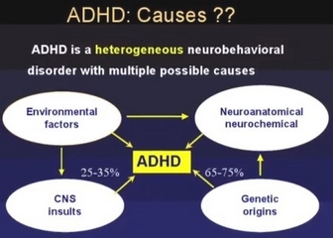

Slide 15
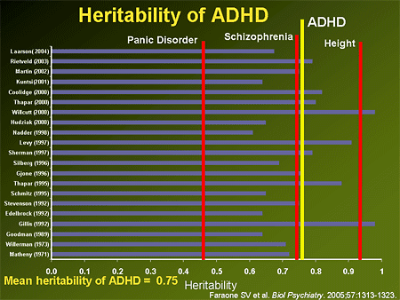
Genetic Factors
High concordance in twin studies
Sibling’s risk of having ADHD 2-5x greater than gen population

Slide 16

Other Causes…
Prenatal/perinatal factors
  Maternal smoking and alcohol use, perinatal stress, low birth weight
Neurochemical Factors
  Pesticides, lead

Slide 17
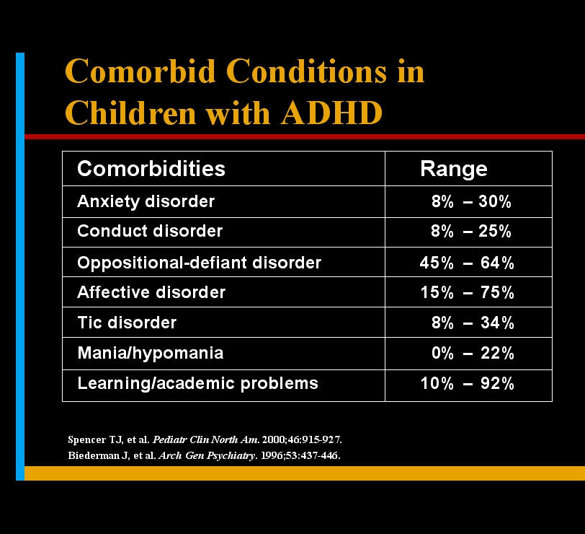
Comorbidities
2/3 of children with ADHD present with ≥ 1 comorbid

Slide 18
Will they always have it ?
Will they always need treatment?

Slide 19
Clinical Course
Rule of “thirds”
  1/3 ➔ complete resolution
  1/3 ➔ continued inattention, some impulsivity
  1/3 ➔ early ODD/CD, poor academic achievement, substance abuse, antisocial adults

Slide 20
More likely to persist:
Increased severity of childhood ADHD symptoms,
Comorbid conduct disorder
Comorbid major depressive disorder
Parent mental health problems
Kay et al, 2016

Slide 21
Not associated with more likely persistence of ADHD symptoms
Child IQ
socioeconomic status
parental education
parent-child relationship

Slide 22
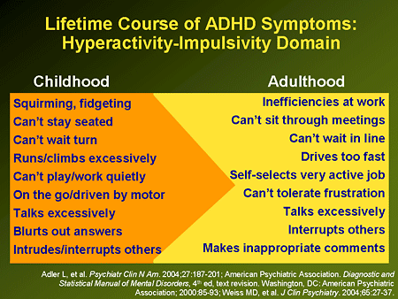

Slide 23
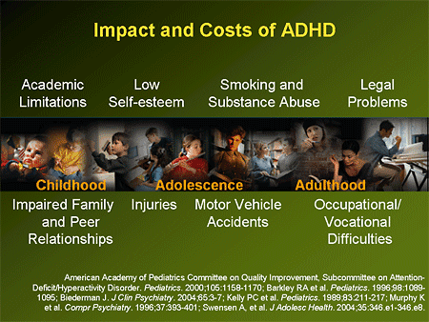

Slide 24
How do you diagnosis it?

Slide 25

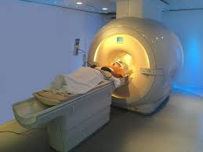
Establishing a Diagnosis
There is no single test to identify ADHD
No “Brain Scan”
Available “psychological tests” are primarily Continuous Performance Tests (CPTs)
Diagnosis must be multi-factorial

Slide 26
Establishing a Diagnosis
  Diagnostic Assessment of Primary Complaint
  Clinical Assessment/ Interview
  Review of Psychiatric Systems
  Medical, Psychiatric, & Developmental History
  Detailed Educational History
  Detailed Family & Social History
  Timeline of Symptoms

Slide 27
Collateral information:
  Patient, Primary Caregivers (parents, grandparents, etc.)
  Teachers, School Counselors, Sunday School Teachers
  Coaches, Music Teachers
Symptoms in ≥ 1 setting:
  Never diagnose ADHD in a 1:1 interview
  Individuals with ADHD can often function well in certain settings with no signs of symptoms when they are interested and maintain total focus (e.g., playing Nintendo, watching videos, etc.)
  Symptoms in group settings are a must!
Establishing a Diagnosis

Slide 28
Establishing a Diagnosis
Use rating scales
  Vanderbilt (parents & teachers, initial and follow-up)
  Do not do a treatment trial
  Risk of adverse effects is significant
  Not necessarily “diagnostic” even if effective

Slide 29
Differential Diagnosis
ADHD
Differential Diagnosis:
Age appropriate high-activity temperamental constellation
Anxiety/Trauma
Mood disorders
Learning disorders
Speech and Language Disorders
Intellectual Disability
Autism Spectrum Disorder

Slide 30

How do you treat it?
Do you have to use meds?

Slide 31


How Do You Treat?
Medication
Behavioral Therapy
  Cognitive/Behavioral Therapy
  Parent Management Training
  Social Skills Training
Educational Support
  504
  Individual Educational Plan (IEP)

Slide 32
Meds: Stimulants are 1st
One of most effective treatments in psychiatry
-70-80% efficacy on core symptoms
-Generally well-tolerated
Non-stimulants are 2nd line
-stimulant augmentation
-comorbid conditions
-Alpha 2 Agonists (tenex, Intuniv, Clonidine)
Dopamine Norepinephrine Reuptake Inhibitor (Wellbutrin)
Norepinephrine Reuptake Inhibitor (Strattera)

Slide 33
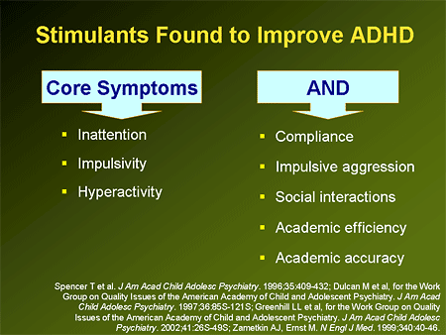

Slide 34
What is a stimulant?
Why would you give a hyperactive kid a stimulant?

Slide 35
Medication Choice: Stimulants
Two classes
Amphetamines Methylphenidates
Short-Acting & Long-Acting Short-Acting & Long-Acting
*Multiple studies have failed to show a difference in efficacy or side effect profiles between the classes

Slide 36
Stimulants:
Dosage & Administration
Forced Dosage Titration
  start at low dose and titrate to effect or side effect
  E.g., for a 100+ pound child: Concerta: 18 mg/d week #1; 36 mg/d week #2; and 54 mg/d week #3
  E.g., for a 50 pound child: Adderall XR: 5 mg/d week #1; 10 mg/d week #2; and 15 mg/d week #3
  Weight based dosing (not generally utilized)
  Dosing averages: 30 mg/d MPH, 20 mg/d AD

Slide 37
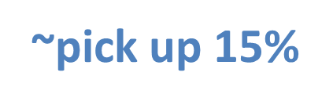
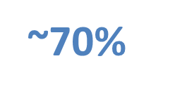
Medication Choice: Stimulants
Start MPH (low dose)
Titrate to efficacy/side effect
Switch to other Class
Titrate
Consider Non-stim or referral
Start Amph (low dose)
Titrate to efficacy/side effect

Slide 38
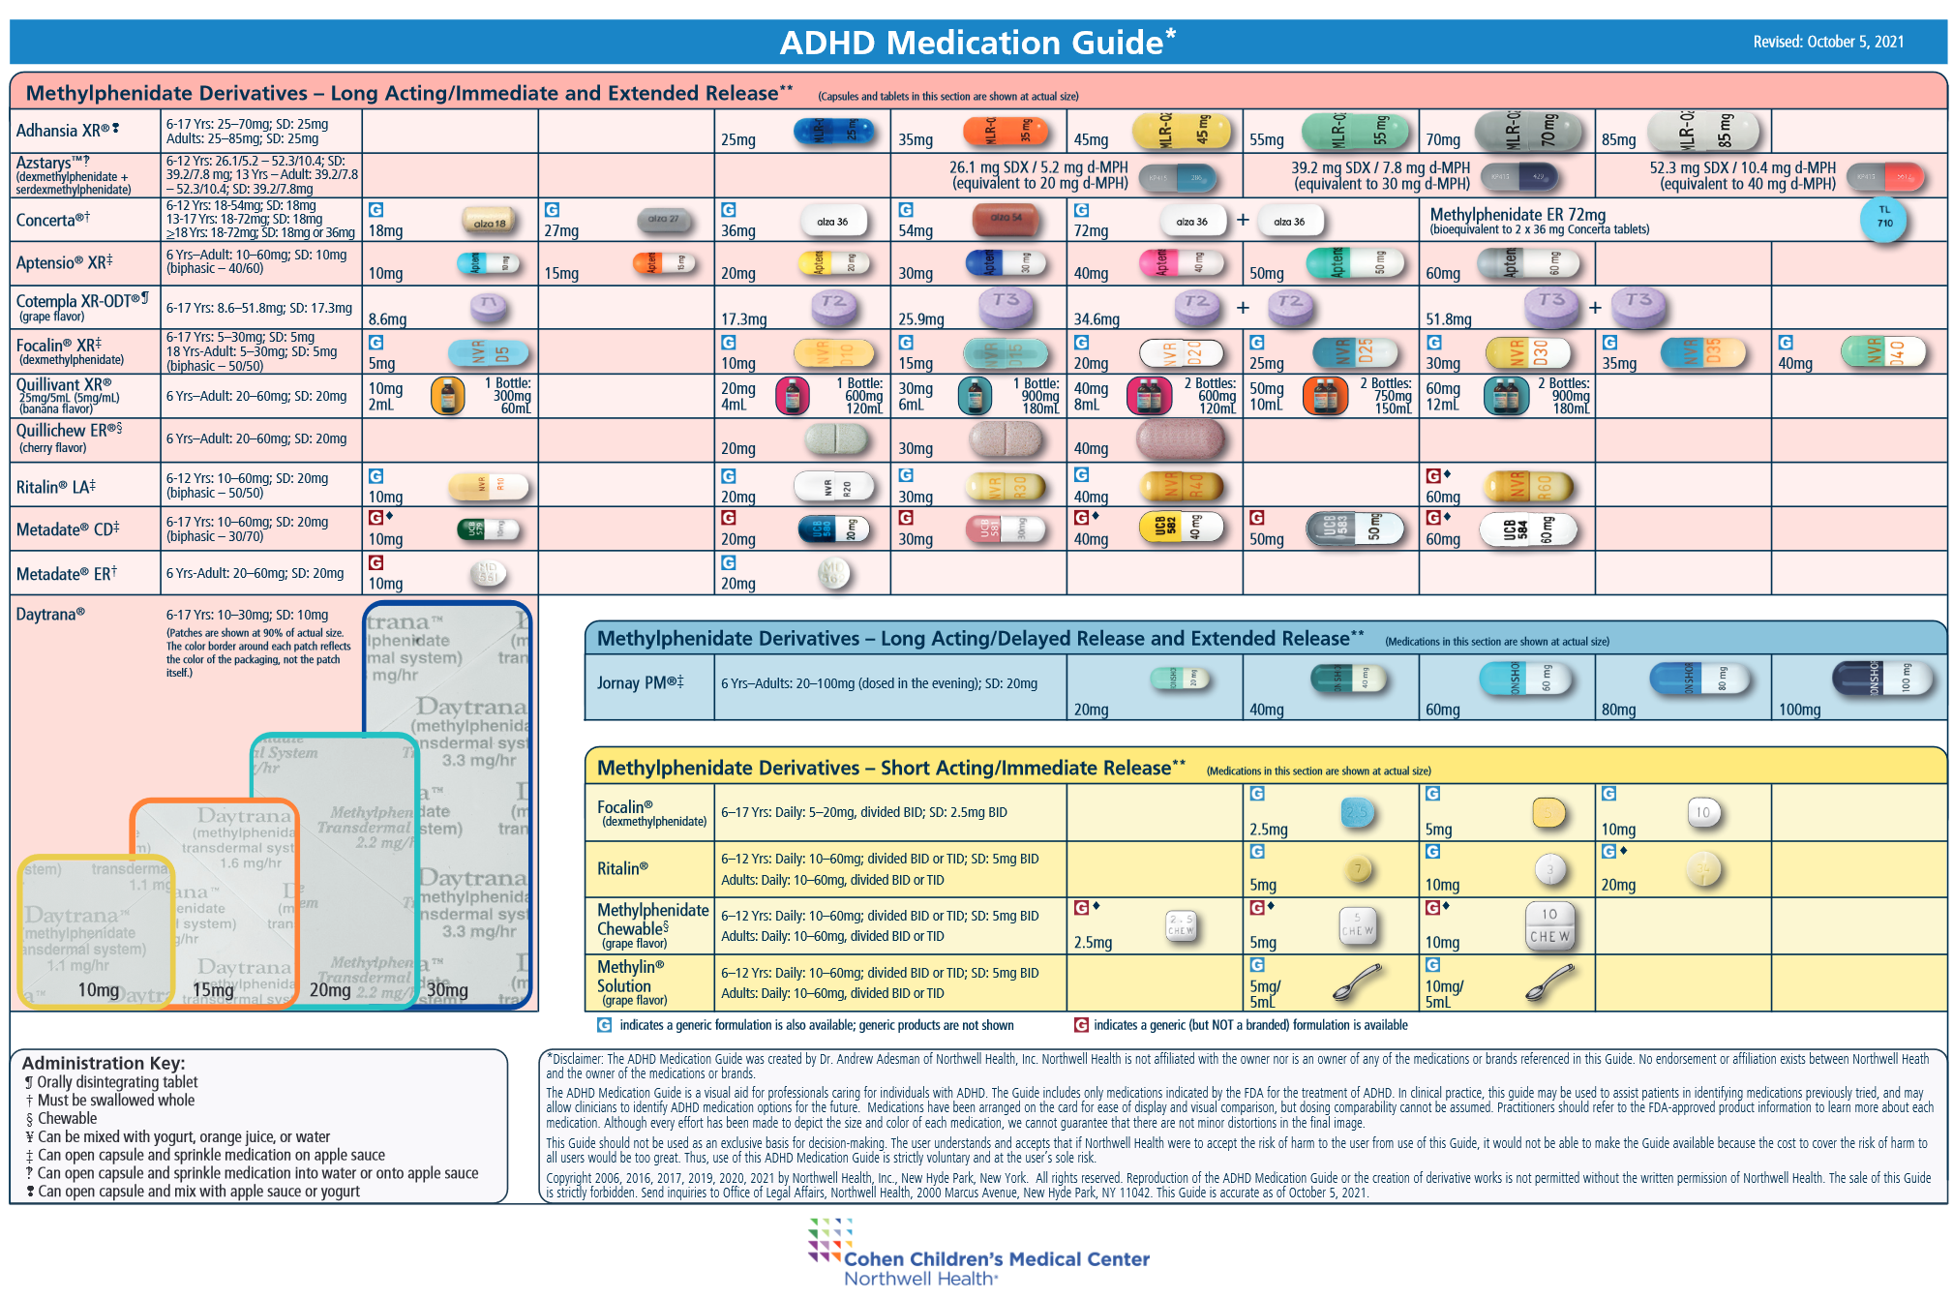

Slide 39
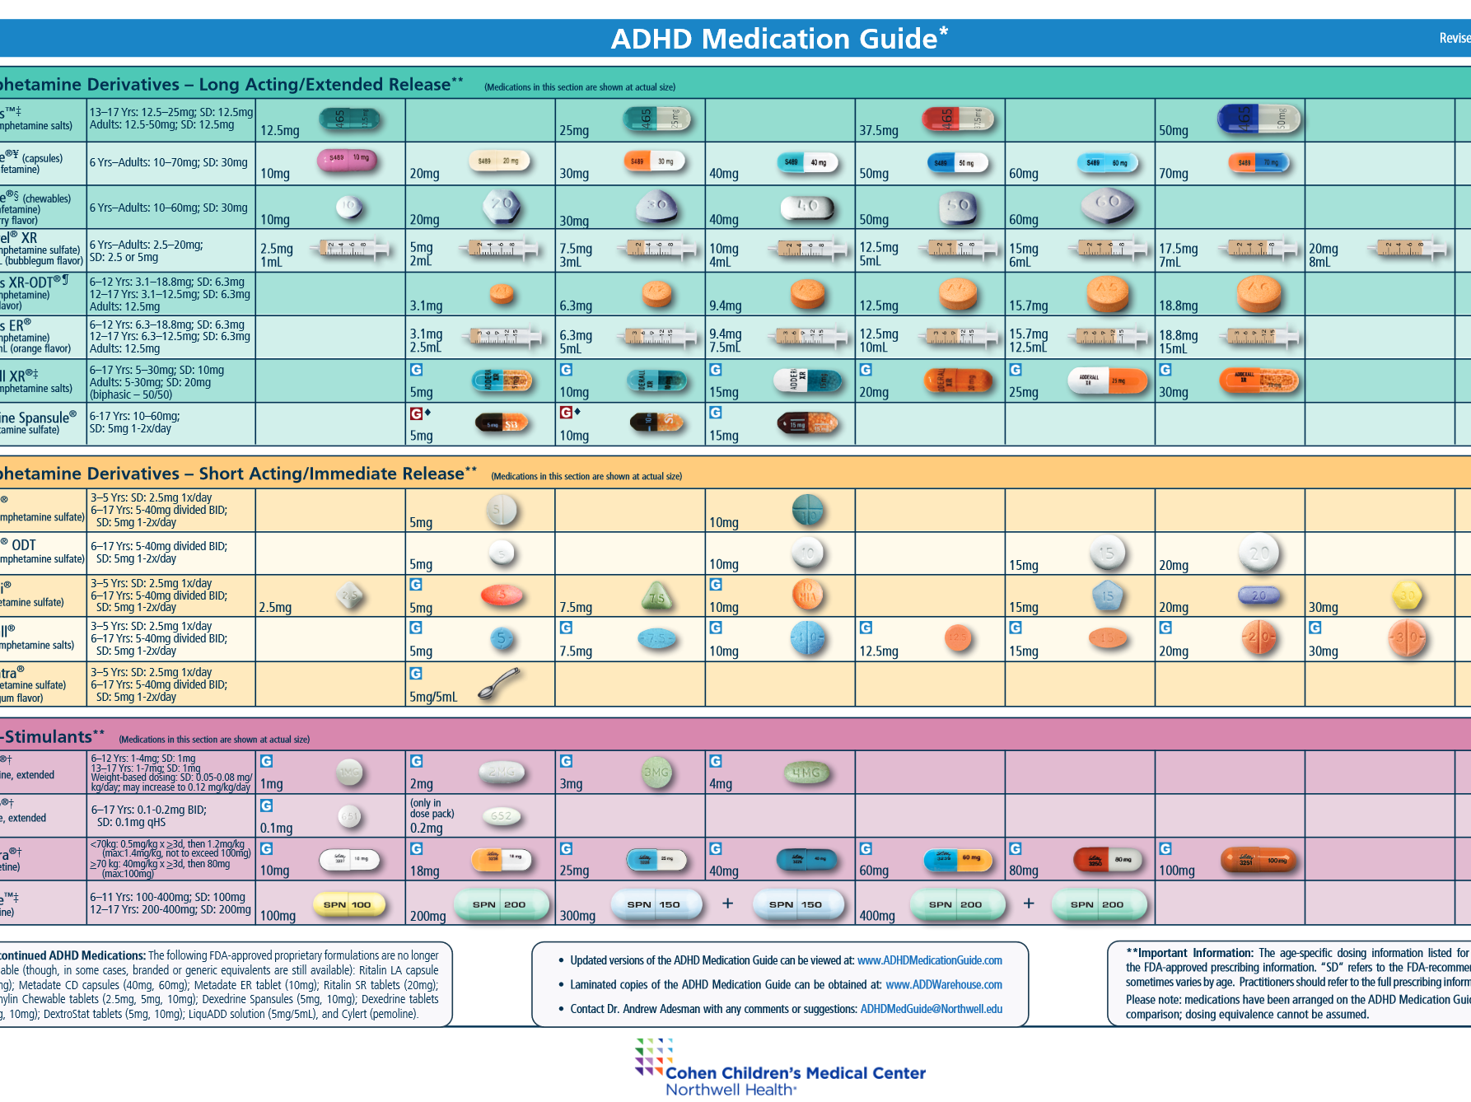

Slide 40
Ritalin LA
Concerta
Metadate CD
Focalin XR
Adderall XR
biphasic delivery of MPH using immediate and delayed release beads
in capsule:
50% immediate
50% delayed
delivers MPH using immediate release coating and delayed release
osmotic mechanism:
22% immediate
78% delayed
biphasic delivery of MPH using immediate and delayed release beads
in capsule:
30% immediate
70% delayed
biphasic delivery of dextro MPH using immediate and delayed release beads
in capsule
50% immediate
50% delayed
(only the d-version of MPH is active, thus only 1/2 the usual MPH dose is used)
delivers mixed salts using immediate and time-released beads:
50% immediate
50% delayed

Slide 41
Match the formulation with the needs of the patient and family
When do they “need” it ? (e.g., early in AM for school only, or including homework, peer activities, week-ends)
Swallow pills?
School?
Adherence?
Parent / Patient sometimes have preferences for one or another, and so do HMOs
Train parents to observe efficacy and side effects through the day and into the evening

Slide 42
Before Starting a Stimulant

Slide 43
Stimulants: Standard Care
Routine Treatment with Stimulants
Prior to treatment:
Height, weight, Blood Pressure & Heart Rate
  Don’t start is BP >95th percentile (clearance from primary/peds cardiology)
  Don’t start if BMI is <5th percentile (clearance from primary)
Cardiac Exam
  Don’t start if you hear murmur (clearance from peds cardiology)
Family history of sudden cardiac death
  clearance from peds cardiology
Personal history of syncope, chest pain, shortness of breath, or exercise intolerance
  clearance from peds cardiology

Slide 44
Side Effects

Slide 45
Side Effects
Appetite →
Abdominal pain →
Headache →
Growth →
Tics →
Irritability →
eat before dosing, breakfast w/ protein & carbs
disappears in few days-wks
disappears in few wks
Study showed a difference of 0.1 inch in children on vs off stimulants over 1 y; Possibly reversible with drug holidays if needed
mostly due to comorbidity, may have less tics with stimulants
change family/class of med ; use another dose in pm
“4th meal” at bedtime
try long acting medication;
give with food
try long acting
use 7 days/wk
0.5% chance of a persistent problem; try lower dose
check family hx and screen prior to starting
if “shut down” lower dose
Insomnia →
Check dose and lower
Consider shorter acting or earlier timing
Sleep hygiene or melatonin

Slide 46
Stimulants: Standard Care
Routine Treatment with Stimulants
During Treatment
At least annual height & weight (compare to published norms)
if height for age decreases by > 1 standard deviation while on stimulants, refer to a pediatric endocrinologist (re: possible growth hormone deficiency or hypothyroidism)
Repeat blood pressure and heart rate at least twice annually and anytime prior and subsequent to a dosage increase

Slide 47
Common errors in dosing psychostimulants
Failure to increase dosing to maximum if no side effects
(MTA study showed lower dosing in community sample)
Beginning with a dose that is too high
  “Start low and go especially slow” with patients who are developmentally delayed
Not assessing the duration of action; (may need to “bunch up “ dosing with IR formulations)
Failure to use another psychostimulant if the first or second trial fails
Failure to use input from school

Slide 48

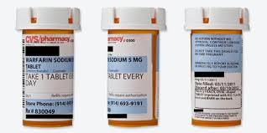
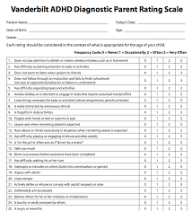
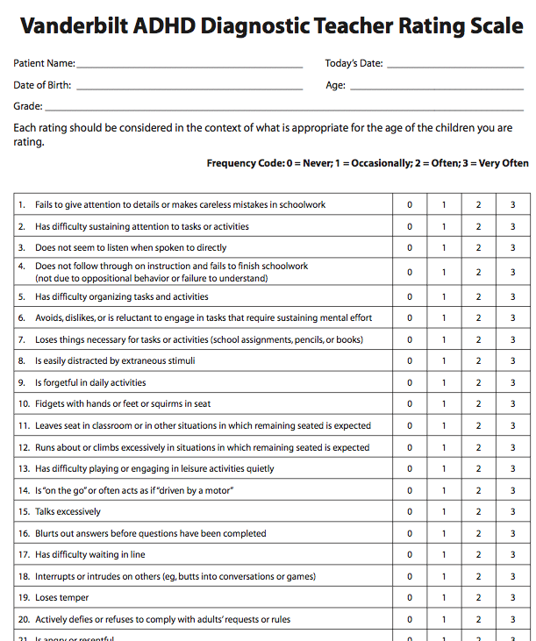
Prepare for ADHD visit
Waiting
Parents complete Vanderbilts when waiting
Write
Teacher Vanderbilts ready: Write your name and fax on top on form so that teacher faxes back to you.
Have
Have Maryland school form ready if patient needs medication at during school hours
*this can also be used to increase adherence in the morning
Write
Write “Dispense 2 labeled bottles”

Slide 49
Cases

Slide 50

Deonte’s Case
Deonte is 10yo w/ ADHD-C diagnosed at age 8. Parents attempted behavioral interventions such as positive rewards for good behavior and structured limit setting with minimal improvement in symptoms. He is struggling in school- earning Cs and Ds, coach notes he is aggressive during basketball practice.
Current meds: Singulair 10mg qam and albuterol MDI PRN asthma
Normal vitals, BMI, and negative cardiac screen

Slide 51
Deonte’s Case
1. Which is an appropriate starting dose?
Concerta 54mg po qam
Focalin XR 5mg po BID
Adderall XR 10mg po qam
Vyvanse 20 mg BID with meals

Slide 52
Deonte’s Case
2. His parents ask “when will this start working?” What counseling do you provide regarding how long to allow for assessing a given stimulant dose prior to increasing it?
  1 week
  2 weeks
  2 to 4 weeks
  6 weeks

Slide 53
Deonte’s Case
3. Deonte has been taking Adderall XR 30mg po qam for 4 weeks and his attention is better w/ improved behavior in school, he earned a “B” on the last test. However, at basketball practice he is still impulsive, can’t wait his turn, and has problems finishing homework. What do you do next?
  Increase Adderall XR to 40mg po qam
  Add short-acting Adderall 5mg po q3pm
  Switch to Strattera 10mg po BID and titrate to response
  Switch to short-acting Adderall 20mg po BID

Slide 54
Jordie Case
5. Jordie is a 7yo with ADHD-C. Concerta 36mg is effective for his symptoms for 2 months, but he has become more tearful and sadder. How should this be managed?
  Do nothing…side effects wear off
  Verify mood symptoms are medication side effect and not change in his baseline state.
  Once convinced it is a side effect try an amphetamine stimulant
  B and C

Slide 55

Ashli Case
6. Ashli is 5y 4mo girl with history of intrauterine EOTH exposure, early neglect, and numerous foster homes who presents with DSS worker requesting evaluation for ADHD because “she is too hyperactive, and another foster parent just gave her up.” Worker requests ADHD evaluation and medication “today.” What do you do?
A. Start a stimulant right away
B. Provide Vanderbilts for DSS worker and school
C. Wait until you receive and score Vanderbilts, if she meets criteria start Methyphenidate 5mg po qam
D. Do nothing until she has therapy

